Slide 1
Utah Division of Water Rights
The Application of Quantity Impairment
Water Law & Policy – March 2018
Teresa Wilhelmsen, P.E.
Assistant State Engineer – Applications and Records
June 21, 2004

Slide 2
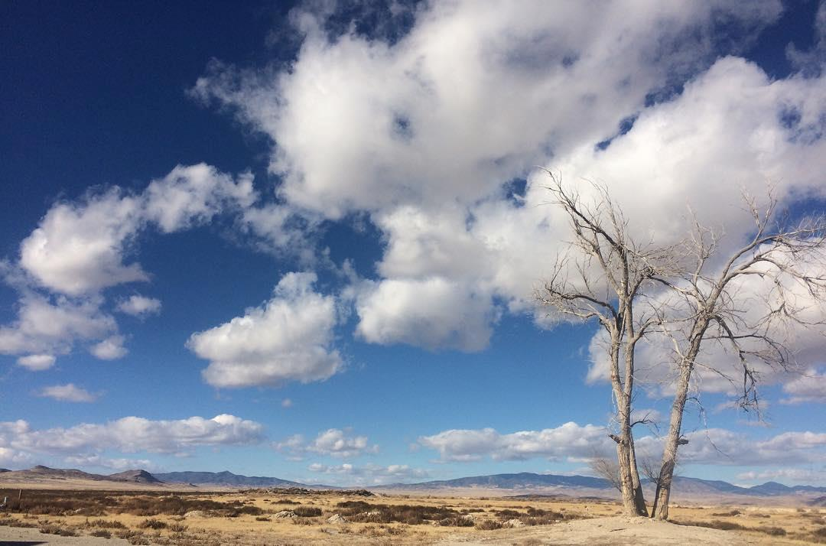
Quantity impairment

Slide 3
STATUTORY CRITERIA:
Modified Utah Code Sections:
73-3-3
73-3-8
Effective May 12, 2015

Slide 4
STATUTORY CRITERIA:
Utah Code §73-3-3(1)(c)(i)
Quantity Impairment: means any reduction in water a person is able to receive to satisfy an existing right that would result from the proposed change, including:
(A) diminishing the quantity of water
(B) change in the timing of availability of water
(C) enlarging the quantity of water depleted by the proposed nature of use as compared to the approved use

Slide 5
STATUTORY CRITERIA:
Utah Code §73-3-3(1)(c)(ii)
Quantity Impairment: does NOT mean a decrease in
the static level of water in an underground basin or
aquifer that would result from the proposed change,
if the volume of water necessary to satisfy an existing
right otherwise remains reasonably available.

Slide 6
STATUTORY CRITERIA:
Utah Code §73-3-3(5)
The applicant has the burden of producing evidence sufficient to support a reasonable belief
(a) That the change will not cause a specific right to experience quantity impairment, or
(b) Rebutting the presumption of quantity impairment described in Subsection 73-3-8(6)(c).

Slide 7
STATUTORY CRITERIA:
Applicant’s burden
Produce evidence
Reasonable belief
Quantity
Impairment
Rebuttable presumption of quantity impairment

Slide 8
STATUTORY CRITERIA:
Utah Code §73-3-8(6)(a)
The State Engineer shall reject a permanent change application if the person proposing to make the change is unable to meet the burden described in Subsection 73-3-3(5).
(The applicant has the burden of producing evidence…rebutting the presumption of quantity impairment)

Slide 9
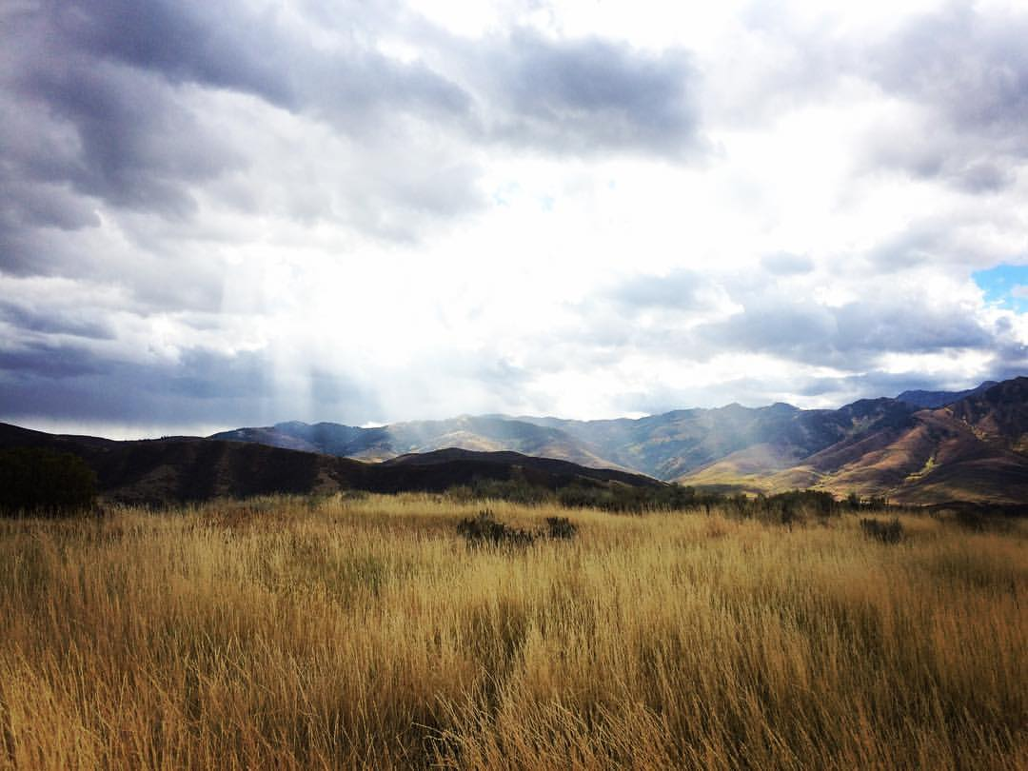
REBUTTABLE PRESUMPTION OF Quantity impairment

Slide 10
STATUTORY CRITERIA:
Utah Code §73-3-8(6)(c)(i)
There is a rebuttable presumption of quantity impairment…
For a period of at least seven consecutive years, a portion of the right has not been:
Diverted from the approved point of diversion; and
Beneficially used at the approved place of use

Slide 11
STATUTORY CRITERIA:
Utah Code §73-3-8(6)(c)(ii)
Rebuttable presumption of quantity impairment if the beneficial use is excused…
73-1-4(2)(e);
73-1-4(2)(b);
73-3-30(7); or
73-1-4(2)(c)(i).

Slide 12
STATUTORY CRITERIA:
Utah Code §73-3-8(6)(d)
The State Engineer may not consider quantity impairment unless…
Raised in a timely protest that identifies which of the protestant’s existing rights will reasonably experience quantity impairment
Written notice by the State Engineer within 90 days from the filing of the change application

Slide 13
STATUTORY CRITERIA:
Utah Code §73-3-8(6)(e)
Written notice in (6)(d)(ii) shall…
Specifically identify an existing right the State Engineer believes will reasonably experience quantity impairment; and
Be mailed to the owner shown on the State Engineer’s records for the identified right if the owner has not protested the change application

Slide 14
STATUTORY CRITERIA:
Utah Code §73-3-8(6)(f)
The State Engineer is not required to include all rights that may be impaired by the proposed change…

Slide 15
STATUTORY CRITERIA:
Utah Code §73-3-8(6)(g)
The owner of a right who received written notice may not become a party unless the owner files a timely protest.

Slide 16
STATUTORY CRITERIA:
Utah Code §73-3-8(6)(h)
If the change applicant, all protestants, and all persons identified by the State Engineer come to a written agreement of how the issue of quantity impairment shall be mitigated…
The State Engineer may incorporate the terms into a change application approval.

Slide 17
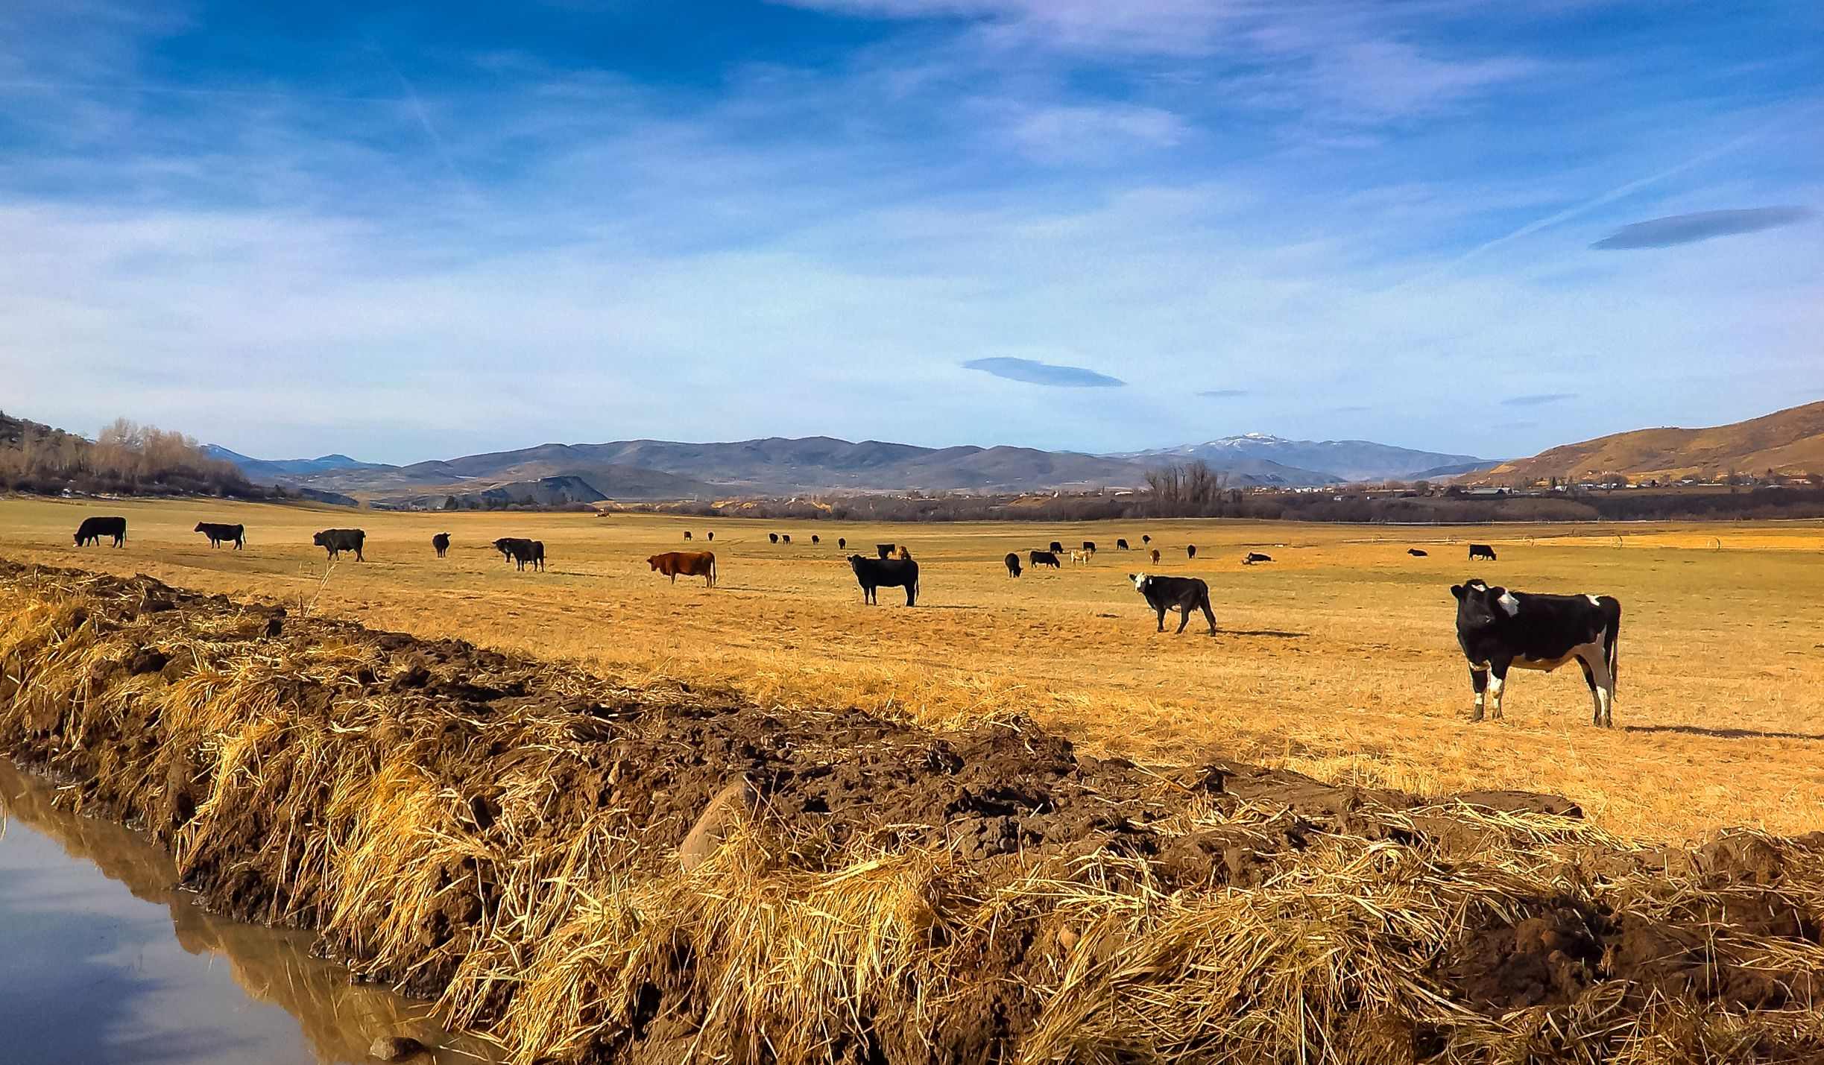
ADMINISTRATIVE STEPS
APPROVAL CRITERIA

Slide 18
ADMINISTRATIVE NOTICE:
New Filings List
All new change applications are preliminarily reviewed for issues of quantity impairment under 73-3-8(6)(c)…
If identified:
Letter is sent (applicant and owner of right identified)
Field report / Memo to the file

Slide 19
ADMINISTRATIVE NOTICE:
Protestant raises the issue of quantity impairment
The protestant should comply with statute and include sufficient information for the applicant to know what they need to rebut.
If after our review of the protest we believe the protestant may be raising quantity impairment, we will send a letter to inform the applicant the issue may have been raised and what they should expect.

Slide 20
ADMINISTRATIVE NOTICE:
A hearing may be held.
A notice of the scheduled hearing will be sent to the applicant that will include instructions regarding the issue of quantity impairment.

Slide 21
ADMINISTRATIVE NOTICE:
At the hearing...what to expect.
Identified as an issue of rebuttable presumption of quantity impairment.
Raised by the State Engineer, a report will be given by the Regional Engineer on the findings.
Raised by the Protestant(s), those parties will be asked to report on their position.
The applicant has opportunity to rebut the presumption of quantity impairment.
The record may be left open if additional time is needed.
The intent to inform the applicant to enable them to be fully prepared to participate.

Slide 22
STATUTORILY EXCUSED

Slide 23
STATUTORY CRITERIA:
Utah Code Ann. §73-1-4(2)(e)
Reversion to the public by abandonment or forfeiture for nonuse within seven years does not apply…
Lease or other agreement vii. Public water supplier
Conservation fallowing program viii. Supplemental water right
Source fails to yield sufficient water ix. Approved change pursued
Unavailable due to priority
Storage under recharge and recovery act
Substantially all used

Slide 24
STATUTORY CRITERIA:
Utah Code Ann. §73-1-4(2)(b)
An approved nonuse application under Section 73-1-4(2)(b) …
An appropriator or the appropriator’s successor in interest may file an application for nonuse with the State Engineer.

Slide 25
STATUTORY CRITERIA:
Utah Code Ann. §73-3-30(7)
Change application for an instream flow…
Water used in accordance with this section is considered to be beneficially used, as required by Section 73-3-1.

Slide 26
STATUTORY CRITERIA:
Utah Code Ann. §73-1-4(2)(c)(i)
The passage of time…
Within 15 years from the end of the latest period of nonuse of at least seven years; or
Within the combined time of above-described 15 years and the time subject to nonuse applications.

Slide 27
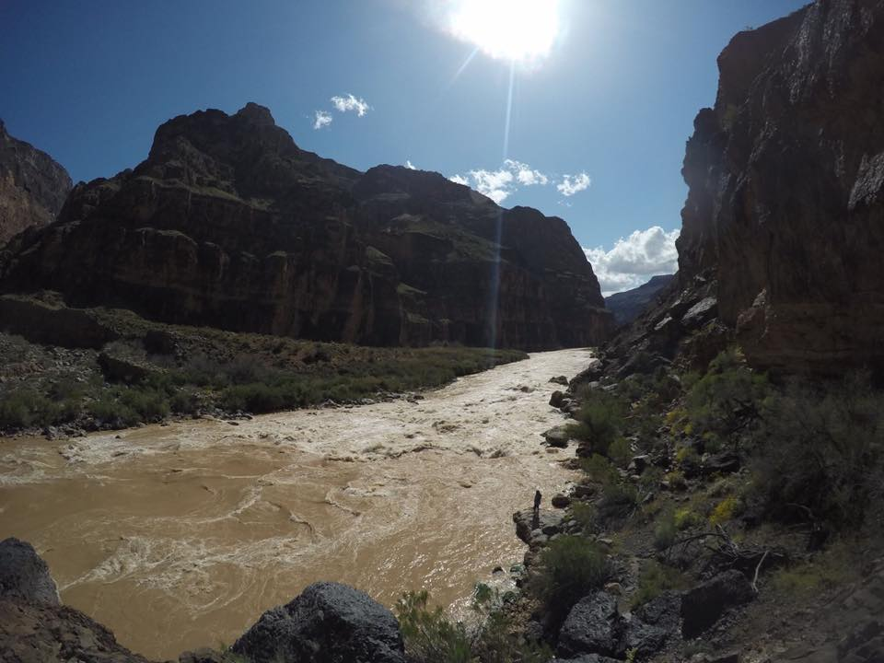
CASE STUDIES

Slide 28
DISCLAIMER:
The stories you are about to hear may seem real/fake and/or be based on fictitious characters/situations and facts. The names and facts have been changed and twisted to protect the innocent. Embellishment of the stories may, or may not occur, most likely will occur.

Slide 29
CASE STUDY 1:
Protestant –
Protestant raised questions if the right has not been used for a period of 7 years
My water right ##-### will be impaired

Slide 30
CASE STUDY 2:
Protestant –
Based on Google images dated 2003 through 2012 no use has occurred at the approved place of use
My water right ##-### will be impaired

Slide 31
CASE STUDY 3:
Change application filed
During 90-days after filing, SE conducts field review because aerial images show prior authorized use has not occurred at the authorized place of use for the last 20 years
Field review cannot verify the authorized diversion of water
SE sends letter with field report to raise a presumption of quantity impairment

Slide 32
CASE STUDY 4:
Change application filed to replace an approved change application that the applicant allowed to lapse 10-years ago
Historical authorized use and diversion of water ceased over 40 years ago
SE letter sent with field report
Hearing held

Slide 33
CASE STUDY 5:
Change application filed to add an additional point of diversion to a prior approved change application for project
The applicant demonstrated diligence in pursing the project in the last extension of time on the first change – proof not due for another four years
Protestant questioned nonuse of the water
Hearing held

Slide 34
CASE STUDY 6:
Change application filed
During 90-days after filing, SE conducts field review because aerial images show nothing occurring at the authorized place of use for the last 10 years, or more
Field review cannot verify the authorized diversion of water
SE sends letter with field report to raise a presumption of quantity impairment
Applicant responds – “They have a lease!”

Slide 35
CASE STUDY 7:
Change application filed
Water right in the name of Sunfiled City
ROC filed in 2016 with deed to city dated 1995
Protestant questions nonuse

Slide 36
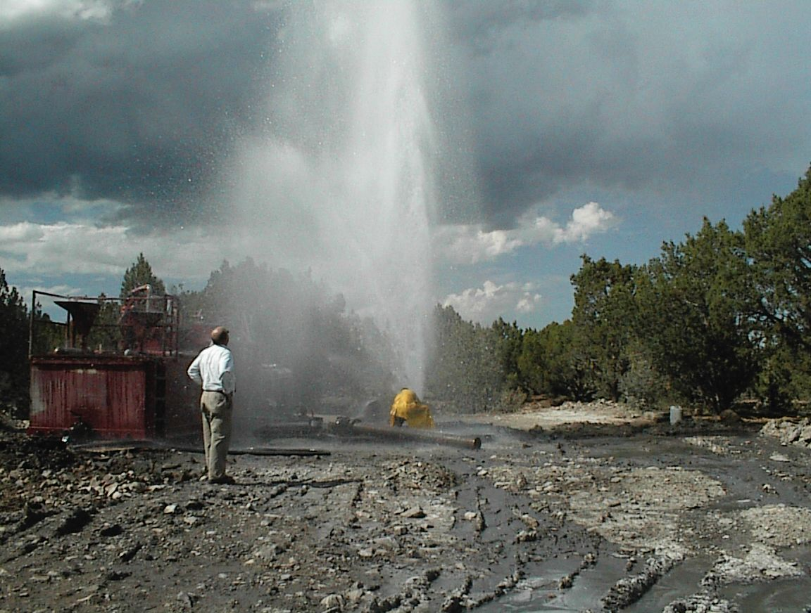
Thank You
– Any Questions?

