Slide 1
Update on Reserve Water Right Settlements in Utah
Norman K. Johnson
The 2018 Utah Water Users Workshop
March 20, 2018
St. George, Utah

Slide 2
J. Golden Kimball
Let’s not get “Out of Order!”

Slide 3
We Live in a Desert

Slide 4
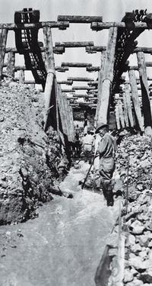
Western Water Law — Origin and History
In the arid West areas of water use were often located far from sources of supply
Miners and irrigators built diversions
and moved water to areas of need
The “first in time/first in right”
mining principles carried over to
water rights
The doctrine of “prior appropriation” of water was born (mid to late 1800s)

Slide 5
Western Water Law — Origin and History
Appropriative water rights are given a priority based on their date of creation
In times of shortage, earlier priority rights are filled first to the limit of the right
No sharing of shortages means some uses will be met and commerce sustained
The intent was to maximize public benefit
Continued beneficial use required

Slide 6
Western Water Law — Origin and History
Appropriative water rights are constitutionally protected property rights
Their basis is the beneficial use of water
They are defined by quantity, time, and nature of use
Priority date is when beneficial use began or when an application was filed to use them
They can be lost by non-use

Slide 7
Western Water Law — Origin and History
The federal government supported growth and development of this water law
1866 Mining Act and 1877 Desert Land Act required state law created water rights
The U.S. Supreme Court said these acts severed the land and water estates and directed that water rights be obtained under the laws of the territories and states

Slide 8
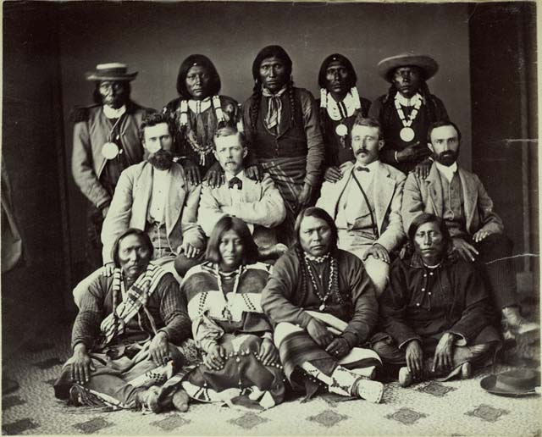
Reserved Rights Doctrine —Origin and History
At the same time the appropriation doctrine was developing with federal approval, federal reservations of land were being made in the West
Congress and the President set aside public lands
for particular purposes, such as National Parks and Indian reservations,
reservations, but did not
create accompanying
water rights

Slide 9
Reserved Rights Doctrine —Origin and History
In 1906 the U. S. sued on behalf of the Ft. Belknap Reservation Indians to secure water rights for them on the Milk River
Defendant farmers/ranchers protested, saying they had valid water rights created under Montana law
The suit created a genuine dilemma

Slide 10
Reserved Rights Doctrine —Origin and History
In 1908 the Supreme Court issued its Winters decision
It said Congress, when it established the reservation, impliedly intended to reserve water for the Indians
The “reserved rights” doctrine was born as an equitable, judicial response to a real and difficult controversy

Slide 11
Reserved Rights Doctrine —Origin and History
In Arizona v. California (1963) the U. S. Supreme Court said the reserved rights doctrine applies to federal reservations other than Indian reservations
For Indian Reservations it said the number of practicably irrigable acres on the reservation (PIA) is used to quantify the right

Slide 12
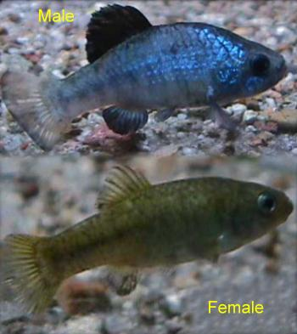
Reserved Rights Doctrine —Origin and History
Subsequent case law further defined the reserved rights doctrine
Cappaert v. U.S. (1976) – the
amount of water reserved is the
minimum amount necessary to
fulfill reservation purposes
U.S. v. New Mexico (1978) –
primary purposes only get
reserved water rights

Slide 13
Reserved Rights Doctrine —Origin and History
Recently, in Agua Caliente Band of Cahuilla Indians v. Coachella Valley Water Dist., et al., the Ninth Circuit Court of Appeals held that in the water-short Coachella Valley the United States reserved appurtenant groundwater when it created the Tribe’s reservation – the U.S. Supreme Court denied cert. petition
This ruling will have minimal impact on Utah’s efforts to negotiate settlements

Slide 14
Reserved Rights vs. Appropriative Water Rights
Reserved water rights are important sovereign and property interests
Their basis is the creation of reservations
The purpose of the reservation defines their quantity (PIA for Indian reservations)
Priority date is creation of the reservation
They are not lost by non-use

Slide 15
Reserved Rights vs. Appropriative Water Rights
In addition to having characteristics that conflict with appropriative water rights, the more pressing problem is that reserved water rights are un-quantified when created
Given their early priority dates, they compete with and can displace State-created water rights

Slide 16
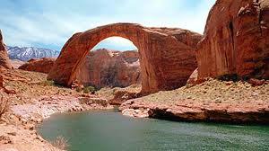
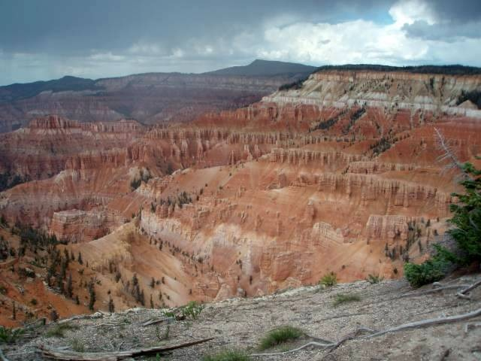
Reserved Water Rights vs. Appropriative Water Rights
Utah, an arid state, has many federal reservations — federal lands set aside for specific purposes like Indian reservations, national parks and monuments, military bases, etc.
How should these rights be quantified?

Slide 17
Reserved Water Rights vs. Appropriative Water Rights
Utah has negotiated reserved rights settlements for:
Cedar Breaks, Hovenweep, Promontory Point, Rainbow Bridge, Timpanogos Cave, and Natural Bridges National Monuments
Zion, Arches, Bryce Canyon National Parks
Uintah Ouray Indian Reservation and Shivwits Band Reservation

Slide 18
Reserved Water Rights vs. Appropriative Water Rights
Utah is working on settlements for:
Dinosaur National Monument
Capitol Reef and Canyonlands National Parks
Navajo Nation Reservation
Utah Legislature ratified the 1990 Ute Indian Water Compact
Settlement implementation matters remain particularly in the Uintah Basin

Slide 19
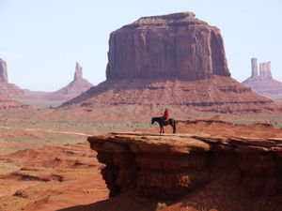
Utah/Navajo Reserved Water Right Negotiations
Navajo has substantial Winters rights
Navajo’s water rights must come from Utah’s share of the Colorado River
Utah and Navajo have worked together to resolve reserved water right issues for more than a decade
A bill has been introduced in Congress

Slide 20
POTENTIAL LIABILITY
PIA = abt. 160,000 AF of Water Depletion
Expensive, Unpredict-
able Litigation
Non-Indian Priority Conflicts
SETTLEMENT PROPOSAL
NAVAJO NATION
81,500 AF of Water Depletion
About $200+ Million in Projects
Emphasis on Drinking Water Projects
Subordination to Existing Rights in local areas
State Share = $8M ($2M set aside)

Slide 21
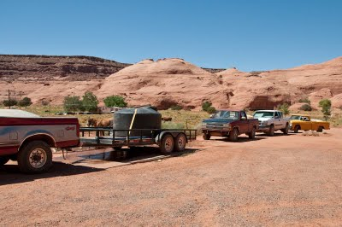
Benefits of a Navajo-Utah Settlement Agreement
Quantify a Significant Reserved Water Right
Improve Quality of Life for Utah Navajo People
Avoid Costly Litigation and Uncertain Outcomes
Provide Certainty for Water Users
Navajo Nation
San Juan County
CUP/Wasatch Front
Price River, Carbon, Emery &
Grand Counties & Uintah Basin
Lake Powell Pipeline
Solve a Colorado River Issue

Slide 22
Utah’s Colorado River Depletion BUDGET
UTAH'S Allocation | 1.369 MAF
Existing Use | 1.008 MAF
UNUSED ALLOCATION | .361 MAF
Future Use
Ute Tribe Reserved Water | 105 KAF
Navajo Nation Reserved Water | 81 KAF
New Ag Uses | 40 KAF
New M&I Uses | 29 KAF
Lake Powell Pipeline | 86 KAF
Total | 341 KAF
Balance | 20 KAF

Slide 23
General Adjudication Considerations
In Utah, general water right adjudications are pending in most of the State
These adjudications, typically done in sub-basin drainages, are comprehensive and qualify for the McCarran Amendment sovereign immunity waiver
They proceed slowly, both because they are complicated and because of resource considerations

Slide 24
General Adjudication Considerations
Once a reserved right agreement is finalized, the State Engineer will present it to the Adjudication Court in the area as a Proposed Determination (PD)
The PD is the State Engineer’s recommendation concerning the water rights for the reservation
The PD is circulated to all parties
Parties have the opportunity to object

Slide 25
General Adjudication Considerations
To minimize controversy, we educate parties before they receive the PD
Objections must be dealt with
Once all objections are resolved, the adjudication court enters an interlocutory decree
The Interlocutory Decree will eventually be incorporated into a basin-wide decree

Slide 26
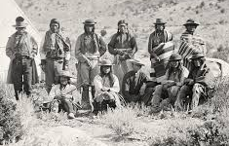
Settlement of Reserved Water Rights
We have learned State negotiators must:
Protect all federal/non-federal/tribal interests;
Realize that settlements must work for all;
Communicate and educate;
Focus on what matters;
Use technicians;
Build trust;
Be patient;
Put things in context; and
Acknowledge finality.

Slide 27
QUESTIONS?
~ The End ~

