Slide 1
Utah Division of Water Rights
Water Law & Policy CLE
Enforcement-A Kinder, Gentler Approach
Kurt Vest, P.E.
Enforcement Engineer
June 21, 2004

Slide 2
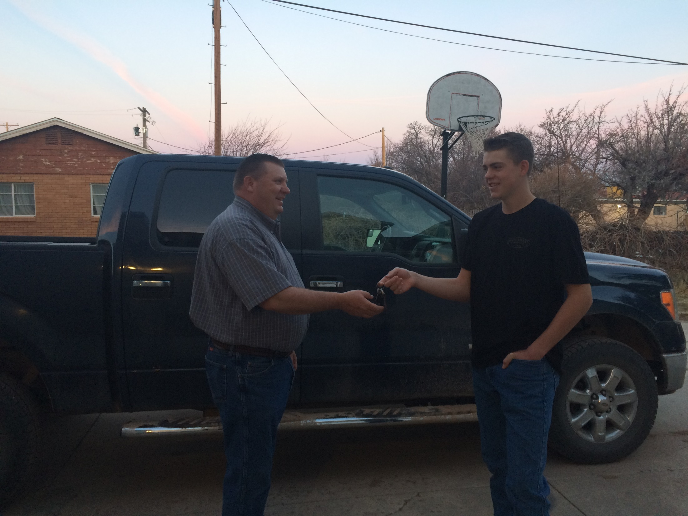

Slide 3
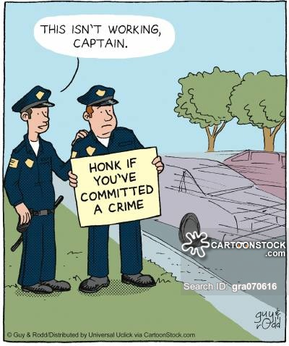

Slide 4
History and Background
Prior to 2005:
State Engineer had no direct enforcement authority
Persistent violations were addressed by:
Criminal complaints when allowed by statute
Civil litigation in pursuit of a court order
Lacking civil litigation by injured parties, violators suffered no penalties

Slide 6
The 2005 Statutes
Section 73-2-25: State Engineer enforcement powers
Section 73-2-26: Administrative penalties
Section 73-2-27: Criminal penalties
Section 73-2-28: Cost and fees in civil actions
The 2005 Administrative Rules
Rule R655-14: Administrative Procedures for Enforcement Proceedings Before the Division of Water Rights

Slide 7
§ 73-2-25: Powers
When is an “enforcement action” authorized?
Taking water without right or in violation of an existing right
Failure to comply with statutes, orders or notices regarding headgates, measuring devices, etc.
Notes:
Slide 8 – When is an “enforcement action” authorized?
Taking water without a right
Violating an existing right means to exceed or violate any of the limiting characteristics of a water right - POD, POU, Period of Use, Nature of Use, Flow Rate, etc.
Failure to comply with a requirement to install or repair headgates and measuring devices.

Slide 8
§ 73-2-25: Powers
Failure to comply with an order or notice regarding dam safety or natural stream channel alteration
Notes:
Slide 9 – continued
Orders and notices regarding stream alteration or dam safety

Slide 9
§ 73-2-25: Powers
When is an enforcement action not authorized:
One year or more has passed since violation
Civil disputes between or among water users
Internal disputes in water or irrigation companies
Right-of-way, easement or trespass disputes
Notes:
Slide 10 – When is an “enforcement action” not authorized?
12 month statute of limitations
The State Engineer can only enforce based upon the water rights of record in the office of the Division of Water Rights – therefore he has no authority, responsibility or information to enforce in situations involving private water related agreements between water users or internal disputes within water or irrigation companies.
Right-of-way or trespass violations are not water right violations even though it may involve a water related structure such as a canal.

Slide 10
To commence enforcement action SE issues an initial order, which includes:
A description of the violation;
Notice of any penalties to which person may be subject; and
Notice that SE may treat each day’s violation as a separate violation.

Slide 11
Final Order; the SE may order that person:
Pay an administrative fine not to exceed:
(A) $5,000 for each knowing violation; or
(B) $1,000 for each violation that is not knowing;
Replace up to 200% of water taken; and
Be liable for any expenses incurred by the SE or Division in investigating and stopping the violation.
Each day of a continuing violation is a separate violation.
A penalty may not be imposed for a violation occurring more than 12 months before a NOV issued.

Slide 12
Before imposing a fine or ordering replacement the SE shall consider:
The value or quantity of water unlawfully taken;
The gravity of the violation, including the economic injury or impact to others;
Whether the person subject to fine attempted to comply with the SE’s orders; and
The violator’s economic benefit from the violation.
R655-14. Administrative Procedures for Enforcement (25 pages single spaced)

Slide 13
Enforcement Data
Period | Enforcement referrals received | Enforcement actions commenced
2005-2015 (Kerry) | 350 | 50
2015-present | 92 | 1

Slide 14
Informal Resolution
Upon receipt of a referral:
The referral is screened for enforcement eligibility under the statute
Alleged violations are investigated by the Enforcement Engineer to independently establish facts by:
Consultation with Region Office
Review of water right records, aerials, etc.
Field investigation

Slide 15
Informal Resolution
If unable to verify or witness said violation:
The Region Office gives advice and consent
A “Notice of Alleged Violation” is issued to the alleged violator to:
Detail the potential problem;
Advise that the problem may result in enforcement action, including fines and other penalties.
The alleged violator is “invited” to:
Contact Enforcement Engineer to discuss case, and/or;
Work with Region Office to remedy situation.

Slide 16
Informal Resolution
If alleged violation is witnessed and verified:
The Region Office gives advice and consent.
A “Notice of Pending Investigation” (NPI) is issued to the alleged violator to:
Detail the problem observed;
Advise that the problem may result in enforcement action, including fines and other penalties.
The alleged violator is “invited” to:
Submit corrective or supplemental information;
Submit a plan/schedule of action to terminate the alleged violation.

Slide 17
Informal Resolution
In the NPI, the alleged violator is further advised:
A “reasonable” period of time is allowed for a response;
A decision regarding enforcement will be made after receipt/review of the NPI response;
If no response is received in a reasonable period of time, an enforcement decision will be made on the basis of available information as detailed in the NPI.

Slide 18
Informal Resolution
If the NPI response is persuasive that enforcement is not justified:
The Region Office gives advice and consent;
Informal correspondence is issued to:
Advise of any necessary corrective action;
Give reasonable time frame to remedy the problem;
Remind the violator that failure to correct the problem may result in formal enforcement action.

Slide 19
Goal of Enforcement Program (My instructions)
Resolve all 1st time offenses informally without having to resort to formal enforcement proceedings and/or levy any fines.
If violation is egregious enough can still consider formal enforcement on 1st time offense.
Any 2nd time offenses will result in commencement of an enforcement action.

Slide 20
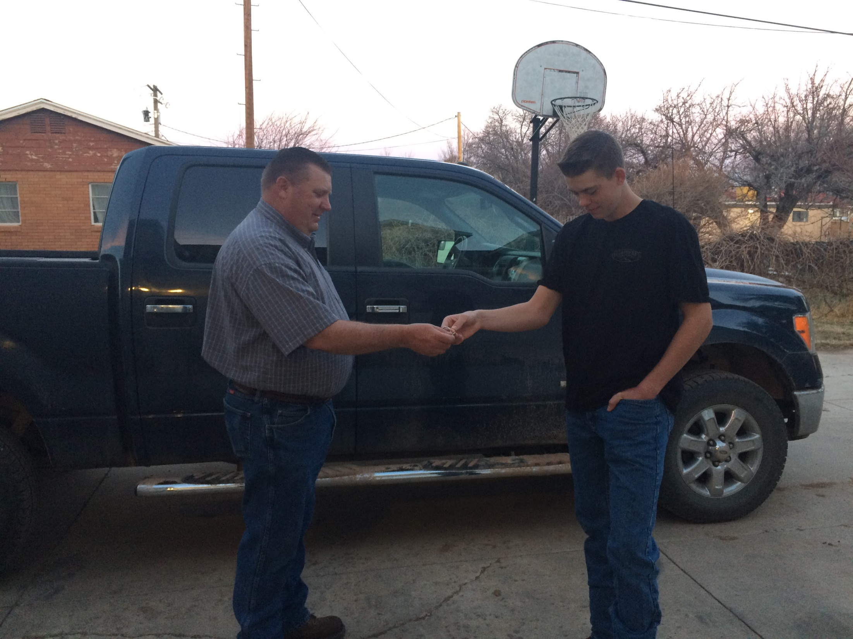

Slide 21
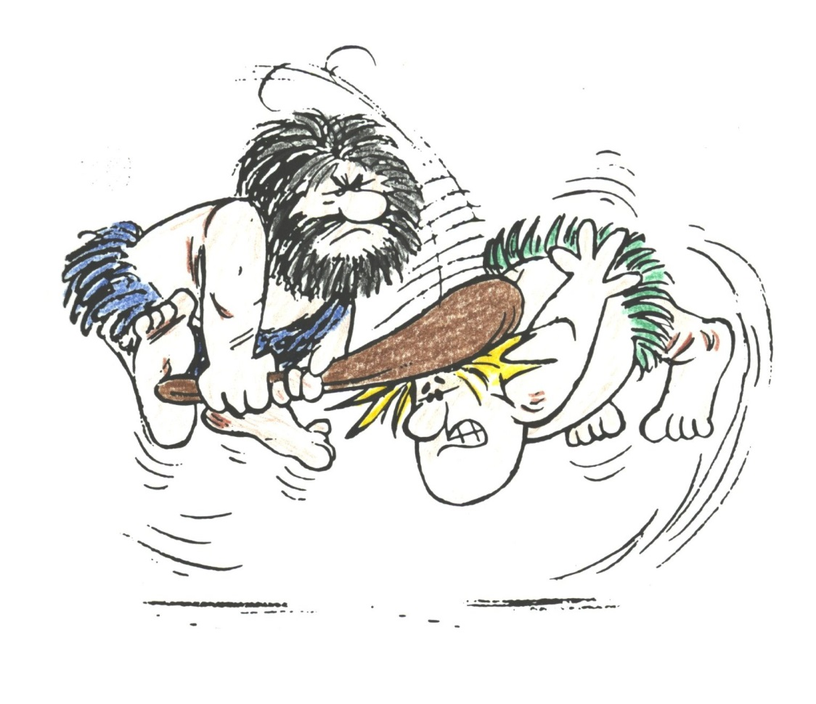

Slide 22
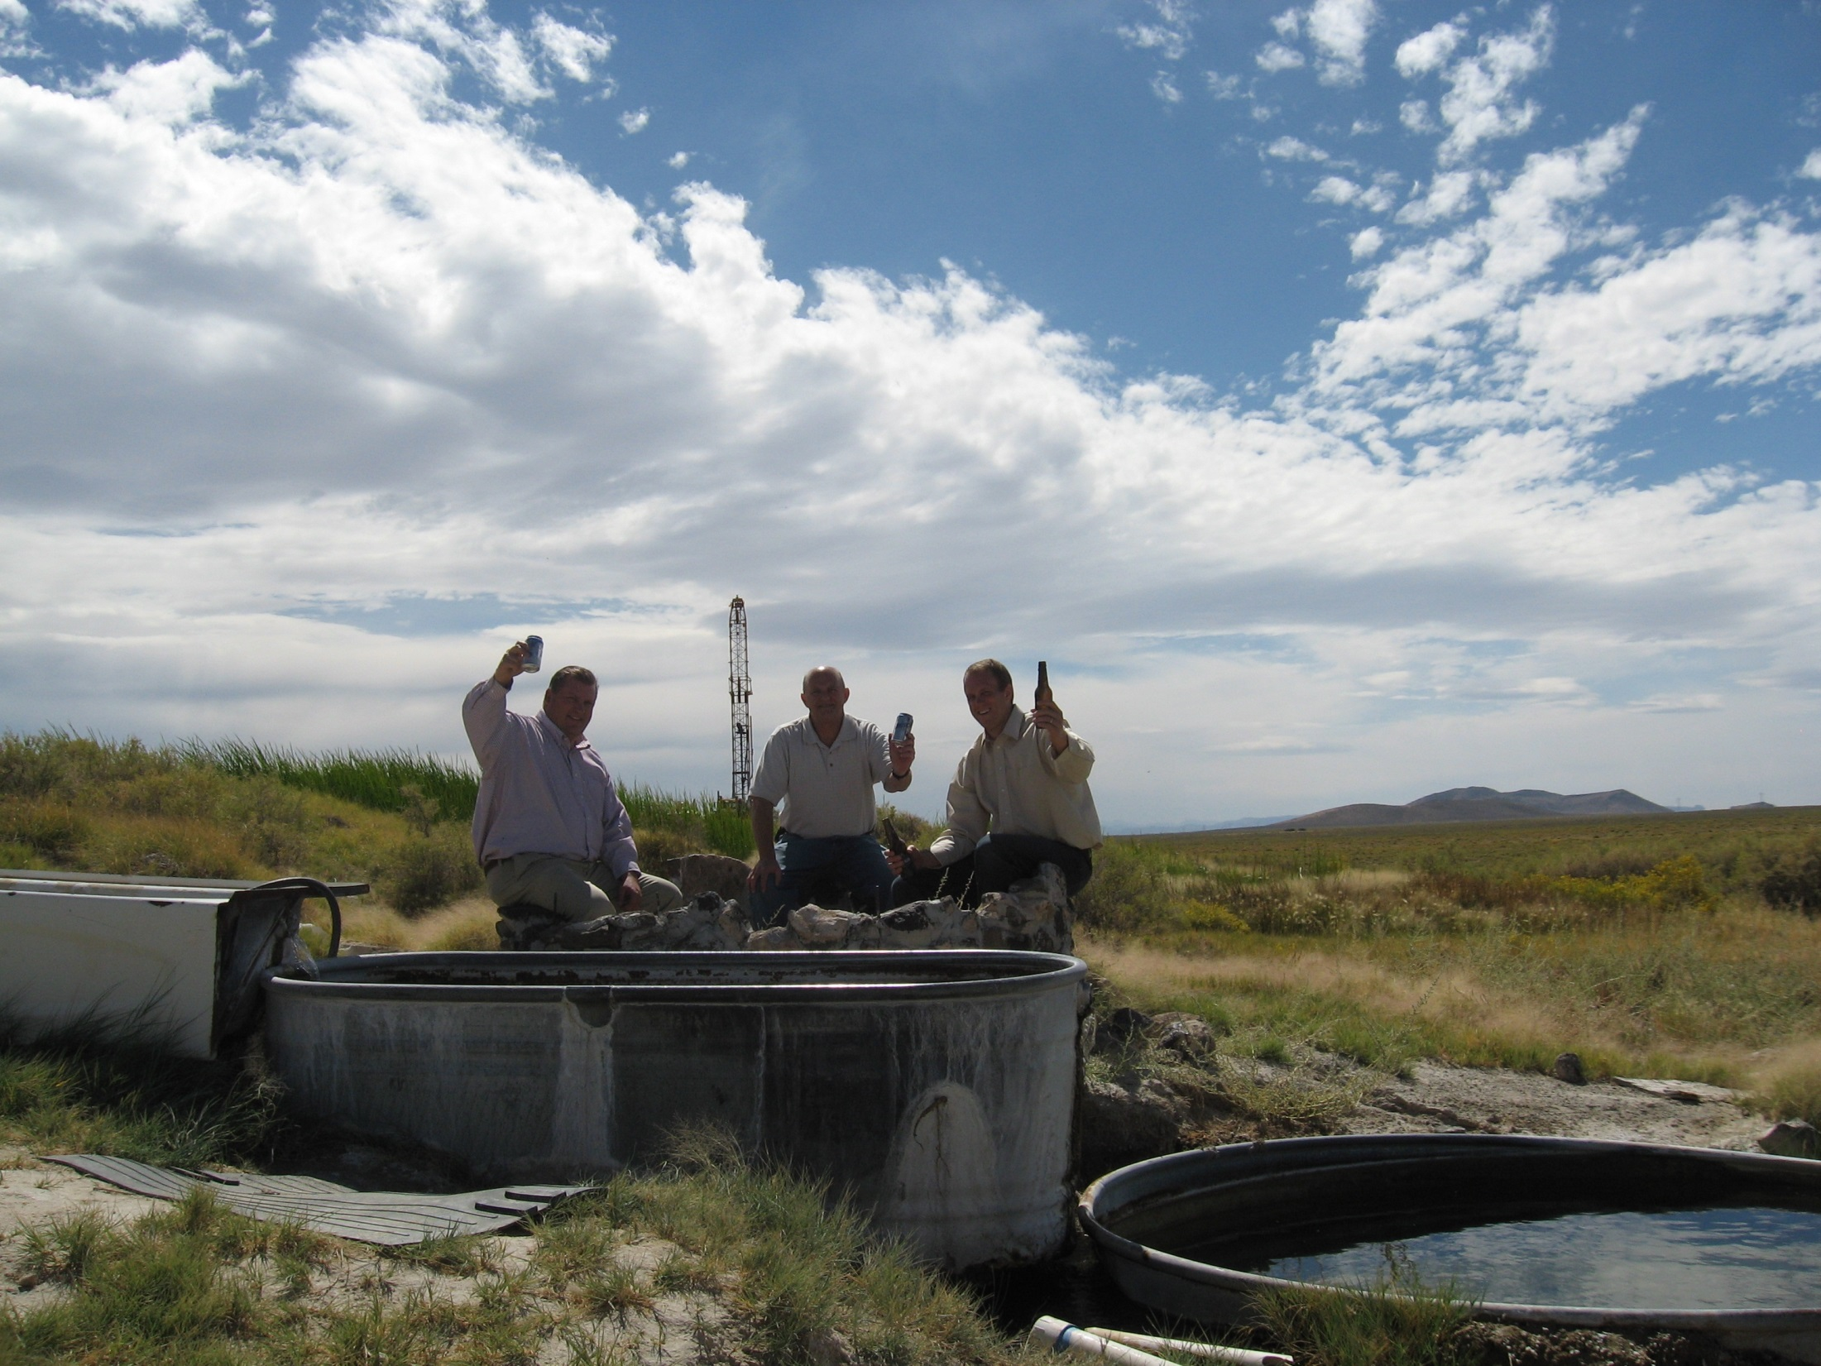
Thank you
Questions?

