Slide 1
Utah Water Users Workshop
Water Right Issues of the State Engineer
Kent L. Jones, P.E.
March 20, 2018 State Engineer
kentljones@utah.gov
Notes:
Governors letter requesting citizens pray for rain …. Friend working on Jordan River Temple rededication pray that the weather will be temperate and that snow and rain won’t interfere with the month plus long open house and activities. So I’m interested to see if anyone gets listened to and how it all works out.

Slide 2
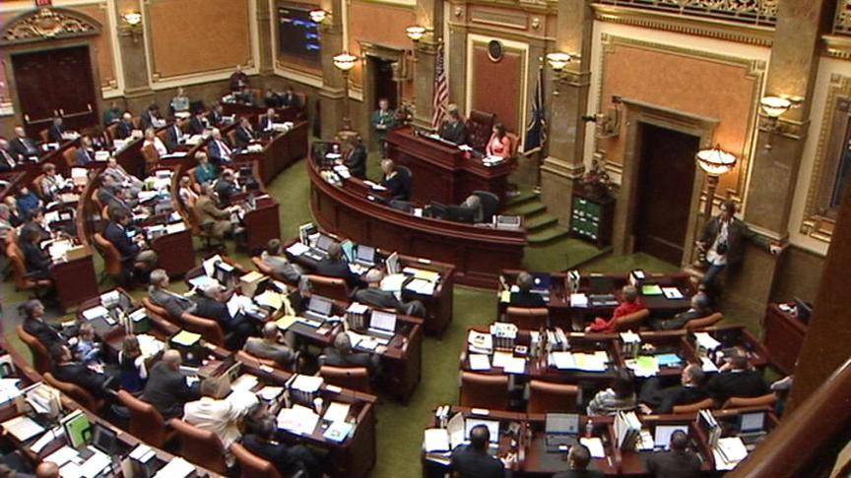
Legislative Bills 2018
(SB 45) Diligence Claim (Dayton) – Passed -
Require report on the beneficial uses
(SB 61) Adjudication Revision (Dayton) – Passed - Addressing addendums
(SB 98) Ute Settlement Compact (Van Tassell) – Passed - 73-21 1980-1990

Slide 3
Legislative Bills 2018
(SB 96) Canal Easements (Hinkins)– Passed -
Altering water conveyance easements
(SB 60) Water Commissioner Amendments (Chew) – Not Passed - Exemptions for commissioners purchasing and vehicle expenses
Notes:
Property Rights Ombudsman can get involved to help resolve disputes.

Slide 4
Legislative Bills 2018
(HB 124) Water Holdings Accountability and Transparency Amendments (Coleman) –
Held - Surplus Water Accounting
(HB 135) Extra Territorial Jurisdiction Amendments (Noel) – Held - Reducing jurisdiction area
(HJR 015) Proposal To Amend Utah Constitution (Stratton) – Held - Surplus Water

Slide 5
Legislative Bills 2018
(SB 35) Water Right For Trout Habitat Repeal Date Extension (Christensen) – Passed - 1 year extension
(HB 73) Instream Flow Water Rights Amendments (Hawkes) – Held - Removes time limit
(HB 450) Wastewater Reuse Amendments (Froerer) – Held – New application and priority date for reuse projects
Notes:
A few others we are watching: SB34 Leg. Water Development Commission Amendments; Water Rights for Trout Habitat repeal SB35 and HB73; HB60 Water Commissioner Amendments; Extraterritorial Jurisdiction (HB 135); Surplus Water Contracts Accounting (HB 124)

Slide 6
Interim Study Items
Surplus Water Accounting and Transparency
Extra Territorial Jurisdiction
Amending Utah Constitution for Surplus Water Considerations
Expanded Instream Flow Use
Water Banking
Part-Season Water Use
Irrigation Efficiencies and Water Use Duties
Notes:
Watch for a committee near you… There should be some interesting discussions going on and ones that could have a significant impact on water right administration.

Slide 7
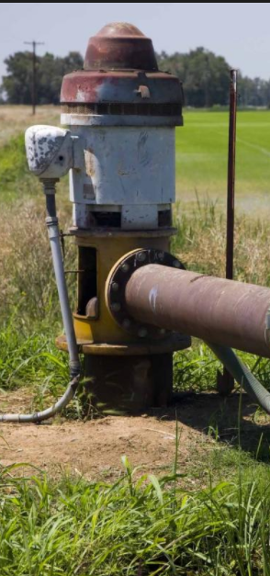
Groundwater Management Plans
Notes:
20 systems with established management plans or management plans 16 completed and administering under the plan, 3 in progress and 1 pending. Most recently we have been getting public involvement in water advisory committees. It has been very helpful for the local citizens to step up and realize that this is not just a State Engineer problem. The State Engineer has a responsibility under statute but, it is a community problem that needs good planning and working together to solve. Malad/Bear River, Cedar Valley, and Moab/Spanish Valley are under consideration now to help work toward finalization of the plans.

Slide 8
Water Use Program
 | Site Visits (total per year) | Systems Reported | Quality of Data Reported
2014 | 10 | 393 | ~% 50
2015 | 80 | 443 | ~ 60%
2016 | 477 | 523 | ~ 90%
Notes:
About 525 systems we are monitoring. Additional funding provided by the legislature. We were able to work with the Division of Water Resources and the Division of Drinking Water to help modify reporting procedures, improve online filings, and visit more systems to help get accurate data reported.
Coordination between DDW and DWRe – Better feedback loop
DDW added points against their system if they don’t report.

Slide 9
Water Use Reporting
New online application in use this year
Prompted checks of numbers
Comparison with previous years displayed
Input of peak use requested
Information helpful for self audit included

Slide 10
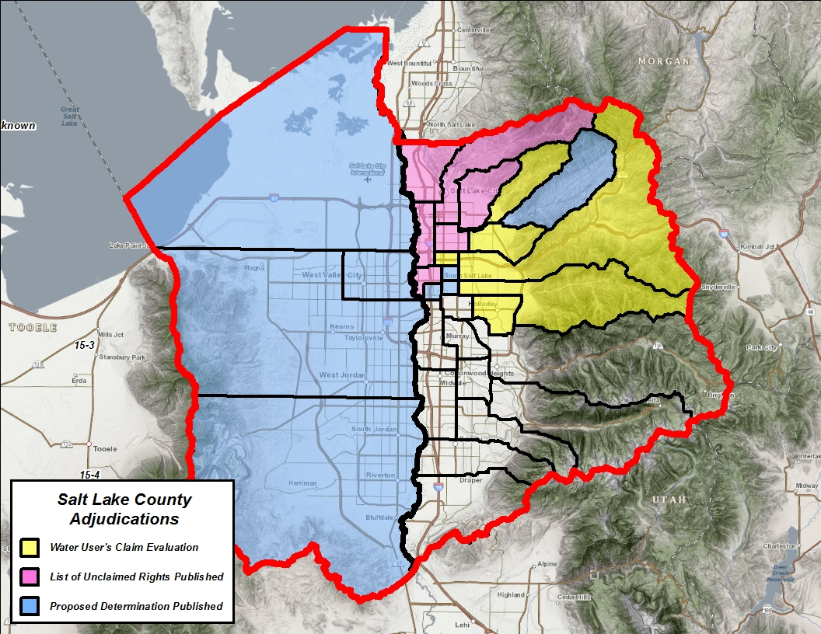
Adjudication Efforts
Revised statute to streamline and modernize the water rights adjudication process.
SB 75 (2016)
SB 61 (Proposed 2018)
Court appointed “Special Master” in the Utah Lake – Jordan River Adjudication to help resolve the backlog of outstanding objections.
Initial backlog of 490 objections
Resolved over 110 within the last 24 months
Focus efforts in areas experiencing greatest development and increase the number of teams to expedite adjudication. Within the last 24 months we’ve…
Initiated 13 adjudications
Mailed over 130,000 notices
Evaluated over 3,500 claims
By Year End:
All of SL Valley Noticed
Notice to 207,000 parties
Future Subdivisions
(Initiated by end of the year)
Notes:
Another area the Governor’s office and the legislature is pushing is to accelerate the adjudication process. SB 61 passed this year to help improve the process and support the efforts of the Division and the Courts. Current major focus is on Salt Lake Valley. Working together to help pull together some pretty complex water right issue that involve all sorts of water agreements, exchanges and undocumented rights.

Slide 11
Other Adjudication Actions
Dedicated phone to answer questions
New online tracking application
Helpful Video released
Meeting with Forest Service to negotiate quantification of reserved right claims
Notes:
Blake Bingham is giving a presentation on our processes, requirements , and progress in a different session and he will be able to give you more information on our adjudication efforts and the Special Master’s progress. This program has been moving along at an impressive rate. I think for the most part people understand and are okay with the process that’s taking place. We’ve only been interviewed by Gephardt twice and been on the news a few times. We have also received some helpful and directional correspondences from a few people to express their excitement. One person writes, “WHAT? The State Engineer has NO right nor any adjudication on my water nor homestead. I’m sick and tired of all you whom are traitors to the constitution and the Bill of Rights!! I will never give up my rights. I own the earth and all the water is mine to use.” Another person helped clarify our responsibility by writing, “You will not coerce, threaten, or bully me into giving up water or anything under my property. I own this property outright. I pay taxes on the property every year. So I figure that what is under my land is mine. I should not have to deal with this crap from the government. I’m DONE! No you can’t have my water! So it seems like … for the most part… people are getting it. We’re looking for a few good people to help us go door to door … in case anyone of you are looking for something to do…

Slide 12
Duty of Water
Wasting water to be avoided
A reasonable amount of water to accomplish the beneficial purpose
Beneficial use shall be the basis, the measure, and the limit of all rights to the use of water in this state 73-1-3 UCA
Notes:
Wasting Water: there was a tendency to claim the entire water source to accomplish one’s beneficial use.
Reasonable Amount: In 1903, under a more regimented appropriation process, the concept of a reasonable amount of water to accomplish the beneficial use was followed. In a 1916 USGS report concerning irrigation in Utah, Wyoming, and Colorado; “The irrigation season is short and large quantities of water are used. In many places 10 to 20 acre-feet of water per acre irrigated is turned onto the land, but only a comparatively small amount of water is actually consumed.”

Slide 13
Irrigation Duty Science
Irrigation duty in Utah means the maximum amount of water necessary to reasonably irrigate a beneficial crop
Duty allows for flexibility in crop type selection

Slide 14
Laws Regulating Use of Water
Duty is not an entitlement of water to which an appropriator may divert regardless of need.
It represents a maximum amount of water the State Engineer considers reasonable to accomplish a particular beneficial use
Beneficial use is defined in terms of acres irrigated, the period of use, and the volume or flow rate which may be diverted for the beneficial use

Slide 15
Laws Regulating Use of Water
Garner v Anderson 67 Utah 553, 248 P.496 (1926)
“The appropriator of water does not acquire title to the corpus of the water but acquires only the right to use the quantity reasonably necessary to mature the crops and for other beneficial purposes. Regardless of the amount of water originally appropriated or historically used, the amount reasonably necessary is the limitation of the quantity appropriated.”
Mt. Olivet Cemetery Ass’n v Salt Lake City 65 Utah 193, P. 1876 (1925)
“The extent of the right of an appropriator is limited to his reasonable necessities. The diversion and use of water creates a legal right only to the quantity necessary for the use.”

Slide 16
Diversion vs Depletion
Diversion is the water removed from the source to be used.
Diverting 4.0 AF of water to irrigate 1.0 acre of land
Depletion is the amount of water that is consumed after application.
After diverting 4.0 AF of water to irrigate 1.0 acre only 2.0 AF of water returns to the natural water system.
When evaluating Change Applications the State Engineer looks at the historical values for both diversion and depletion.
Neither value can be enlarged.
Notes:
4.0 AF (Diversion)
Convert to livestock = ~143 cows
2.0 AF (Depletion)
Converts to livestock = ~71 cows
Water used up by the plants, bound to soil, and lost through evaporation, is water that doesn’t make its way back to the natural water system enabling other water rights to be satisfied.

Slide 17
Use of Duty in Change Applications
A water right change application is an application to the State Engineer to retire an existing use in exchange for a new use of water
The fundamental test to be applied to all change applications is whether implementing the proposed change will interfere with or impair an existing right

Slide 18
Example to Consider
Water Right for the irrigation of 60 acres.
Flow rate: 1cfs from a spring to be changed to a well for the same use.
A: Spring source supplies whole amount of water
Duty limits diversion right to 240 acre-feet (4ac-ft/acre)
Depletion limits right to 120 acre-feet (2ac-ft/acre)
Other criteria reviewed. If it meets requirements, it is approved
Notes:
SB 109S01 and HB 123 are the most critical to our processes. There a lot of tough decisions we have to make concerning water rights and change applications and we need the clarification from the legislature to give us the direction we need. Let me go over some of the decisions we are asked to make.

Slide 19
Example to Consider
Same issue: Water Right for the irrigation of 60 acres.
Flow rate: 1cfs from a spring to be changed to a well for the same use.
B: In this instance, the spring only flows 1 cfs early in the season and always dries up in August.
Duty would have to determine the amount of flow available. Estimated in this example at 50% supply. Therefore the duty would be 120 acre-feet (4 ac-ft/acre X 50%). Depletion would be 60 ac-ft (2ac-ft/ac X50%).
Other criteria must be met but restrictions are imposed because of limited source supply and impairment to the rights of others. There is restricted beneficial use because of the source.

Slide 20
Example to Consider
Same issue: Water Right for the irrigation of 60 acres.
Flow rate: 1cfs from a spring to be changed to a well for the same use.
C: In this instance, spring flows the whole use period at the full rate but it hasn’t been used for 20 years. Other right holders downstream are using the water with their junior rights.
If the change is approved water users may be impaired by the resumed use. Utah Code Sections 73-3-3 and 73-3-8 clarify State Engineer authority to reject an application by requiring a review of Quantity Impairment through the change application process and a Rebuttable Presumption of Quantity Impairment if the water right has not been used for seven years or more.
There are statutory requirements to go through for the applicant, any protestants, and the State Engineer to address nonuse issues in a change application process.
Notes:
If the issue of Quantity Impairment is raised in a change application proceeding because of a nonuse issue, the applicant has the burden of rebutting the presumption of nonuse before the State Engineer to assure that the water is not subject to nonuse or the change application may be rejected.

Slide 21
Domestic duty
Since the early 1980’s, the State Engineer has used domestic duties based on 400 gallons/connection/day which is about 0.45 ac-ft/year.
With continuing conservation efforts, studies have shown that 70 gallons per person per day may be a more reasonable estimate for indoor domestic use in Utah. With an estimated average of 3.6 people per connection that equals about 250 gallons/connection/day or about 0.28 ac-ft/year on average for a full-time, year-round residence. Part-time recreational usage may only require 0.14 ac-ft/connection or less based on those numbers.
Based on the conservation numbers, 0.45 ac-ft would supply the annual inside domestic needs of 5.7 people. While some homes exceed that number, on the average there are less people per connection than 5.7.

Slide 22
Domestic duty
While 0.45 ac-ft/connection is a safe number that will cover a large usage per connection, that amount of water may not be needed to meet the projected needs of the residential users in any particular situation. It is a number we will continue to used if there is no evidence that it should be different.
The State Engineer will consider reduced amounts of water required per connection in applications filed if the projected usage rate numbers are based on scientific evaluations and the water used is measured and reported to the Division of Water Rights through the Water Use Program.

Slide 23
Municipal rights
Since 2010 the Division of Water Rights has extended the “Municipal Use” type of use to “Public Water Suppliers” as defined in 73-1-4(1)(b)UCA
Systems serving 100 connections or 200 year round residents
Municipal water right holders in this category have statutory protections under 73-1-4 and 73-3-12 and the ability to prepare 40-year plans to help preserve their underlying water rights to meet reasonable future needs.
These protections apply to protection from claims of forfeiture and for having extensions of time granted to prove up on their water rights
Notes:
This action expanded the use of qualifying entities to include private water companies regulated by the PSC and community water systems serving at least 100 connections or 200 year round residents which were controlled by the residents they serve.

Slide 24
Municipal Use Rights Extended
Typically “Municipal Rights” have been limited to those entities defined as “Public Water Suppliers” in Section 73-1-4 UCA. Applications filed for municipal rights must have a mechanism for leaving the municipal use designation in control of one of these public water suppliers.
The Utah Division of Drinking Water has a reference in rule to “Public Water Systems.” These systems are either publicly or privately owned and provide water for human consumption or other domestic uses and have at least 15 service connections or serve an average of at least 25 individuals daily at least 60 days out of the year.

Slide 25
Municipal Use Rights Extended
These smaller systems don’t fit the protection criteria in Section 73-1-4 UCA but the option of having “Municipal Use” as a recognized use will now be extended to these smaller public water systems to allow these entities to submit applications to cover the universe of uses under the umbrella of municipal use.
This use will be extended with the conditions that all water use must be metered and the use must be reported to the Division of Water Rights through the Water Use Program.
Submitting proof on all municipal rights will include measurements of the quantity of water diverted over the amount of water rights already certificated and must show that diversion and depletion limitations of the rights have not been exceeded.

Slide 26
Municipal Use Rights Extended
It is important to note that while “Municipal Use” is being extended to these smaller “Public Water Systems”, they do not meet the qualifications given under 73-1-4 and 73-3-12 for “Public Water Suppliers” and do not have the special protections under statute provided to “Public Water Suppliers”.

Slide 27
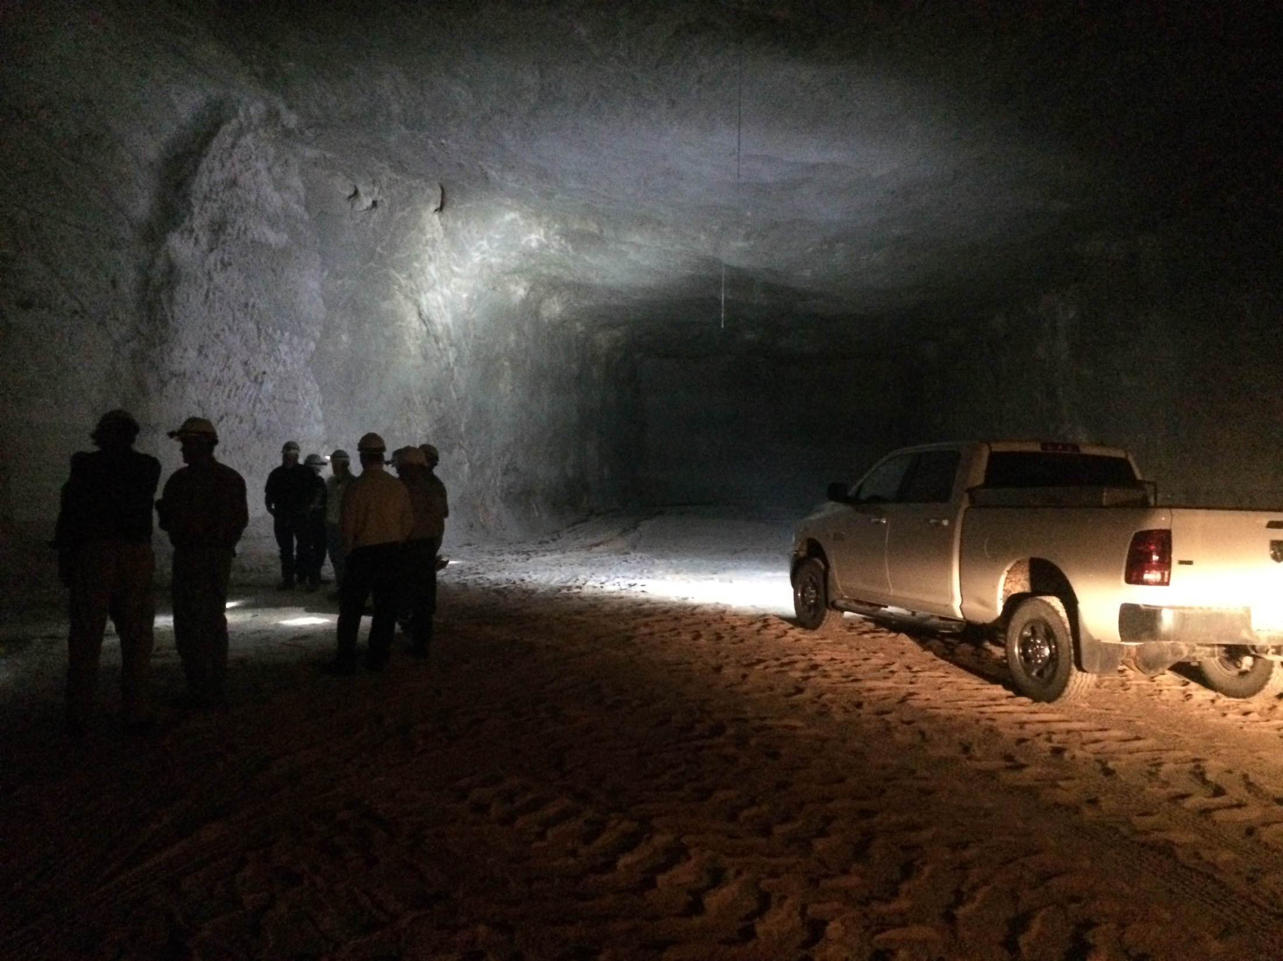
Questions?

