Slide 1
Utah Division of Water Rights
Water Use Groups
Understanding Supplemental Rights and Database Water Use Groups
Teresa Wilhelmsen, P.E.
Assistant State Engineer
June 21, 2004

Slide 2
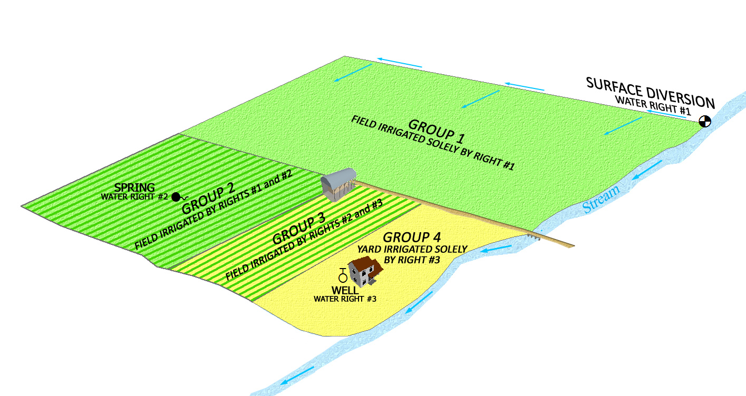

Slide 3
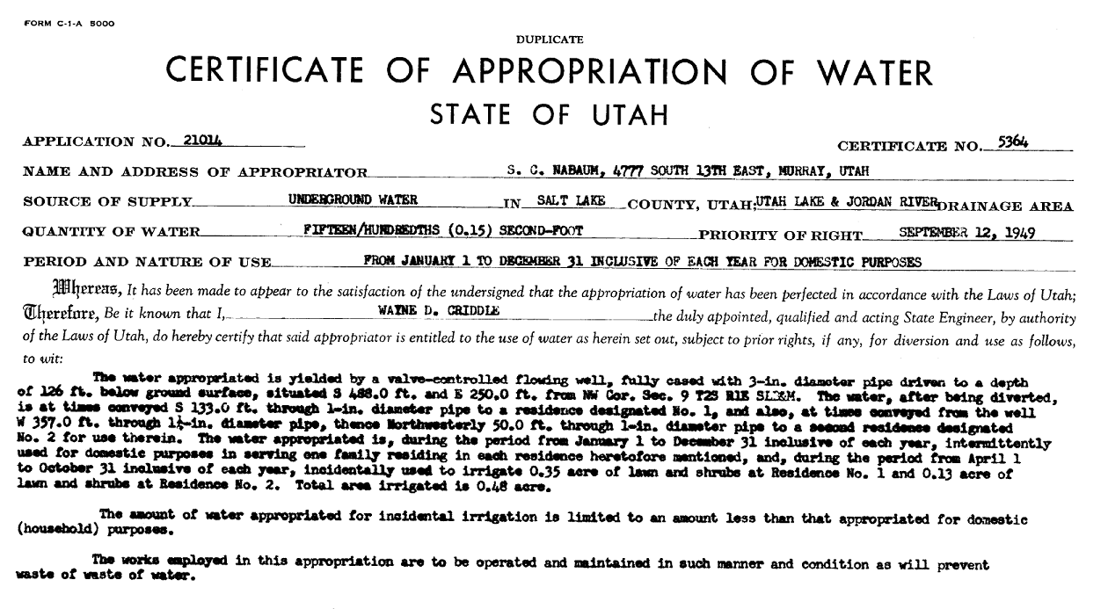
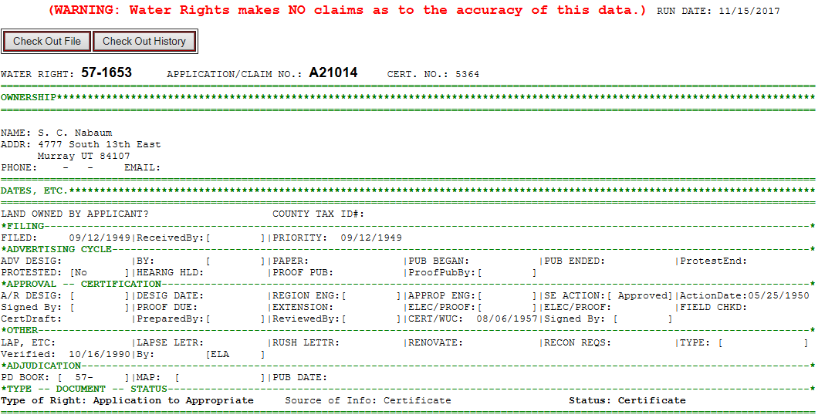

Slide 6
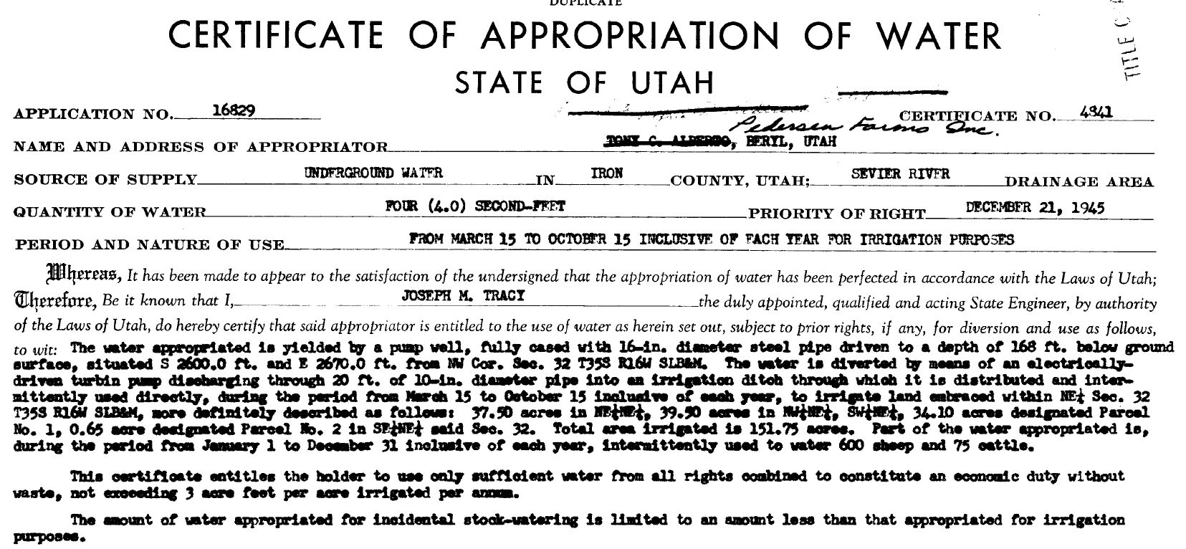
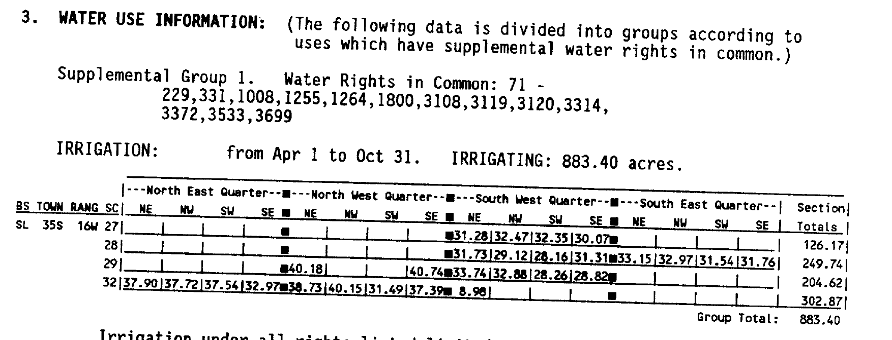

Slide 7
If the Beneficial Use Amounts are defined, a water right can be segregated for the purpose of filing a change application.

Slide 8
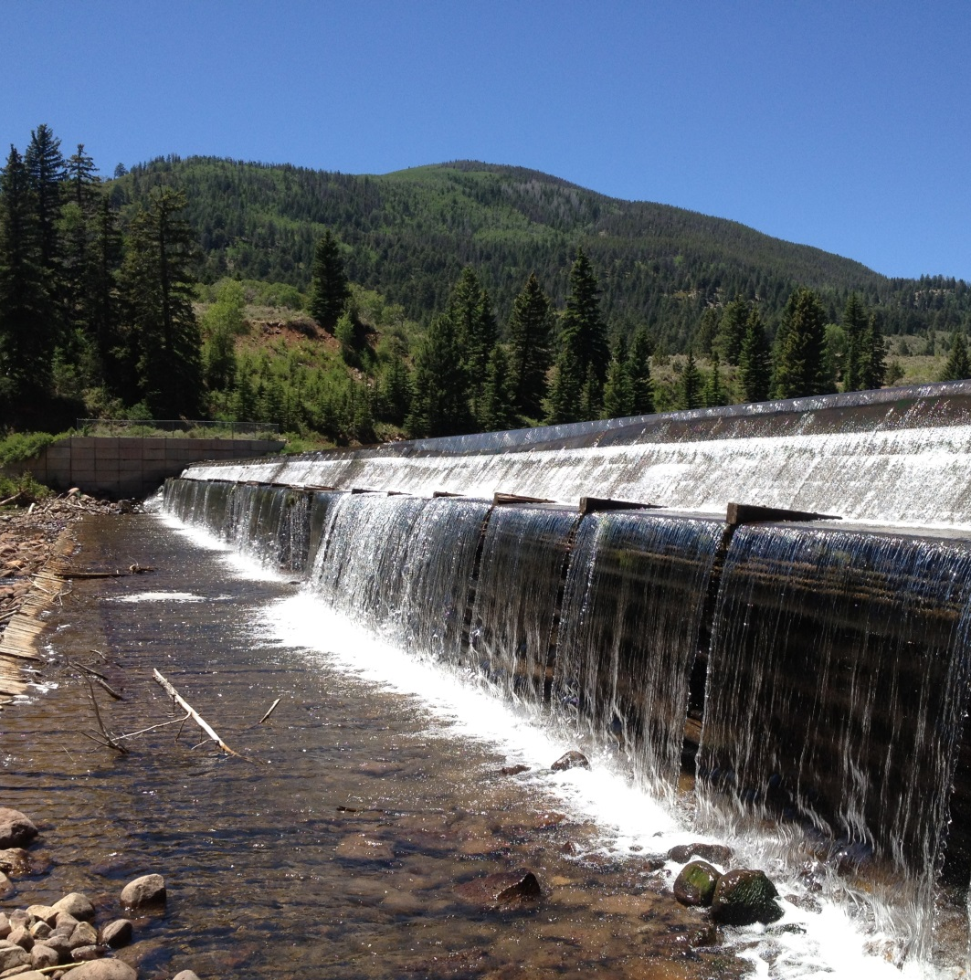
Supplemental to an irrigation company

Slide 9
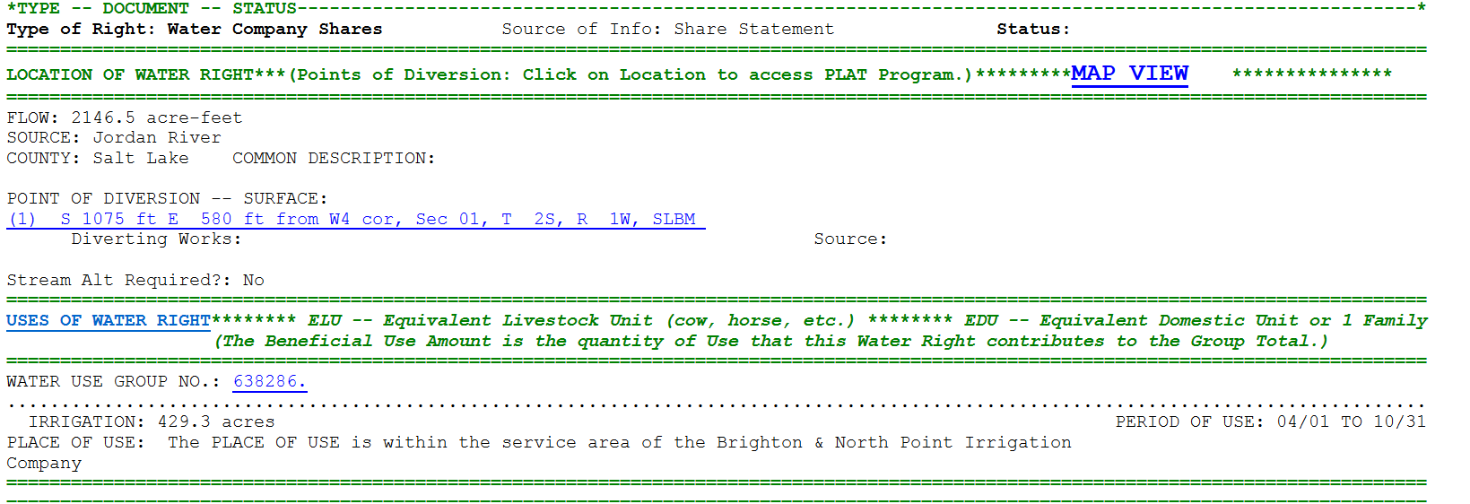
Share statement

Slide 10
Important Items to Understand:
Research the record to ensure the documentation supports the database entry.
Groups are dynamic. They change over time.
Chronological order of occurrence.
Application to Appropriate
Certificate of Beneficial Use
Published Proposed Determination Book
Addendum to the PD Book
Change Application
Certificate of Beneficial Use

Slide 11
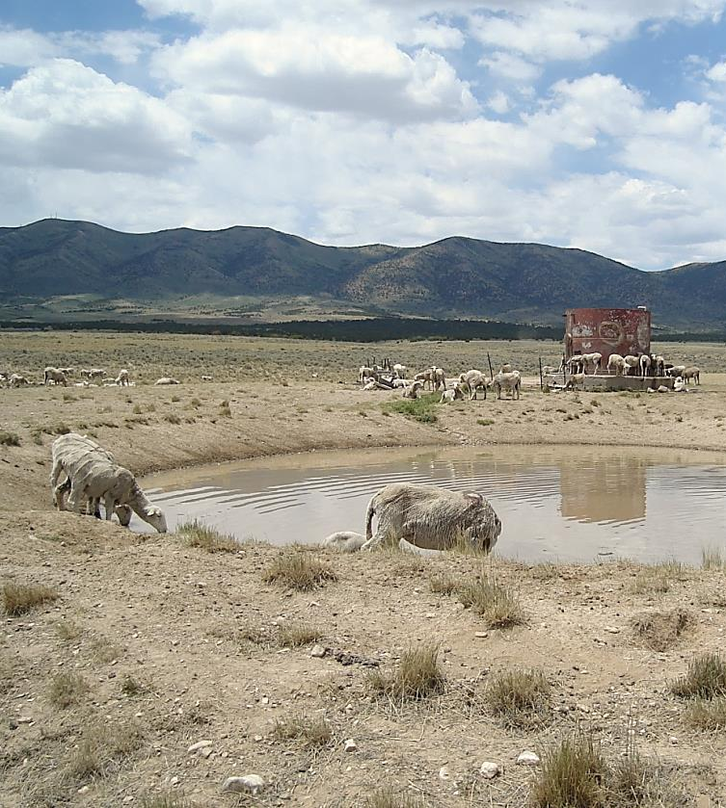
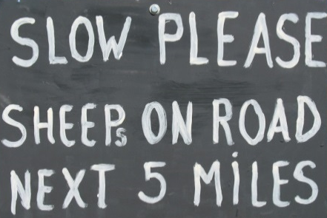
Terms to Remember
Water Use Group
Beneficial Use
Beneficial Use Amounts
Group Totals
Sole Supply
Notes:
Summary and questions.

Slide 12
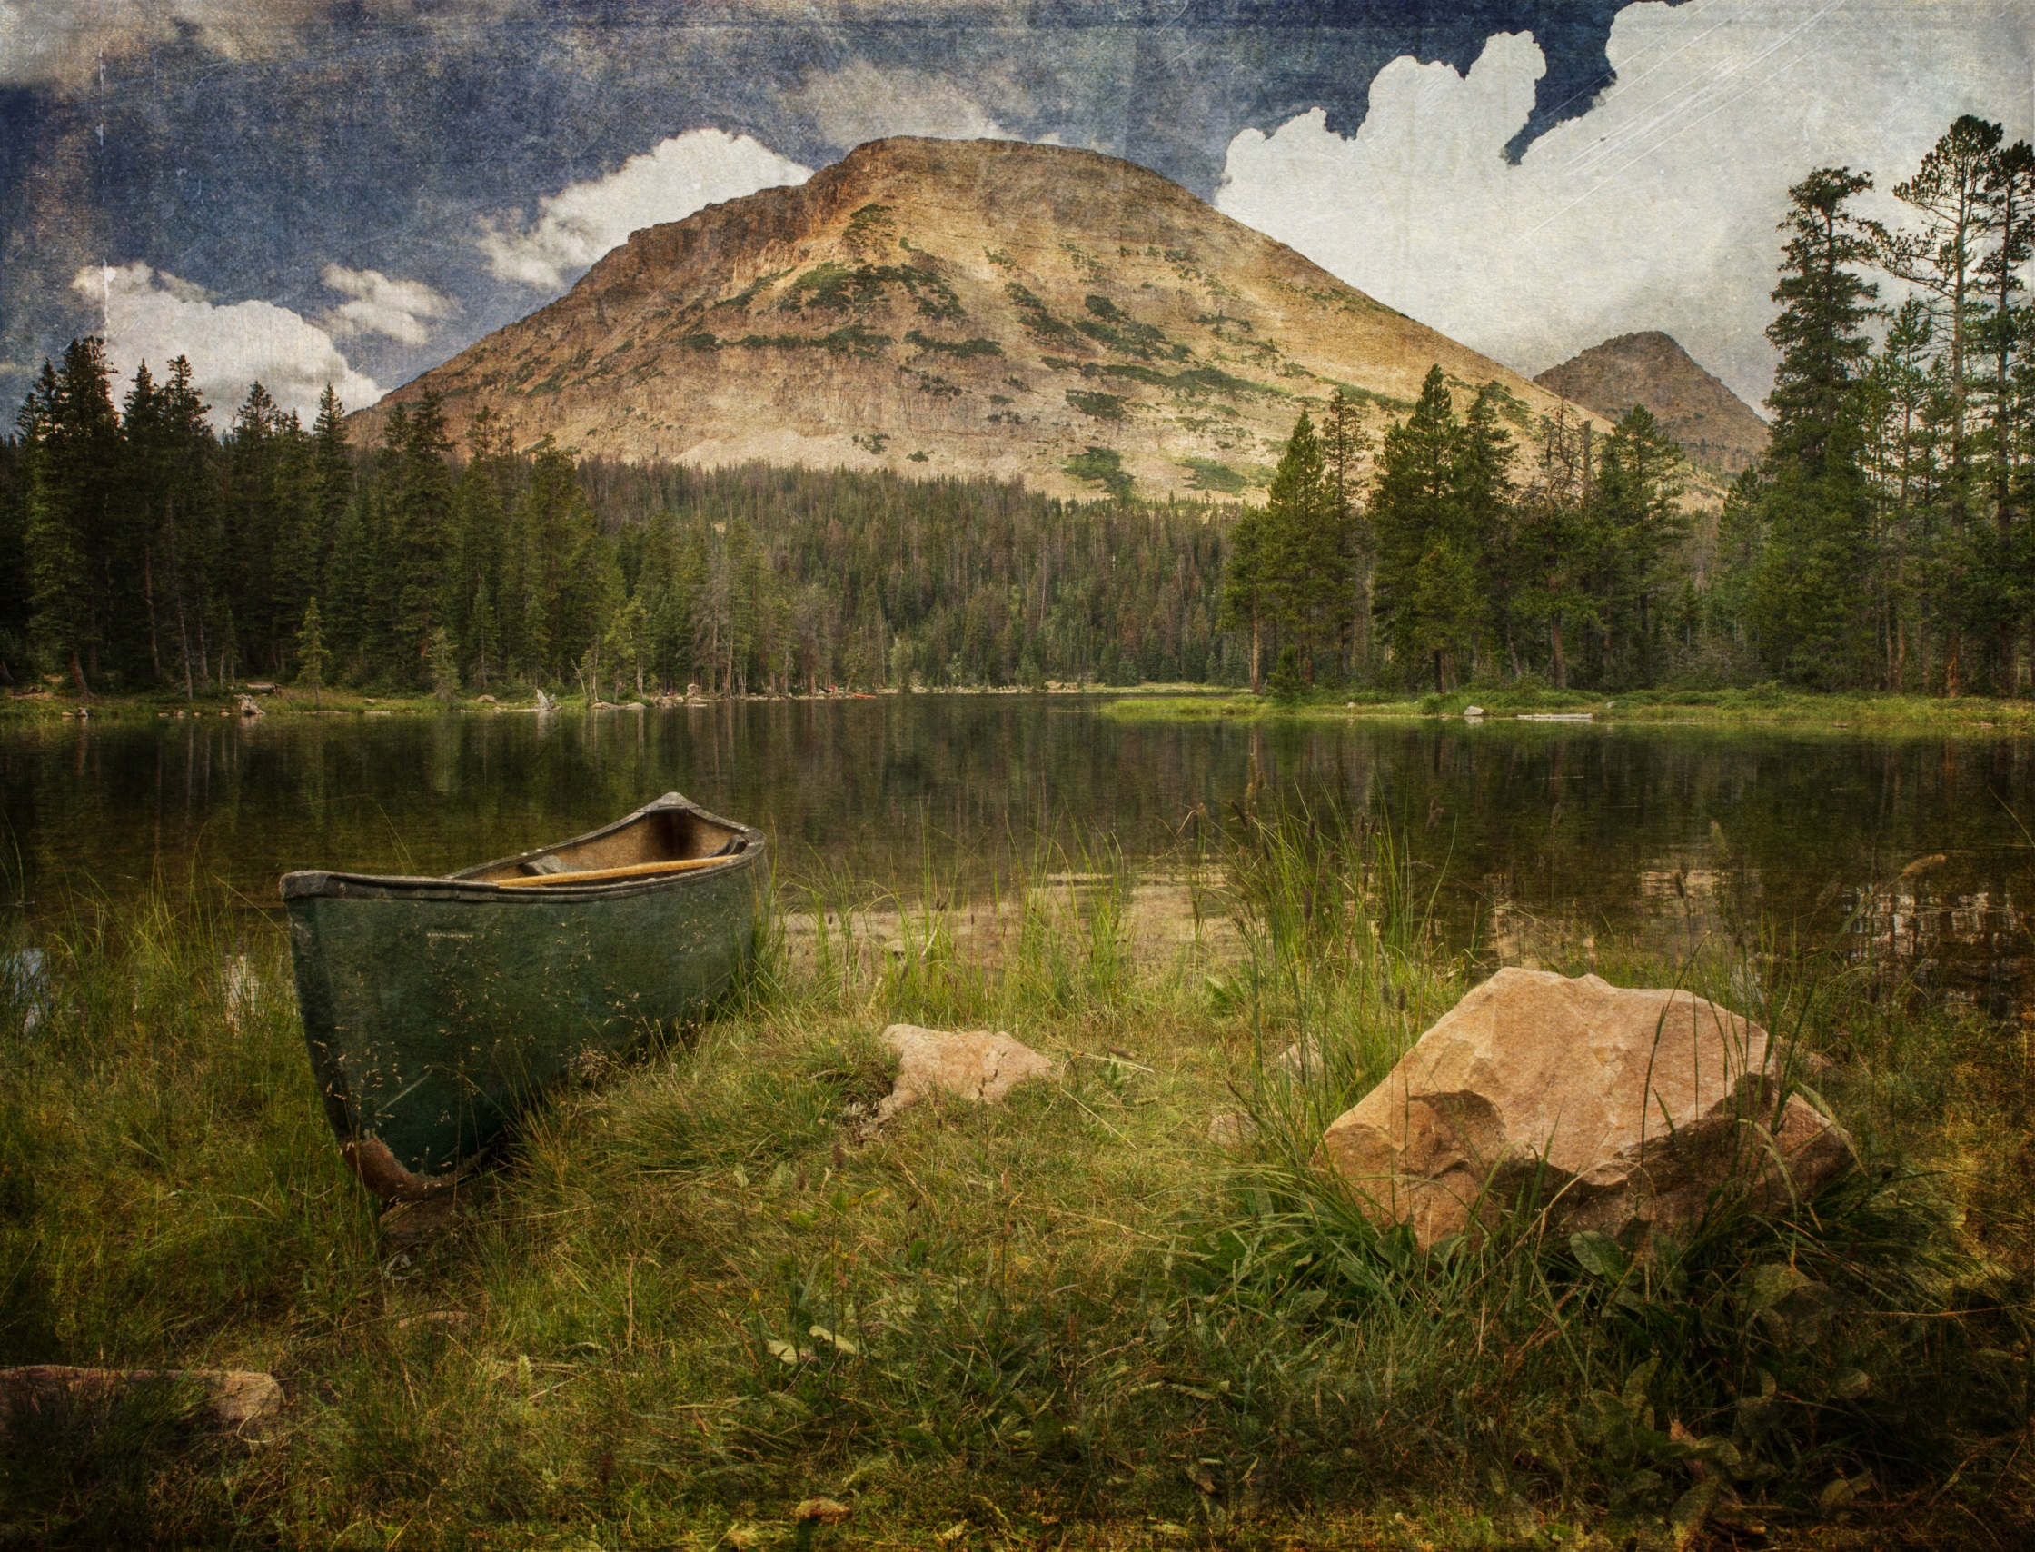
Questions?

