Slide 1
Utah Division of Water Rights
Water Use Groups
RWUA Training—April 2017
Boyd Clayton, P.E.
Deputy State Engineer
June 21, 2004

Slide 2
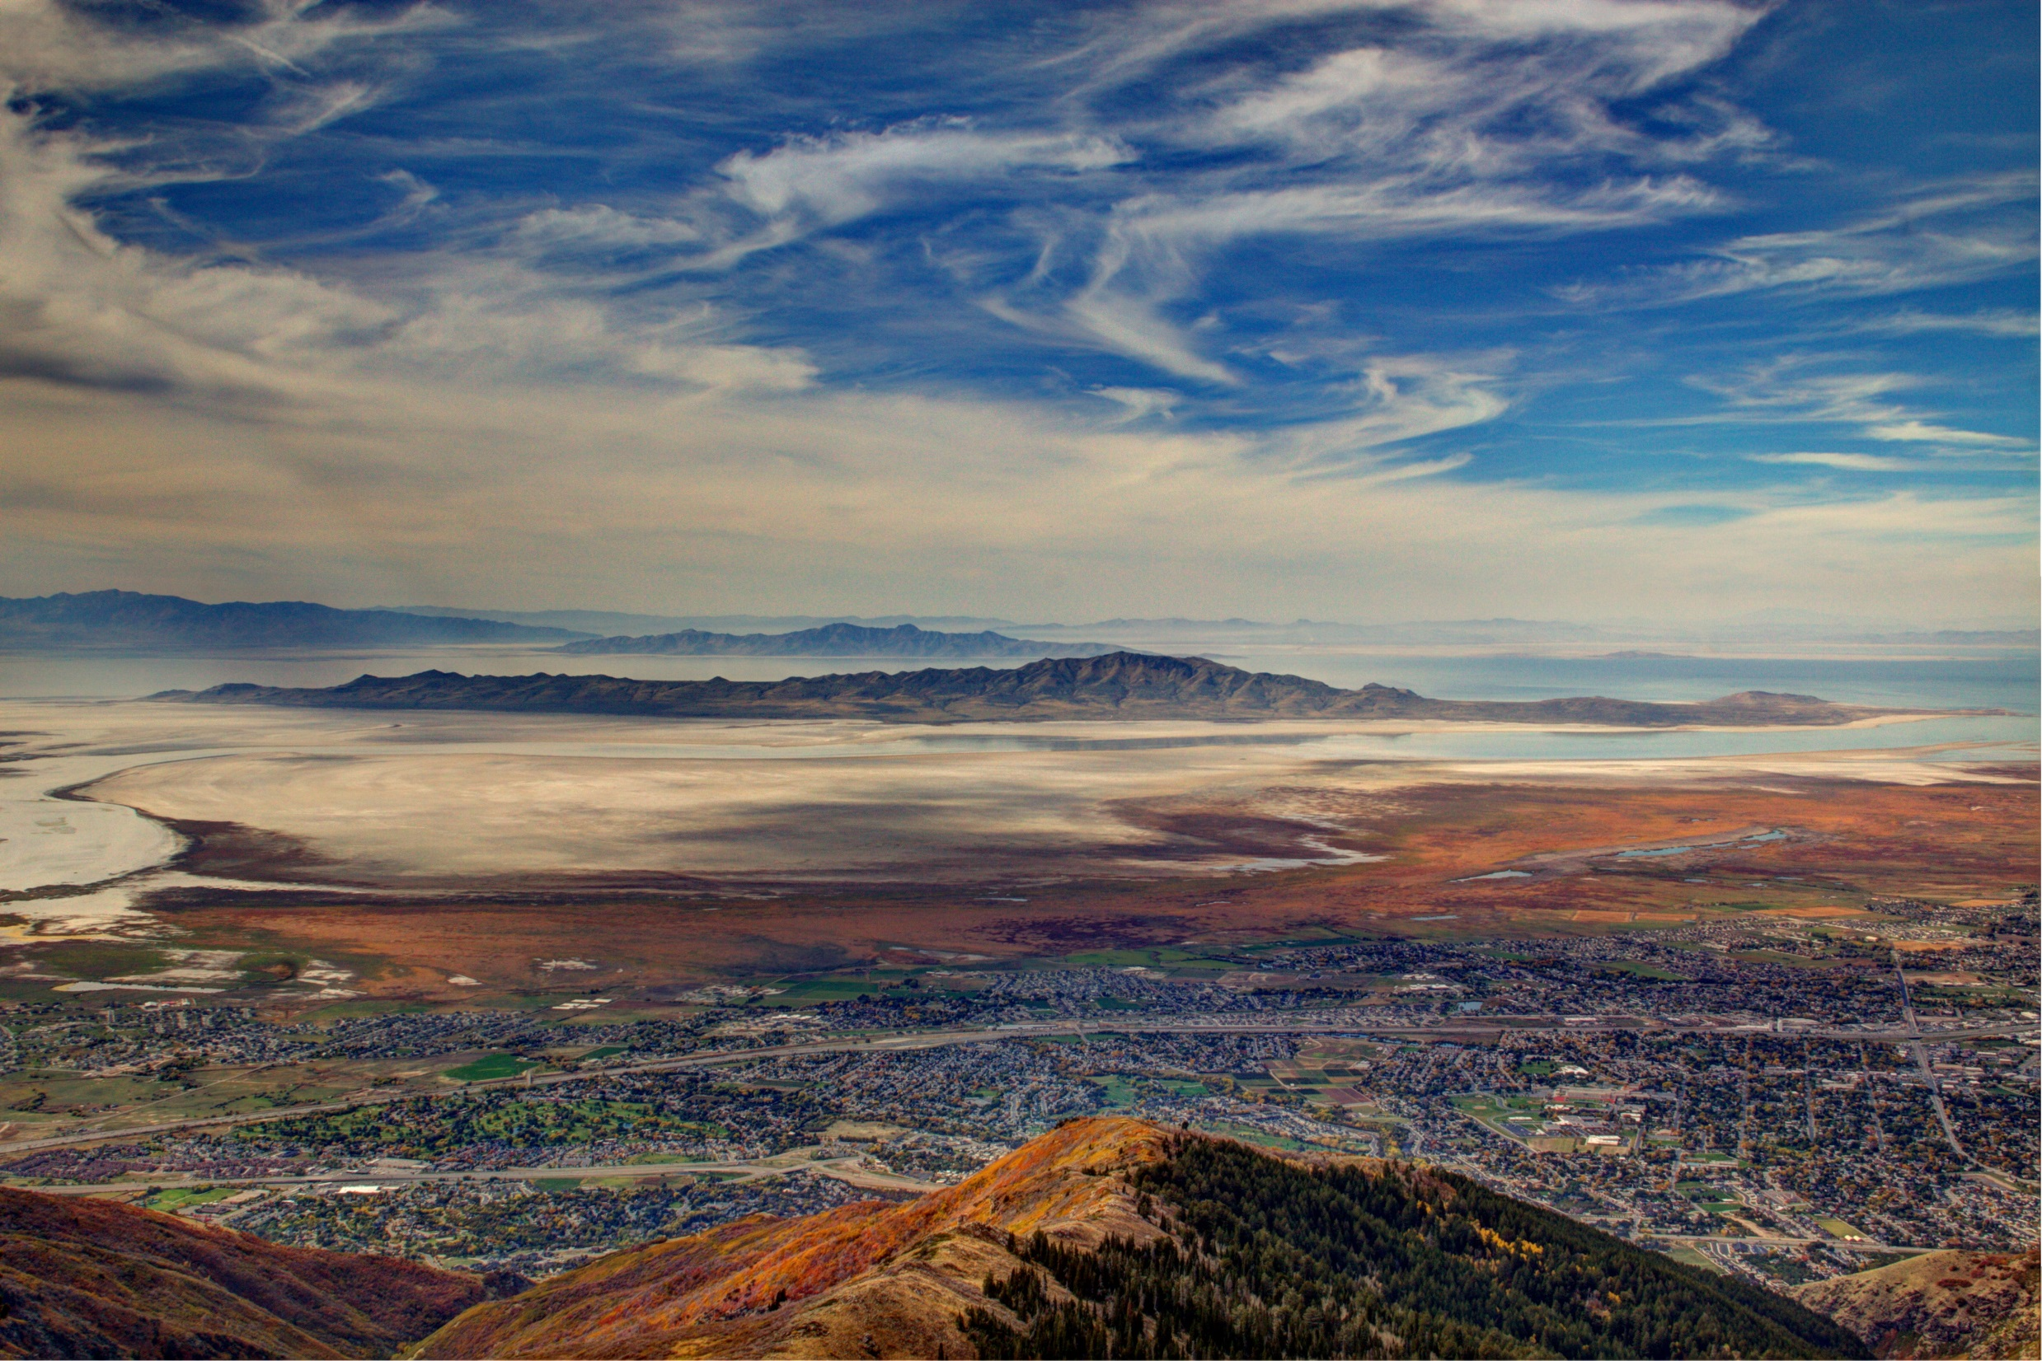
Understanding Water Use Groups
The What, Why, and How.

Slide 3
What is a Water Use Group?
An organizational structure designed to help overcome a weakness in water right records.
A water right represents a unique right to divert water but does not always describe a unique beneficial use of water.
Each water use group represents a unique beneficial use of water and ties together the water rights that serve that use.
Every water right has at least one water use group.
Beneficial use is the basis, measure, and limit of a water right.

Slide 4
Water Use Groups on a Water Right Printout

Slide 5
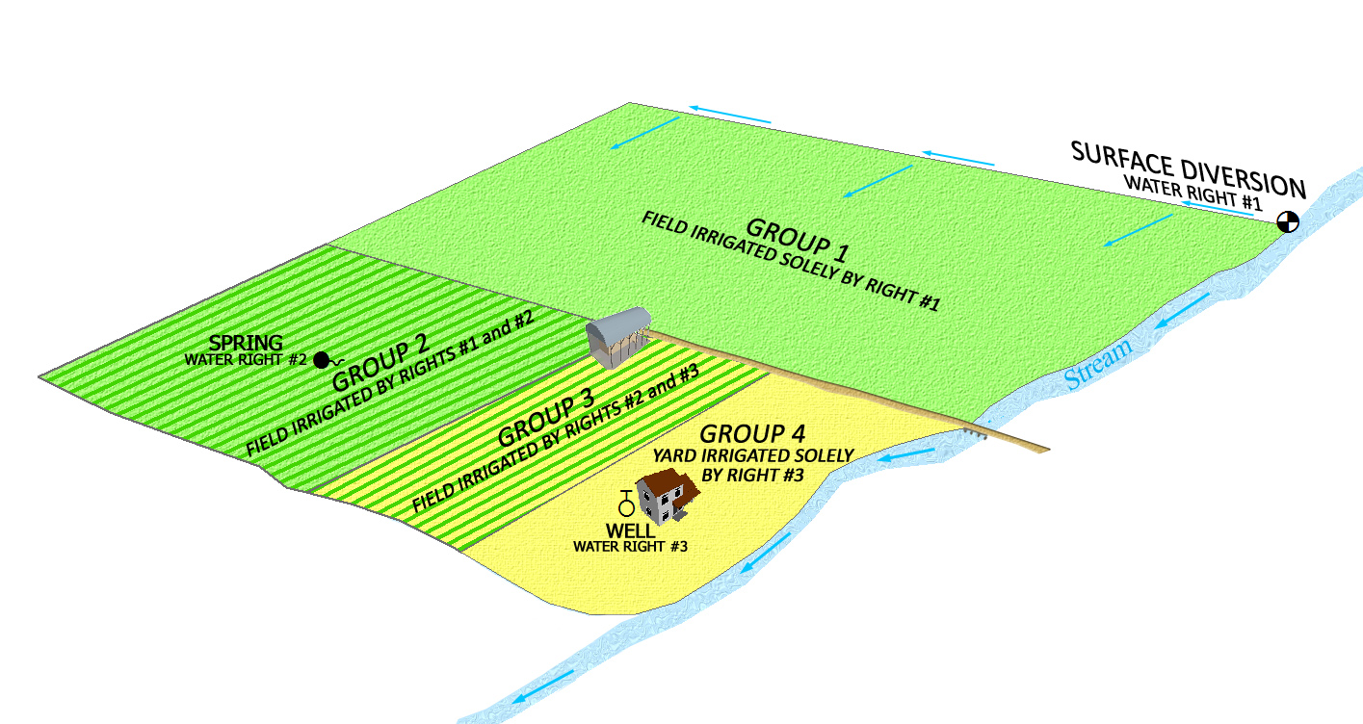

Slide 6
Why do we use Water Use Groups?
To account for the limits and measure of each water right.
As an index to the water rights that serve a use.
To uniquely account for all uses of water in the state.

Slide 7
Use Group Overlap/Inconsistency Issues
Irrigation Company water right use groups are independent of individual right use groups. If service area overlaps, individual right use groups have a comment referencing the irrigation company.
All rights of a Public Water Supplier are in use groups only associated with the public water supplier. Generally the supplier has only one use group.

Slide 8
A group contains a water right owned by an individual and the water rights for an irrigation company. What does this mean?
The use described in the group is supplemental to shares of stock in an irrigation company.
The individual right provides only a portion of the total Beneficial Use Amount.
The land is within the service area of the irrigation company.
Shares in an irrigation company are bought and sold as securities and lands served by the company may change.
This is an error that you can ask the Division to correct. We no longer include irrigation company rights in groups with private rights.

Slide 9
IRRIGATION COMPANY USE NOTE

Slide 10
Terms to Understand
Sole Supply
May be expressed as a limit of use of a water right
May also refer to a water right limit in a group
Group Total
The total use in this particular water use group
Period of Use
Time interval during year when water can be applied to use in the group
Place of Use
40 acre tracts or acres in a 40 acre tract where use occurs

Slide 11
What documents provide information to help clarify what is included in a Water Use Group?
Information included in a water right file
Application to Appropriate
Diligence or Underground Water Claim
Certificate of Beneficial Use
Judicial Decree
Published Proposed Determination Book / Addendum
Maps (application, claims, certificate, hydrographic survey maps)

Slide 12
How will you use and interact with Water Use Groups?
As a key indicator of value when acquiring a right.
As an issue to be reconciled when changing a right.*
As a limit to be observed when using a right alone.
*Since many of the water use groups which relate to more than one water right are not completely quantified you will likely become involved in an effort to complete that work in water right processes.

Slide 13
Water Use Groups may not be 100% correct
Duplicate groups and incomplete groups may exist due to database conversions and entry errors which have occurred over time.
Identifying errors
Research records
Send a written request to review the record and include statements as to how it is believed the groups should be modified.

Slide 14
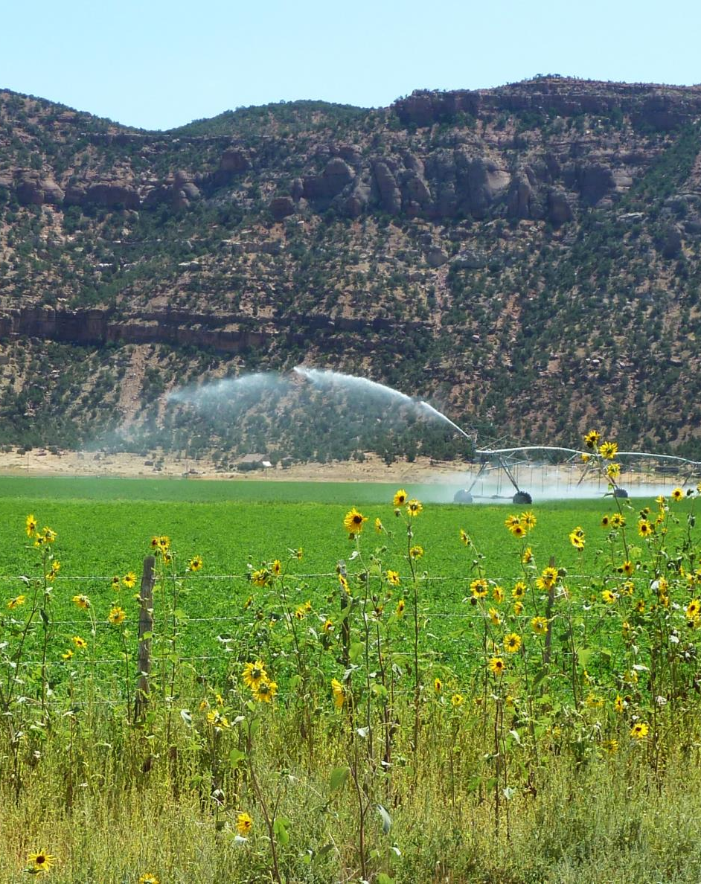
A water right group contains:
Place of Use
Period of Use
Beneficial Use(s)
Water Use Groups are dynamic – can change over time unless you declare a group contribution amount to be 0.

Slide 15
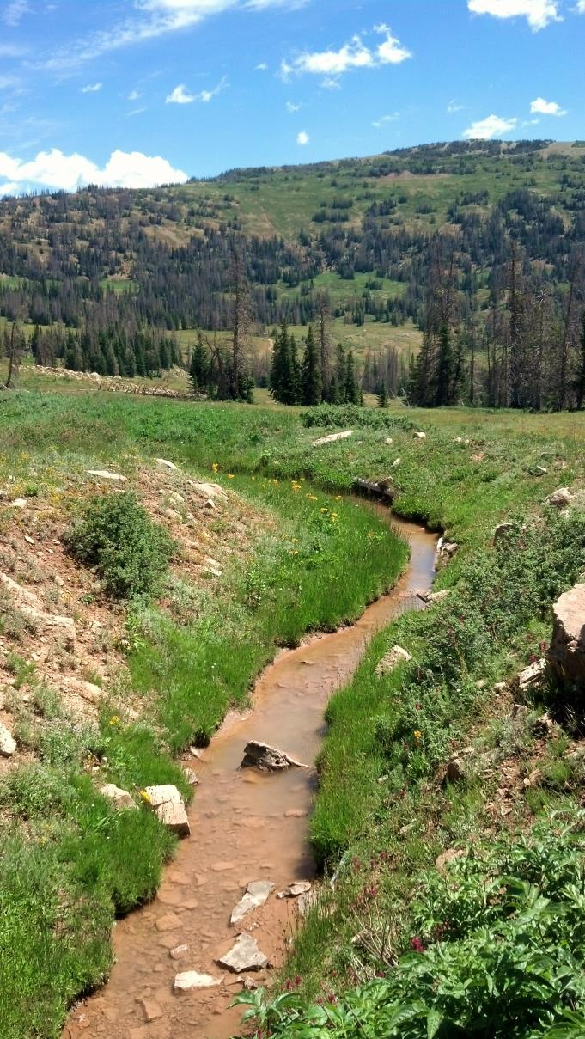
Beneficial Use Amount means:
The beneficial use amount a water right contributes to a use group in which it is included.
“Beneficial Use Amount” is the same as the term “Group Contribution”

Slide 16
Declaration Title Issues
Ownership of water rights in a Water Use Group may be in the name of more than one person
A group may define only one owner’s water rights.
A group may also define multiple water rights owned by various owners.
The use within a group can be ‘supplied’ by one, or more than one source of water – surface source, ground water well.

Slide 17
If the Beneficial Use Amounts are defined, a water right can be segregated for the purpose of filing a change application.
If not …

Slide 18
Why do you need to define the Beneficial Use Amount (Group Contribution)?
To file a segregation.
To file a change application.
Defining the Beneficial Use Amount of all water rights within a group ensures the amount of water and beneficial use of the individual water rights in the group is properly defined so there won’t be confusion if the rights are used independent of each other.

Slide 19
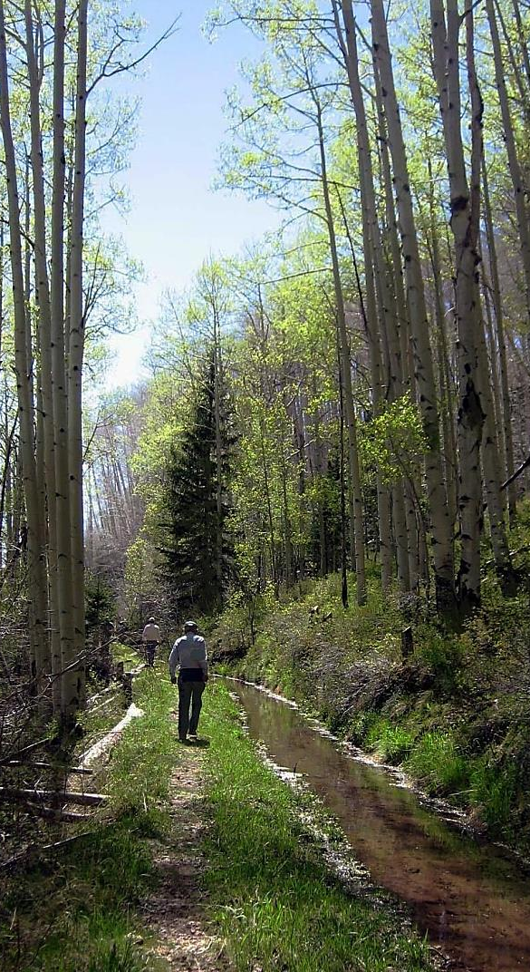
Administrative Rule R655-16
Declaring Beneficial Use Amounts
Written request for corrections to be made.
Declaration of Beneficial Use
Used to declare the beneficial use amount of a water right in a use group.
Application for Apportionment of Beneficial Use Amounts.
The applicant has exhausted all reasonable efforts to complete a Declaration of Beneficial Use.

Slide 20
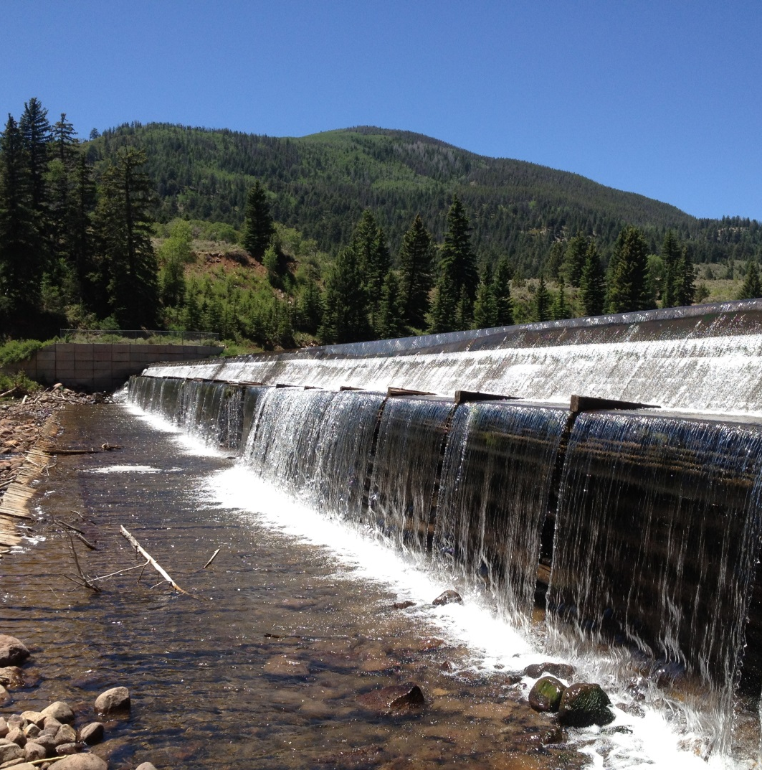
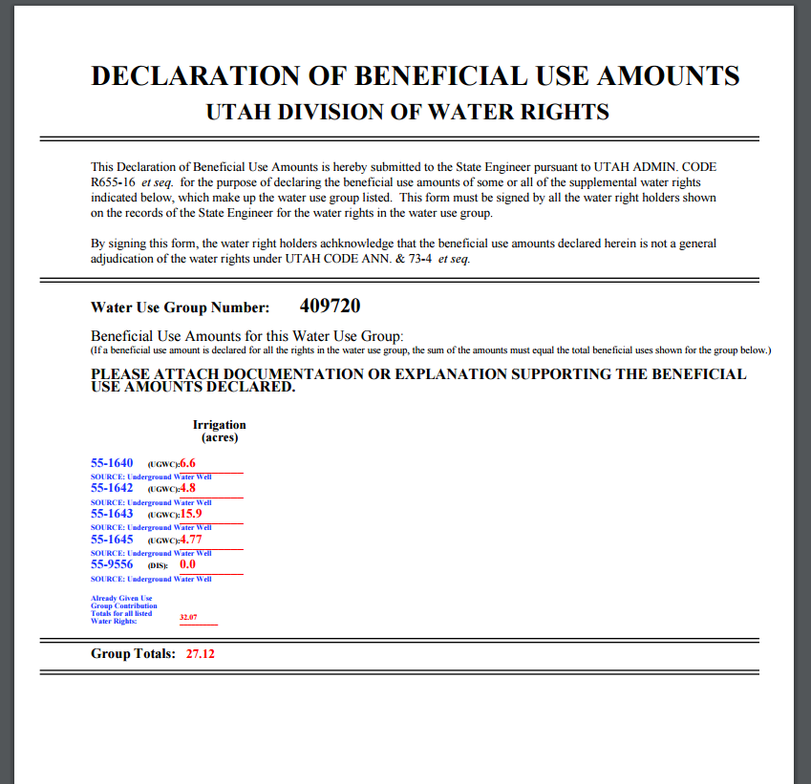

Slide 21
Buzzword Review
Supplemental
Sole Supply
Water Use Group
Declaration of BU Amt
Apportionment
Group Contribution
Group Total
Period of Use
Place of Use
Group Number
Statute
Administrative Rule

Slide 22
Questions?

