Slide 1
Utah Division of Water Rights
RWAU Water Right Training
Other State Engineer Roles
Kurt Vest, P.E.
Enforcement Engineer
June 21, 2004

Slide 2
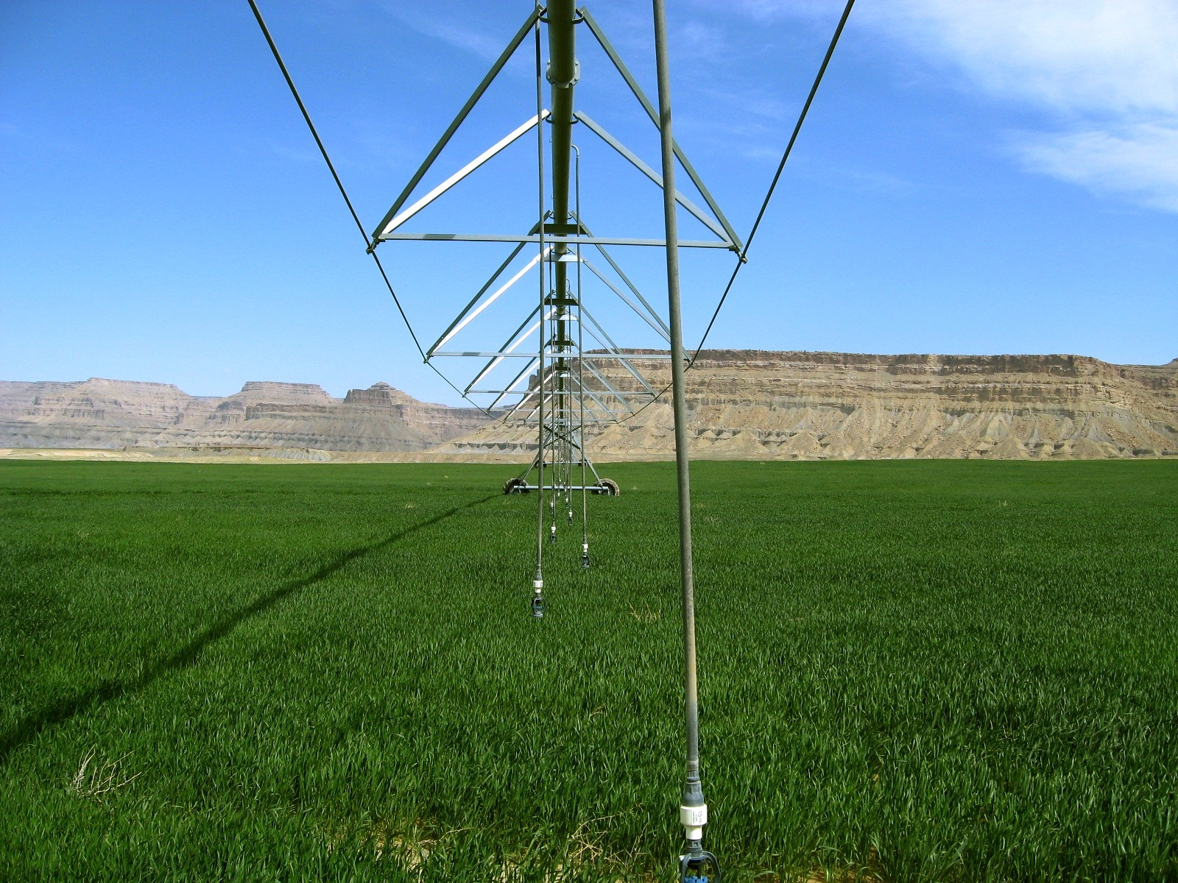
EnforcEment
Violations of water law

Slide 5
State Engineer Enforcement Powers
Diverting, impounding, or using water w/no WR
Diverting, impounding, or using water violating WR
Violates Section 73-5-4 (control works & meas. Dev.)
Violates Section 73-5-9 (waste, pollute, cont. waters)
Violates a written dist. Order from State Engineer
Violates Section 73-3-29 (relocation of streams)
Violates a notice or order regarding dam safety
Fails to submit a report required by Section 73-3-25 (well drillers)
Engages in well drilling without a license

Slide 6
To commence enforcement action SE issues an initial order, which includes:
A description of the violation;
Notice of any penalties to which person may be subject; and
Notice that SE may treat each day’s violation as a separate violation.

Slide 7
Final Order the SE may order that person:
Pay an administrative fine not to exceed:
(A) $5,000 for each knowing violation; or
(B) $1,000 for each violation that is not knowing;
Replace up to 200% of water taken; and
Be liable for any expenses incurred by the SE or Division in investigating and stopping the violation.
Each day of a continuing violation is a separate violation.
A penalty may not be imposed for a violation occurring more than 12 months before a NOV issued.

Slide 8
Before imposing a fine or ordering replacement the SE shall consider:
The value or quantity of water unlawfully taken;
The gravity of the violation, including the economic injury or impact to others;
Whether the person subject to fine attempted to comply with the SE’s orders; and
The violator’s economic benefit from the violation.
R655-14. Administrative Procedures for Enforcement
(25 pages single spaced)

Slide 9
Protecting the public
Dam Safety

Slide 11
Power of SE to Regulate Dams
SE has authority to regulate dams for public safety
SE may make rules controlling construction and operation of dams, including:
Design;
Maintenance;
repair;
Removal; and
Abandonment.
SE may exempt any dam that:
Impounds less than 20 AF and if fails threatens no human life; or
Does not threaten human life and if fails only minor damage to owners property.

Slide 12
Qualifications of Persons Designing Dams
Each plan for the construction, enlargement, repair, alteration, or removal of any dam shall be prepared by a qualified engineer who is:
Licensed in Utah; and
Experienced in dam design and construction.
Written approval must be obtained from SE prior to commencing work.

Slide 13
Dams classified according to hazard and use
Hazard Classifications
Use Classifications
High hazard – if fail, have high probability of causing loss of human life or extensive economic loss;
Moderate hazard – if fail, have low probability of causing loss of human life, but would cause appreciable property damage;
Low hazard – if fail, would cause minimal threat to human life and economic losses would be minor.
Water storage
Flood control
Tailings
Other
stock ponds
regulating reservoirs
diversion dams

Slide 14
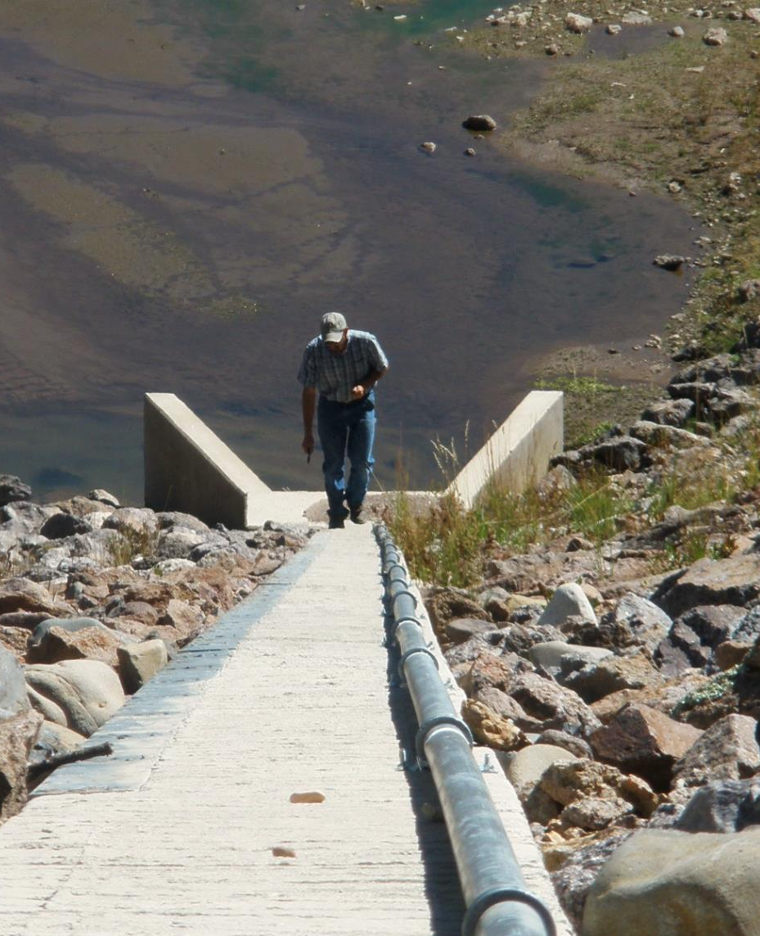
Submission of plans to SE
Before a dam is constructed, enlarged, repaired, altered, removed, or abandoned, plans submitted to SE for his approval;
The plans shall be submitted 90 days before:
Awarding the construction contract; or
The commencement of construction, if the owner constructs the dam.

Slide 15
Application for approval to SE
If submission of plans not required, approval to construct, enlarge, repair, alter, remove, or abandon the dam obtained by application to the SE.
The application shall contain:
Location of dam;
Physical dimensions of dam;
Water rights attached to dam; and
Any other information required by SE.
Upon review, application approved, rejected, or approved with conditions.

Slide 16
State Engineer to inspect dams
The SE shall inspect each dam that:
Poses threat to human life; or
Could cause significant property damage if failure.
An inspection shall occur:
At increments commensurate with the risk to life and property; and
Not less than once every five years.

Slide 17
Owners required to perform maintenance
After inspection, SE specifies maintenance necessary for dam.
SE may issue orders for:
Engineering studies;
Repairs;
Storage limitations;
Removal of dam;
Breaching of dam; or
Any other remedy SE determines appropriate.
Owner of dam responsible for maintenance.

Slide 18
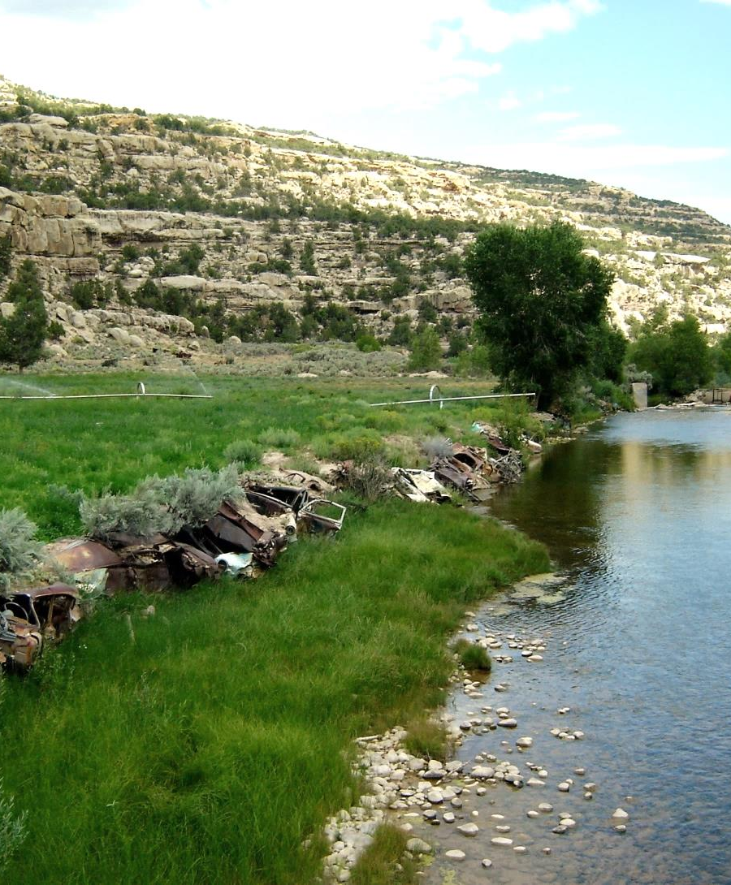
Stream Alterations
Natural Source
To divert you need a water right
To alter you need a state stream alteration permit
Federal permission under clean water act (404 permit)

Slide 19
Relocate or Alter Natural Streams
May not relocate any natural stream channel or alter beds and banks without first obtaining written approval of SE
Fee based upon the entity applying for permit:
Non-Commercial applicant….$100
Governmental applicant………$500
Commercial applicant………….$2000

Slide 20
State Stream Alteration Permits
Notice to state and federal agencies
Short response timeframe (generally < 30 days)
Approval criteria
Impair vested water rights
Unnecessary adverse effect on public recreation or stream environment
Unnecessarily endanger aquatic wildlife
Unreasonably diminish natural channel flow capacity

Slide 21
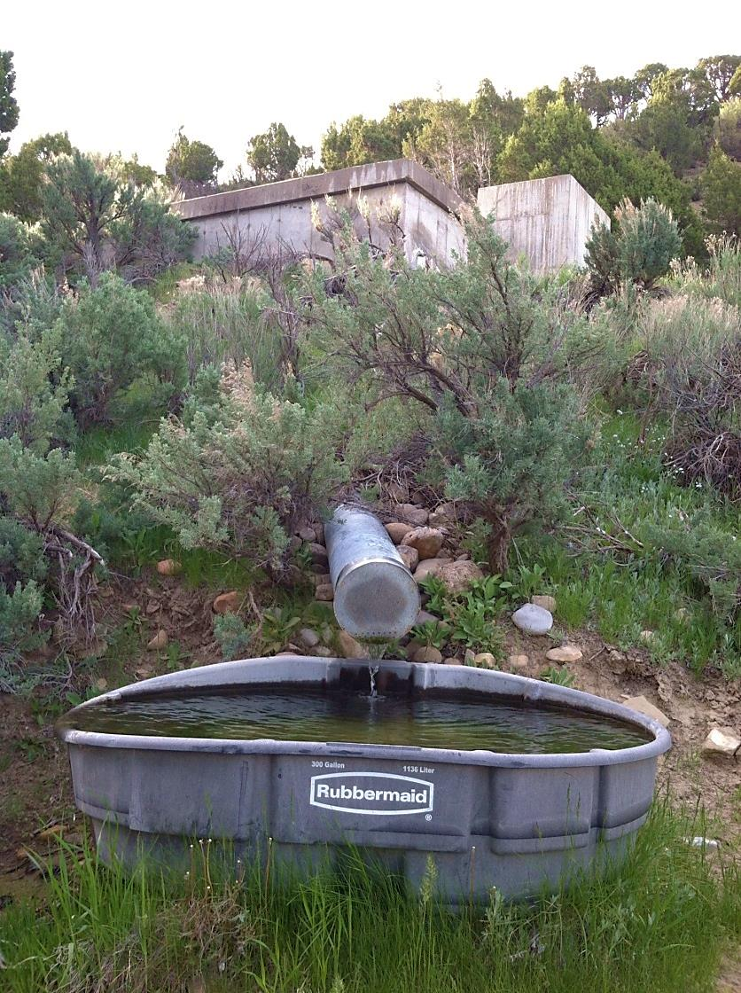
State Alteration Permit Does Not:
Review or grant permission to alter or trespass on land
Grant other local or federal permits except as stated
Relieve applicant from suit for injury by other parties

Slide 22
State and Federal Permit Coordination
State permit can be filed as a joint permit
State stream alteration permit
Coverage under PGP10 permit issued to Utah eliminates need for 404 permit
US Army Corps of Engineers (USACE) decides suitability
Cultural resources
Endangered species
Clean water act implications
State approval will state if GP40 coverage is granted
State and Federal Enforcement for failure to secure a permit
State allows after the fact permits with corrections as alternative to enforcement.

Slide 23
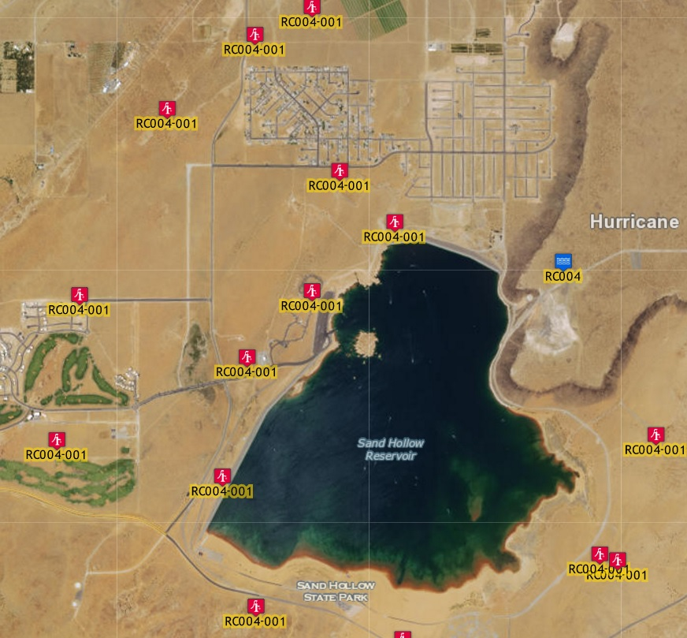
Groundwater Recharge and Recovery

Slide 24
Groundwater Recharge and Recovery
A person may not artificially recharge an aquifer without first obtaining a recharge permit.
A person may not recover from an aquifer water that has been artificially recharged unless the person first obtains a recovery permit.
A person proposing to artificially recharge water into an aquifer must have:
A valid water right; or
An agreement to use the water with a person who has a valid water right.
A person who holds a recovery permit may recover the amount of water stored that remains within the hydrologic area of influence.

Slide 25
Application for a Recharge Permit
The name of the groundwater basin;
A legal description of the proposed recharge project;
The source and amount of water proposed to be recharged;
A valid water right for project;
Quality of water recharged and water quality of receiving aquifer;
Have applied for all applicable water quality permits;
A plan of operation which shall include:
Design capacity;
A detailed monitoring program; and
Proposed duration of the project.

Slide 26
Application for a Recharge Permit continued
Copy of a study demonstrating:
The area of hydrologic impact of project;
The recharge project is hydrologically feasible;
The recharge project will not:
Cause unreasonable harm to land; or
Impair any existing water right; and
The percentage of anticipated recoverable water;
Evidence of financial and technical capability.
A filing fee is submitted based on the amount of water proposed to be recharged.

Slide 27
Application for a Recovery Permit
May be filed with a recharge permit application;
Legal description of well(s) intended to recover water;
Name of groundwater aquifer which is the source of supply;
The purpose for which water will be recovered;
The depth and diameter of well(s);
A legal description of land where water will be used;
The designed pumping capacity of the well(s).
A filing fee must be submitted with the application - $2500

Slide 28
Storage account - Monitoring
The SE will establish a storage account for each groundwater recharge and recovery project;
Person holding a groundwater recharge or recovery permit shall:
Monitor the operation of the project and its impacts; and
File reports with the SE regarding:
The Quantity of water stored and recovered; and
The Water quality of the recharge water, receiving aquifer, and recovered water.
Annual fee assessed that covers Division’s costs to administer.

Slide 29
Reuse of wastewater

Slide 30
Reuse by public agency owning WR
A public agency owning or operating a POTW that treats domestic wastewater consisting of water supplied under a WR the agency owns may use, or contract for the use of, reuse water if:
The WR is administered by the SE as a municipal WR;
The reuse is consistent with underlying WR; and
The public agency receives approval from Water Quality Board and SE

Slide 31
Reuse by public agency under contract
A public agency may use or contract for the use of reuse water if:
The domestic wastewater consists of water for which the agency has a reuse authorization contract;
The WR is administered by the SE as a municipal WR;
The reuse is consistent with underlying WR; and
The public agency receives approval from Water Quality Board and SE

Slide 32
Application to the State Engineer
A public agency proposing water reuse shall apply to the SE.
An application for water reuse shall include:
A description of the underlying WR;
An evaluation of the underlying WR’s diversion, depletion, and return flow requirements;
The estimated quantity of water to be reused; and
An evaluation of depletion from hydrologic system caused by water reuse.
The SE shall conclude that reuse is consistent with WR if:
The use does not enlarge the underlying WR; and
Any return flow requirements of underlying WR is satisfied.

Slide 33
In the future wars will be fought over water

Slide 34
QUESTIONS?

