Slide 1
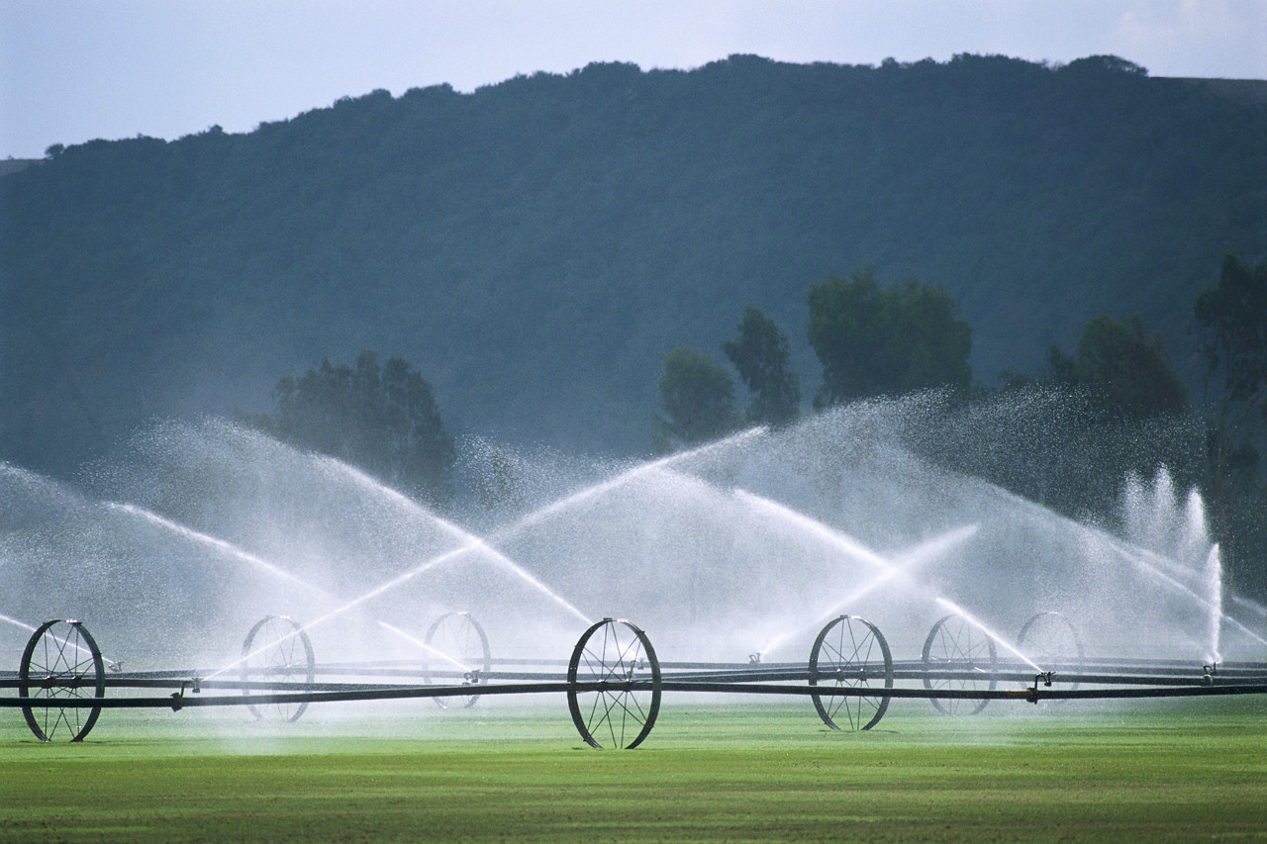
Division of Water Rights
WaterRights.utah.gov

Slide 2
UTAH WATER USE PROGRAM
Frank Quintana, PE
(801) 538-7223
frankquintana@utah.gov

Slide 3
What do you need to know?
What do you need to record?
What form do you need to report?

Slide 4
WHAT DO YOU NEED TO KNOW?
Public Land Surveying System
North 275 feet West 658 feet from the SE¼ corner of Section 21, T 2 N, R 5E, SLB&M

Slide 5
WHAT DO YOU NEED TO KNOW?
Units of Measurement
Gallons, Kilo gallons, Mega gallons, Acre-feet
1 acre-foot = 325 851 gallons

Slide 6
WHAT DO YOU NEED TO KNOW?
Measuring Devices
Meters

Slide 7
WHAT DO YOU NEED TO RECORD?
Diversion data
Water use data
Revenues and expenditures

Slide 8
DIVERSION DATA (Monthly)
Record amount of water diverted
from each source
JAN | FEB | MAR | APR | MAY | JUN | JUL | AUG | SEP | OCT | NOV | DEC

Slide 9
DIVERSION DATA (Yearly)
Record total amount of water diverted
from each source
JAN | FEB | MAR | APR | MAY | JUN | JUL | AUG | SEP | OCT | NOV | DEC | ANNUAL

Slide 10
WATER USE DATA (Yearly)
What are the uses?
How much water for each use?

Slide 11
Diversion Data
Water Use Data
Well
In
Pipe
Out
Spring

Slide 12
YEARLY
Report data no later than March 1st

Slide 13
Paper form

Slide 17
Online form

Slide 18
E-Form Preparation:
E-mail address
Login-ID
Login-Key
http://waterrights.utah.gov/wateruse

Slide 25
REVENUES AND EXPENDITURES FORM
Division of Drinking Water

Slide 26
Division of Drinking Water
Michael Grange, Engineering Manager
mgrange@utah.gov
(801) 536-0069

Slide 27
Non-Public Water Suppliers E-Form

Slide 28
SUMMARY
What do you need to know?
What do you need to record?
What form do you need?

Slide 29
SUMMARY
Record diversion data (Monthly)
Total up diversion data (Yearly)
Record water use data (Yearly)

Slide 30
SUMMARY
Paper form
Online form
Submit report no later than March 1st

Slide 31
Striving for
Reliable data

