Slide 1
Utah Water Users, 2015
Legislation passed in the 2015 Legislative Session
And what it does to us…

Slide 2
Senate Concurrent Resolution 2 Senator Hinkins
Declares support for the Utah/Navajo Nation Reserved Water Right Settlement.
It further talks about the projected $8 Million cost to the State of Utah and offers the idea that the State’s Rainy Day fund may be used to fulfill Utah’s remaining $6 Million obligation.

Slide 3
Senate Bill 2 New Fiscal Year Appropriation Act Sen. Hillyard
Line 1722: The Legislature intends that the Department of Natural Resources continues to facilitate and staff the Executive Water Task Force
Appropriates $438,000 ongoing for Adjudication
Appropriated $11 Million one time for Dam Safety

Slide 4
Senate Bill 15 Senator Dayton
Clarification: Abandonment and forfeiture do not apply to a water right for nonuse during the period of time in which the water right is subject to an approved change application
(If applicant is diligently pursing certification)

Slide 5
Senate bill 35 & House bill 58 Sen. Dayton and Rep. Grover
Response to Supreme Court “Big Ditch” ruling
Requires that a person who applies for a permanent or temporary change to a water right meet one of these qualifications:
1. a holder of an approved but unperfected application to appropriate water;
2. the record owner of a perfected water right;

Slide 6
35 &58 continued
3. a person who has written authorization from a person described above to file a change application on that person’s behalf;
4. a shareholder in a water company who files in accordance with Section 73-3-3.5

Slide 7
Senate Bill 225 Senator Van Tassell
A Change application on a United States Indian Irrigation Service water right that is serving the needs of a township or municipality shall be signed by: the local public water supplier that is responsible for the operation AND
The record owner of the water right.

Slide 8
Senate Bill 40 Senator Dayton
An individual who wished to withdraw an unperfected application must send written notice to the state engineer.
The State Engineer will then update State Engineer Records noting the withdrawl
Fees will not be refunded for a withdrawn application

Slide 9
Senate Bill 281 Senator Adams
Creates “”Water Infrastructure Fund”
The fund earns interest and consists of future legislative appropriations, voluntary contributions and earned interest.
The fund use is “the development of the state’s undeveloped share of the Fear and Colorado Rivers as described in Bear River Development Act and Lake Powell Pipeline Development Act” also..unfunded Reclamation projects…
Appropriates $5,000,000 to the fund

Slide 10
House Bill 25 Representative Snow
Authorizes a change applicant to request a meeting with State Engineer to discuss potential issues arising from the change
Authorizes the State Engineer to determine if the proposed change would impair another water right
Authorizes State Engineer to limit change to current depletion
Provides for applicant and protestant to negotiate mitigation which may become a part of change application approval

Slide 11
House Bill 43 Representative McIff
“If the water company fails to timely respond (within 120 days)… the failure to respond shall be considered the water company’s consent to the proposed change application and the shareholder may file the proposed change application with the state engineer”
Other Highlights…

Slide 12
House Bill 47 Representative McIff
This bill will be studied during interim…
It hopes to Define Public Trust in relation to Water rights.
It hopes to protect Private Water rights from being converted to “Public Use” under the public trust Doctrine.

Slide 13
House Bill 161 Representative McIff
This bill will be studied during interim…
The bill hopes to declare that a shareholder has a vested property right, proportional to the % of shares held, and
States that a shareholder is a person entitled to use of water including the right to change the nature, purpose, and place of water use…

Slide 14
House Bill 258 Representative Chew
Water Commissioners (River Commissioners) are employees of the Division of Water Rights
They are career service exempt
They are appointed (if qualified) upon recommendation of the water users
They are paid from a new expendable special revenue fund created to move money from River systems to “Water Commissioner Fund”

Slide 15
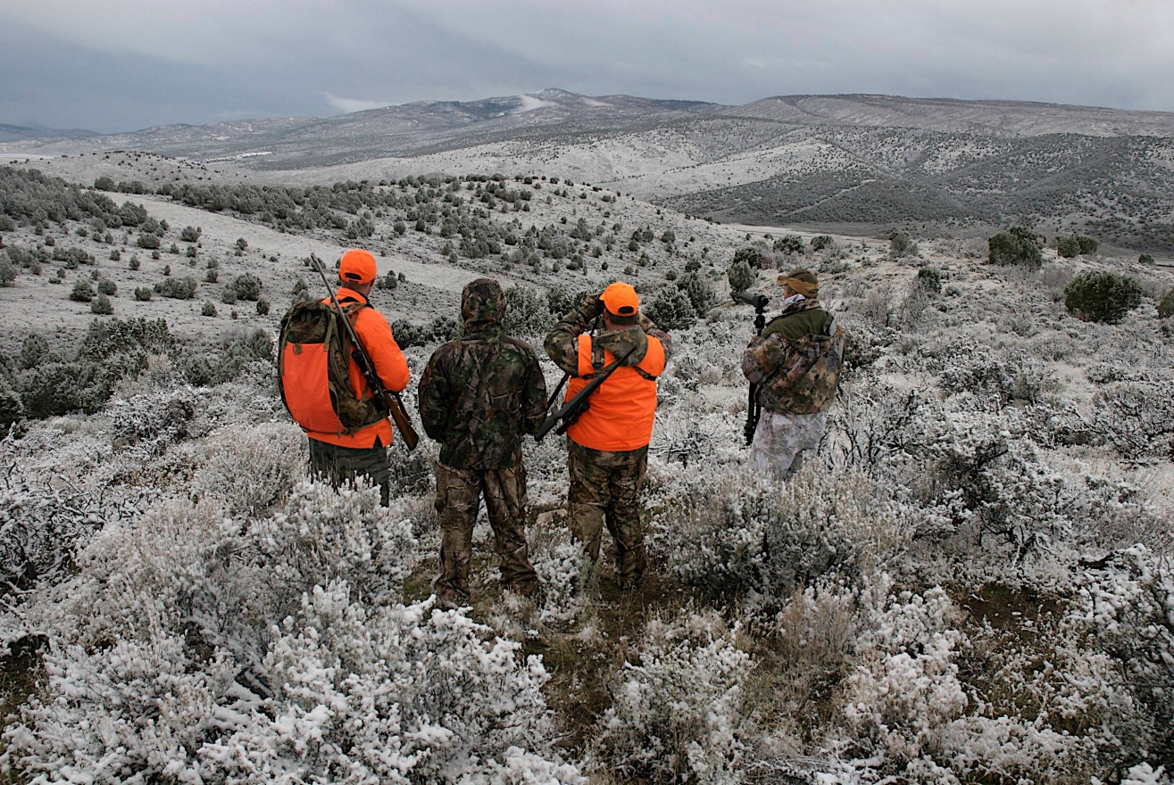
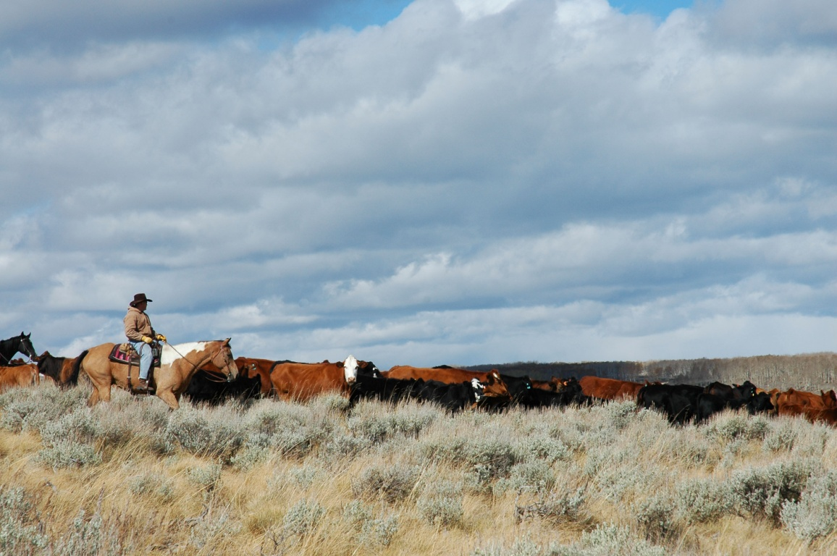
Creating Healthier Lands Supports Diverse Uses

Slide 17
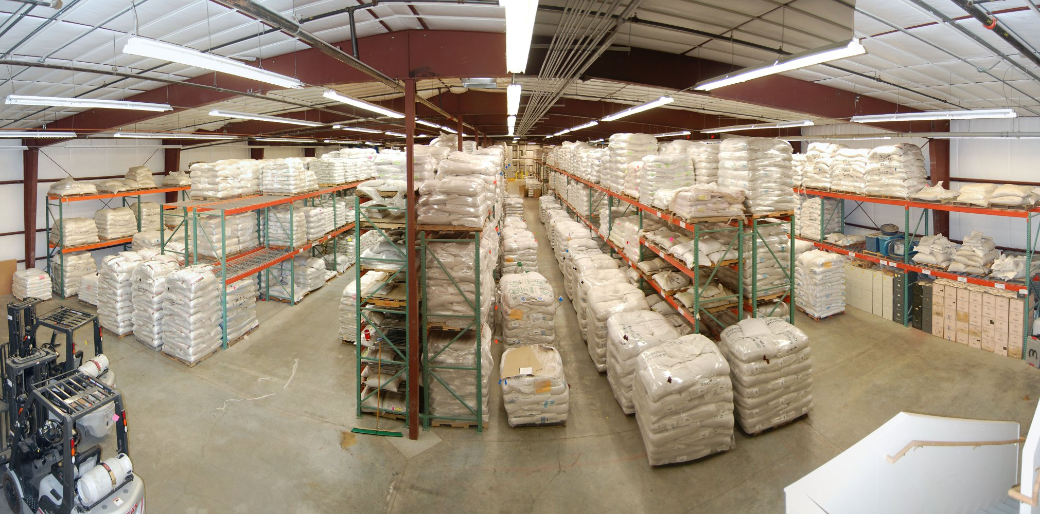
This is how we do it….
Seed purchasing
Seed storage/mixing facility in Ephraim, UT

Slide 18
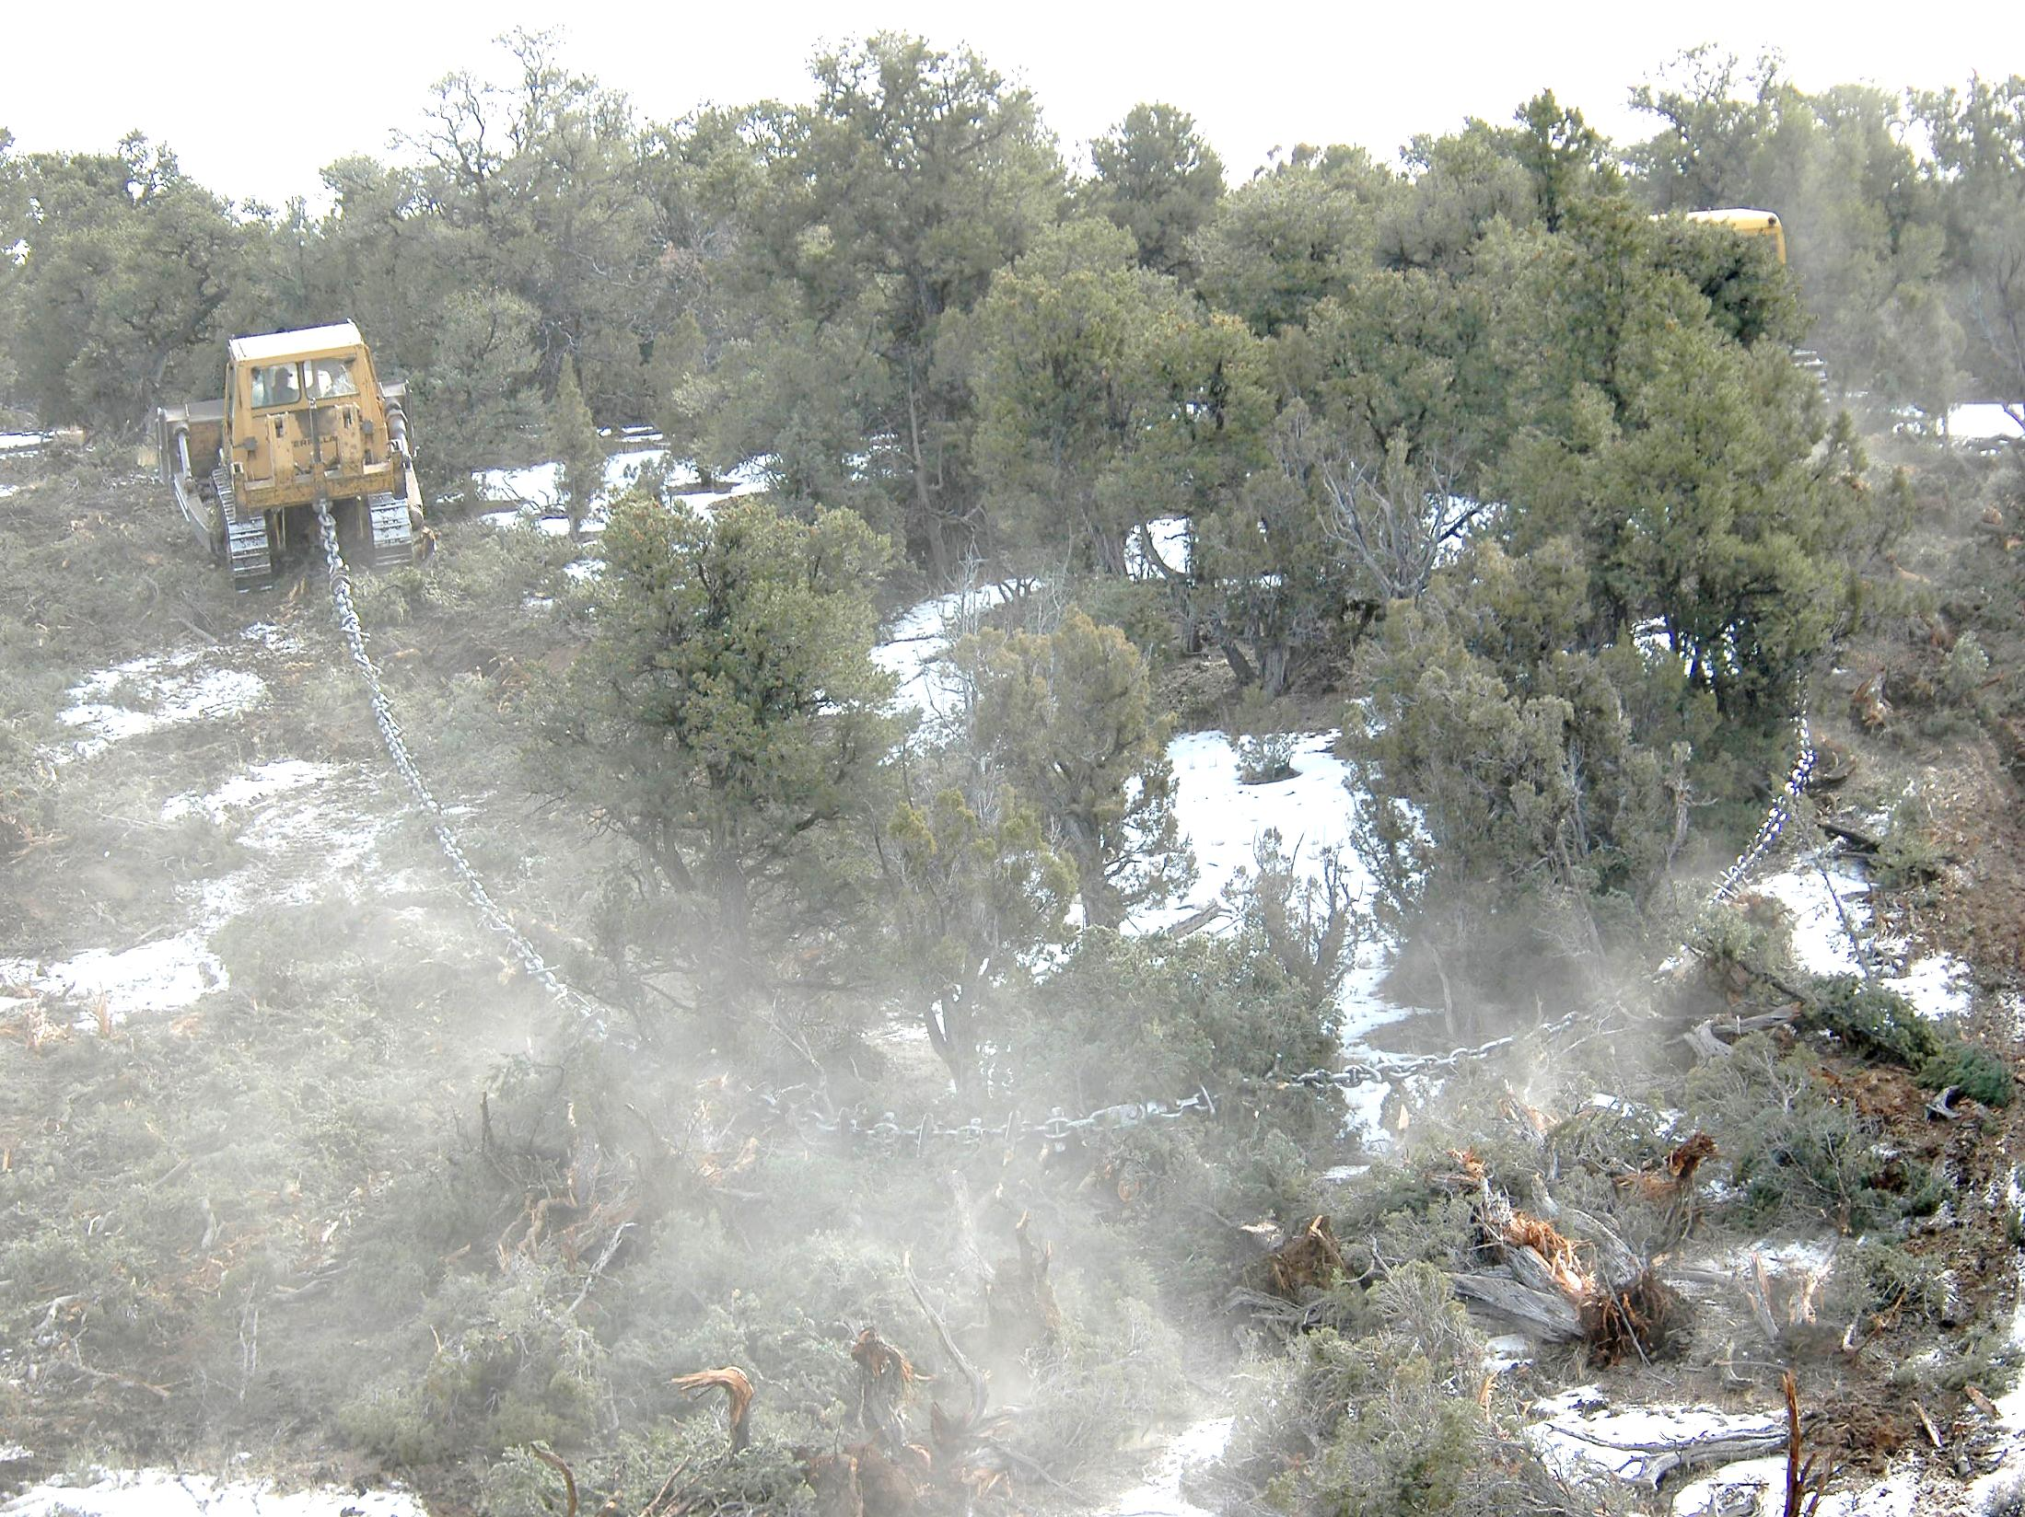
Watershed Rehab/Treatment Methods

Slide 19
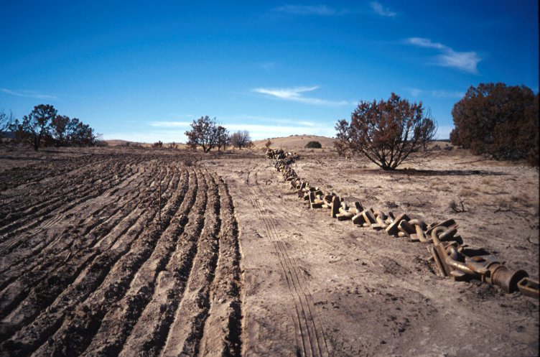
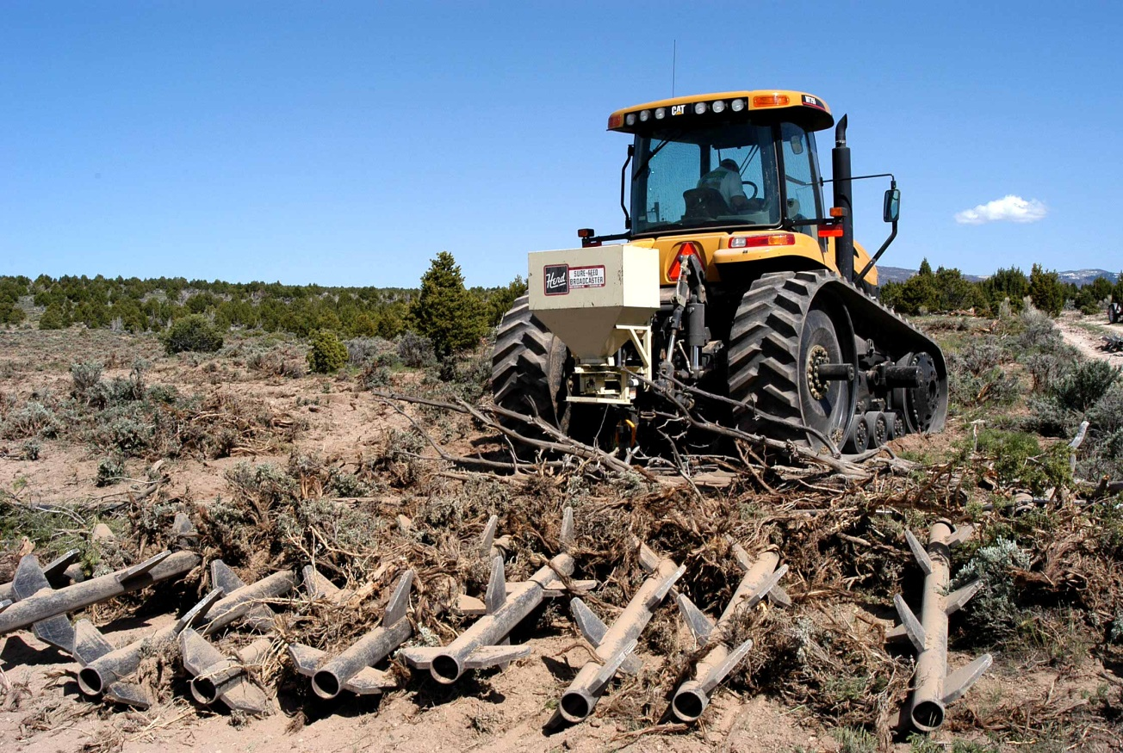
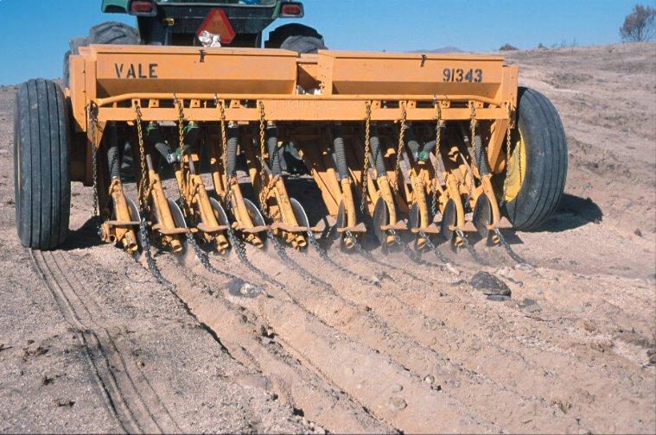
Watershed Rehab/Treatment Methods
Watershed Work in Progress
Chaining Photos

Slide 20
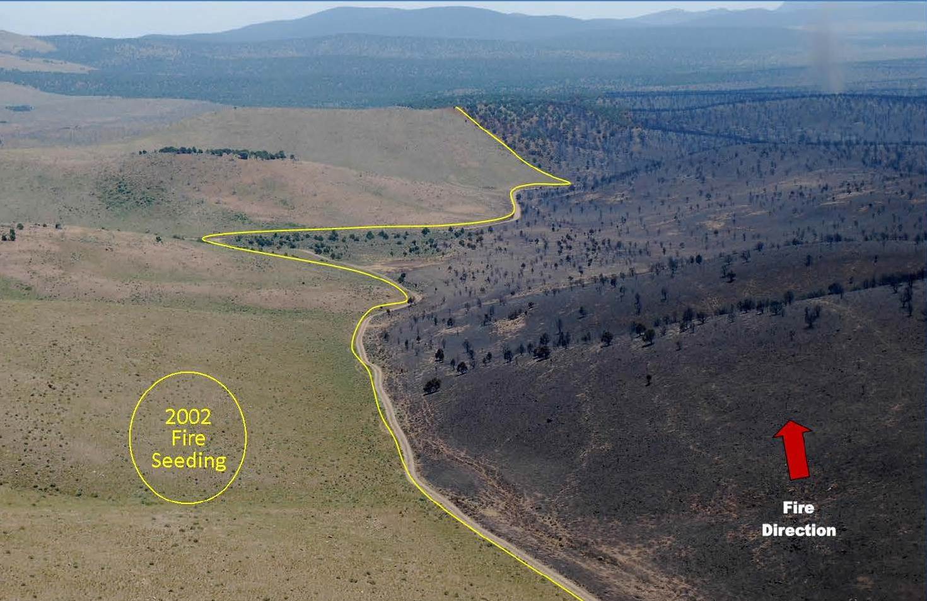
2013 Black Mountain Fire
Watershed Restoration Initiative
Post Fire Seeding
Saves Dollars, Habitat
Helps Firefighters Fight Future Fires Reducing Their Size
3 miles southeast of Minersville
2002 Maple springs fire re-seeded with diverse flame resistant seed mix
Millions of fire suppression dollars saved
Thousands of acres saved from burning

Slide 21
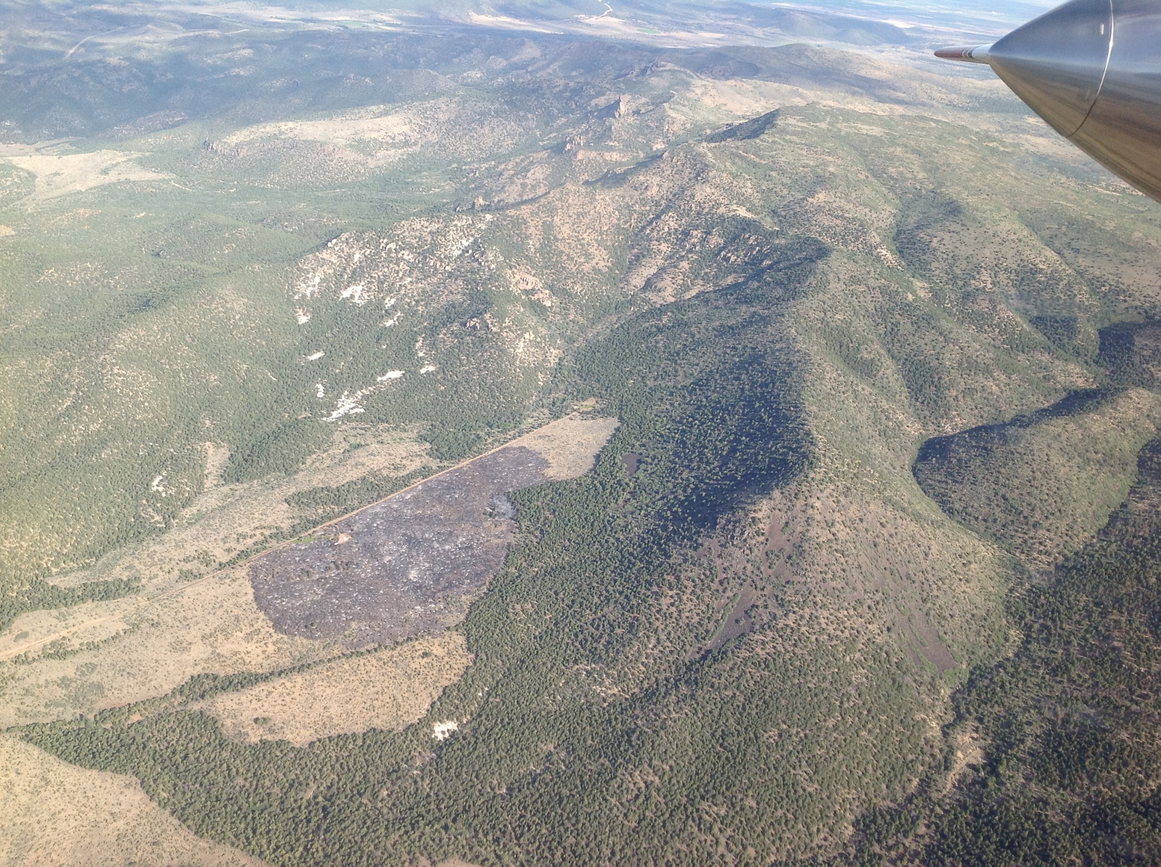
2012 Atchinson Fire
Utah’s
Watershed Restoration Initiative – Pre-Suppression Projects Help Slow or Stop Large, Destructive, Out of Control Wildfires
2 miles from towns of Central and Pine Valley
Trees cleared in 1970’s and 2008 by WRI
August 2012 lightning started fire
Minimal spread (51 acres)

Slide 22
Benefits of Watershed Initiative:
Increased forage (Livestock and Wildlife)
Reduced fire costs and damages
Increased productivity of watersheds (increased volume and quality of yield)
Protection of sensitive species
Reduced siltation in streams and reservoirs

Slide 24
Total Dollars in 2016 Budget for Healthy Lands?
Forestry & Fire Pre-suppression $2 Million
Catastrophic Fire Prevention ---- $2.5 Million
Watershed Restoration $1.8 Million
Matching Fires (NRCS) $1.7 Million
We’ll Match 5 to 1 $8.0 Million total
SageGrouse Conservation Easmt. $1.0 Million
Matching Conservation Easmt. >$3.0 Million
New Industry Mitigation Banking ???
Multi-State litigation Reserve $1.0 Million
“ “ Effort to retain Management $2.0 Million

