Slide 1
Water Use Groups
Rural Water Association of Utah
Water Rights Certification Training
April 10 – 11, 2014

Slide 2
Water Use Groups
What is a Water Use Group?
Database Issues – Is it Correct?
If Correct, What Do I Do?
If NOT Correct, What Do I Do?
What is the Purpose of Defining Beneficial Use Amounts?

Slide 3
Water Use Groups - Basics
Water Use Groups Consist of:
Water Use Group Number
Water Right Number(s)
Beneficial Use(s)
Period of Use(s)
Place(s) of Use(s)

Slide 4
Group & Water Right Number(s)

Slide 5
Beneficial Use(s)

Slide 6
Period of Use(s)

Slide 7
Place(s) of Use

Slide 8
Water Use Group - Basics
Water Use Groups can contain several Water Rights
Water Use Groups are used to define the extent of the use of the group such as place of use, type of use, or quantity
In a Water Use Group, there may be one or multiple water rights owned by various owners

Slide 9
Terms
Supplemental
Group Contribution
Beneficial Use Amount
Group Total
Sole supply
Notes:
Show locations from the database in following slides

Slide 10
Group Contribution/Beneficial Use Amount

Slide 11
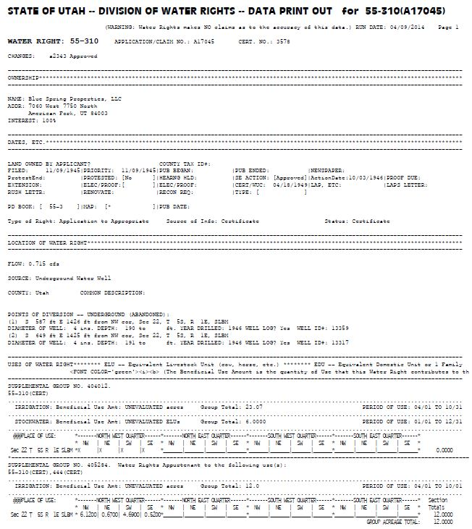
Group Total

Slide 12
Sole Supply

Slide 13
Water Right(s) in Water Use Group from a different drainage
Federal water project imports water from another basin used as a supplemental supply for use of water
Other trans-basin diversions/imports

Slide 14
Irrigation Company Rights

Slide 15
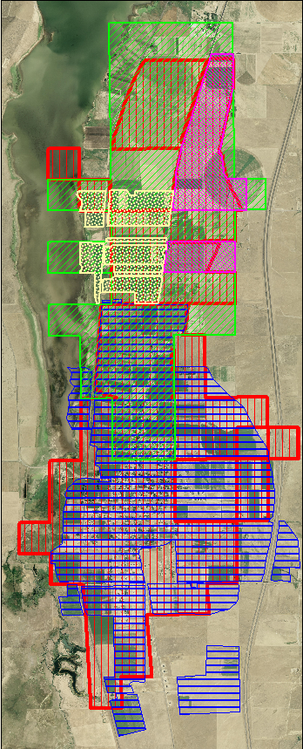
Water Use Overlap
Private Water Rights
Company Water Rights
Project Water
Trans-basin Diversions

Slide 16
Water Use Group - Basics
There may be one or more point(s) of diversion for the water rights affecting a Water Use Group
A point of diversion may be an underground or surface source of water

Slide 17
Water Use Group - Basics

Slide 18
Why is it important to determine group contribution/beneficial use amount?
To ensure the amount of water and beneficial use of the individual Water Right in the group is fully defined
Ensure that no enlargement of the Water Right occurs

Slide 19
Beneficial Use - Example

Slide 20
Water Use Groups – A water use group defines…
…the place of use
…if a water right is supplemental with other water rights
…the group contribution (aka beneficial use amount) of a water right
…the sole supply of a water right

Slide 21
Water Use Groups – Place of Use
Defines the authorized and recognized place of use for the use of water described in the use group
Should be consistent with the information contained in the State Engineer’s records
May include more than one Section or Quarter Section of land

Slide 23
Water Use Groups - Caution
Data entry errors
Database conversion - February 2006

Slide 24
Water Use Groups May Be Altered as a result of:
Resolving errors, deficiencies, or ambiguities
Not consistent with the water right files
Declaration of Beneficial Use Amounts
Application for Apportionment of Beneficial Use Amounts

Slide 25
Water Use Groups – Sources of Information for Group Review
Information contained in the water right file
Published Proposed Determination Book and Hydrographic Survey Maps
Judicial Decree

Slide 26
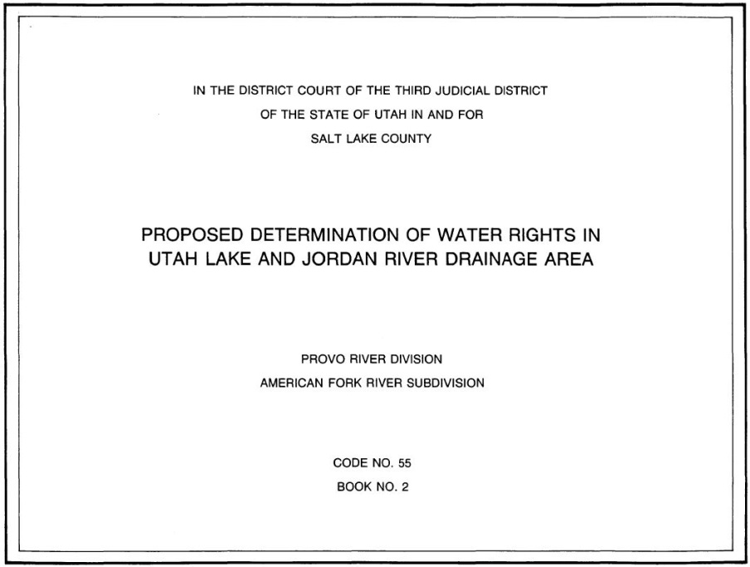
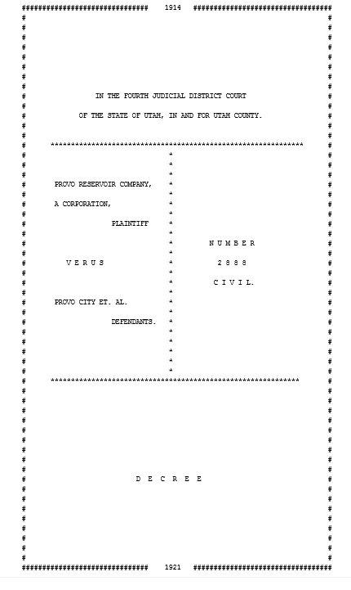
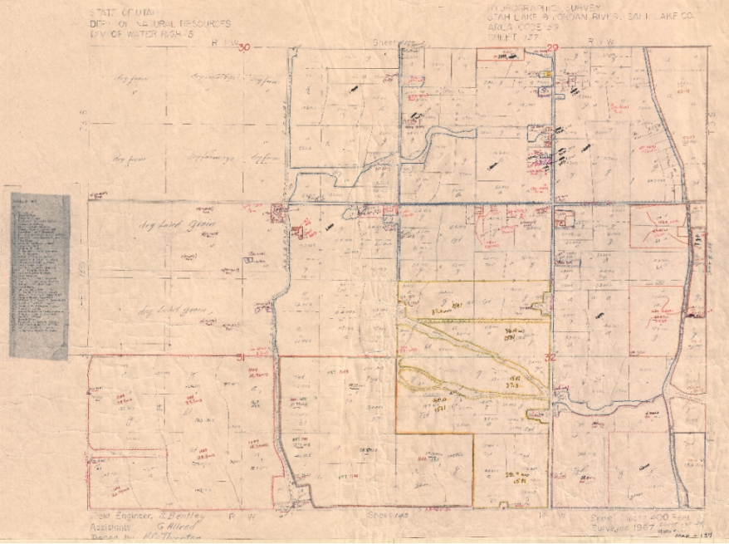
Proposed Determination
Certificate
Decree
Hydrographic Survey Map

Slide 27
If an error is believed to exist in a Water Use Group, what should you do?
Written Request
Submitter includes how the database should be
State Engineer review file and database
Ensure Database is consistent with file

Slide 28
Water Use Groups – Declaration of Beneficial Use
R655-16
Water Right Number(s)
Declare Beneficial Use Amount (aka Group Contribution)
Need initials
Need signatures
Owners of record
All parties involved*
Notes:
Used to declare the Beneficial Use Amount (aka Group Contribution) of some or all of the individual water right in a Water Use Group
Beneficial Use Amount is the amount of Beneficial Use a Water Right contributes to a Water Use Group

Slide 29
Application for Apportionment of Beneficial Use Amounts
R655-16
Declaration first
Apportionment Application signed by Apportionment Applicant
Submitted with
Declaration of Beneficial Use
Supporting documentation

Slide 30
Reasons to Define a Water Right Beneficial Use
Segregation Application
Change Applications

Slide 31
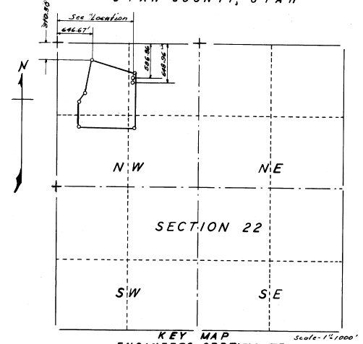
Water Use Group(s) Example
WR #1
Certificated 1949
2 wells
23.07 acres irrigation

Slide 32
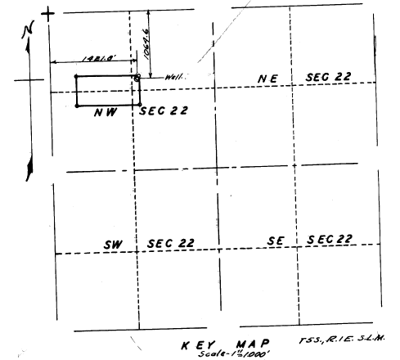
Water Use Group(s) Example
WR #2
Certificated 1950 (supplemental with WR #1)
1 Well
12 acres irrigation

Slide 33
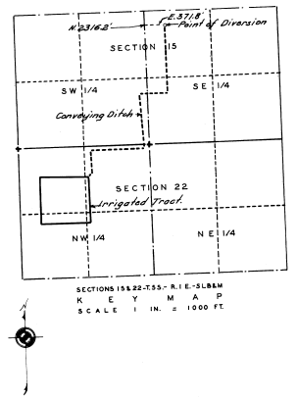
Water Use Group(s) Example
WR #3
Diligence Claim 1956
Surface Point of Diversion
22.37 acres irrigation

Slide 34
Water Use Groups Reflects:
WR #1
Group A = 23.07 acres
Group B = 12.0 acres (supplemental w/ WR #2)
WR #2
Group B = 12.0 acres (supplemental w/ WR #1)
WR #3
Group C = 22.37
Group Totals = 57.44

Slide 35
Water Use Group(s) Example: WR #1
w
w

Slide 36
Water Use Group(s) Example: WR #2
w

Slide 37
Water Use Group(s) Example: WR #3
S

Slide 38
Water Use Group(s) Example: WR #3

Slide 39
Water Use Group(s) Example
57.44 acre
???

Slide 40
WR #1, #2, & #3

Slide 41
WR #1 & #3

Slide 42
WR #3

Slide 43
WR #1

Slide 44
Water Use Group should reflect
Group A
10.9 acres (approx.)
WR #1, #2, #3
Group B
9.58 acres (approx.)
WR #1, #3
Group C
1.4 acres (approx.)
WR #3
Group D
3.34 acres (approx.)
WR #1
Group Total = 25.22 acres
Not 57.44 acres
D
C
B
A

Slide 45
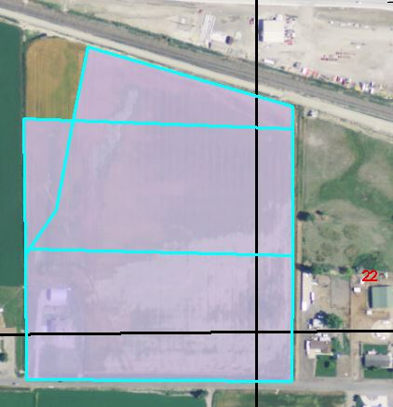
What Now?
Written Request
Includes how the database should be
State Engineer review file and database
Ensure Database is consistent with file
D
C
B
A

Slide 46
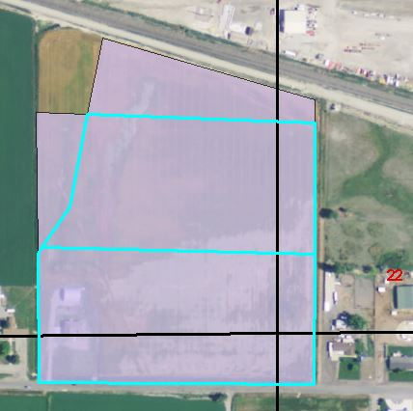
What Now? - Declaration
Declaration of Beneficial Use
Defines Beneficial Use Amount (aka Group Contribution)
Beneficial Use Amount is the amount of Beneficial Use a Water Right contributes to a Water Use Group
B
A
Notes:
some or all of the water rights in a Water Use Group

Slide 47
What Now? - Apportionment
R655-16
Declaration first
Apportionment Application signed by Apportionment Applicant
Submitted with
Declaration of Beneficial Use
Supporting documentation
B
A

Slide 48
What Now?
Segregation
Change Application

Slide 49
Water Use Groups
Water Use Group Number
Water Right Number(s)
Beneficial Use(s)
Period of Use(s)
Place(s) of Use(s)

Slide 50
Terms
Supplemental
Group Contribution
Beneficial Use Amount
Group Total
Sole supply

Slide 51
Water Right Database and Research Materials
Caution – Database errors
Information Contained in Water Right Files

Slide 52
Beneficial Use Defined
Beneficial Use Amount (aka Group Contribution)
Group Total
Sole Supply
B
A

Slide 53
Database Modifications
Errors and/or Ambiguities
Written Request
Declaration of Beneficial Use
Application for Apportionment
B
A

Slide 54
Purpose of Defining Beneficial Use Amounts (aka Group Contribution)
Ensure no enlargement occurs
Order and Certainty
Segregation Application
Change Application

Slide 55
What is a Water Use Group?
Database Issues – Is it Correct?
If Correct, What Do I Do?
If NOT Correct, What Do I Do?
What is the Purpose of Defining Beneficial Use Amounts?

Slide 56
QUESTIONS?

