Slide 1
Water Users Workshop 2014
Dam Safety Issues
David K. Marble, P.E.

Slide 3
Outline – We do fix things
Minimum Standards update
Fairview Lake
Manderfield
Rule Changes
Inspections and Monitor
Baker Dam
Red Creek Dam
South Creek Dam

Slide 4
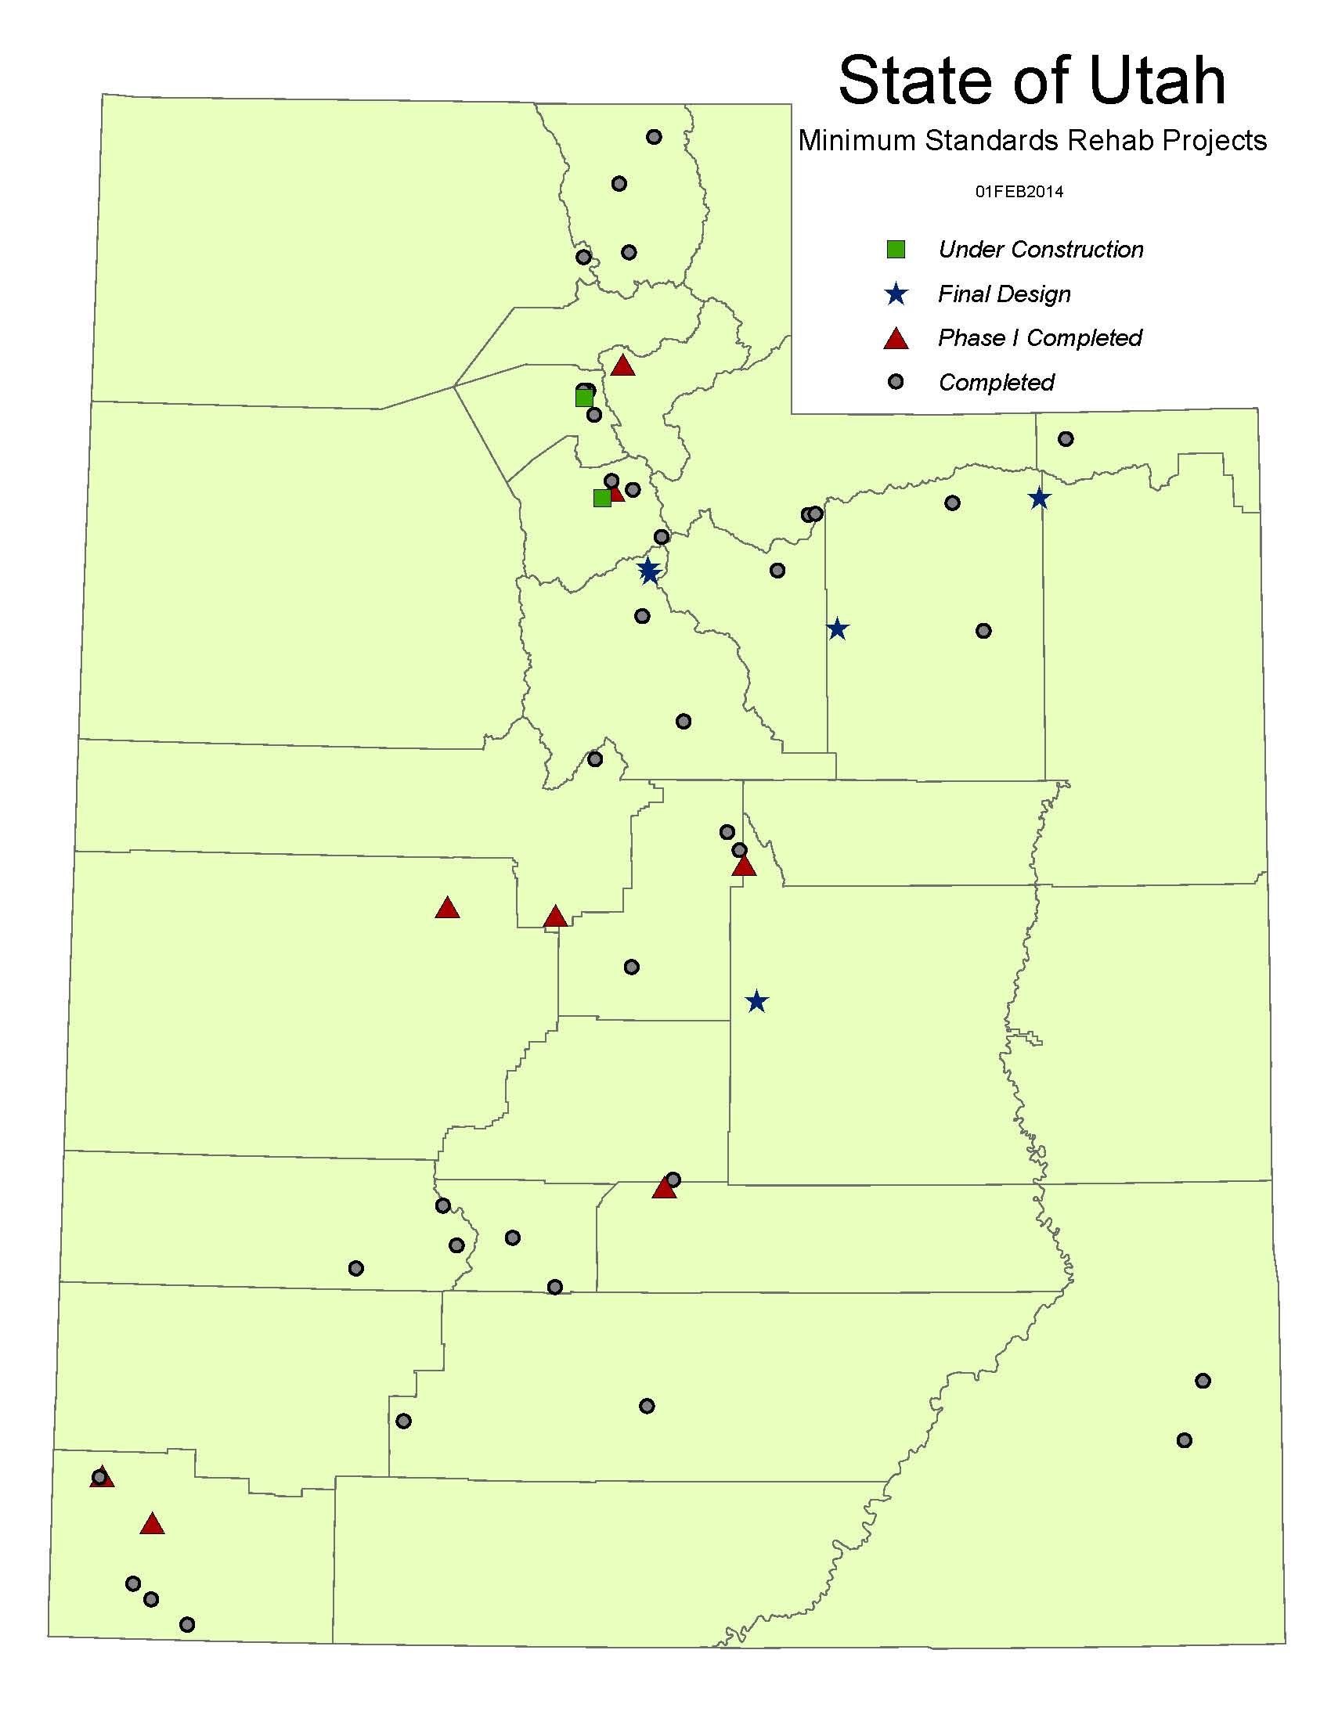
Total dams investigated
- Completed 186
Need Rehab 133
- On-going 14
Construction Projects
- Rehab complete 36
- Rehab partial 9
Under Construction 2
Under Final Design 5
Dams on Priority list 82

Slide 5
Fairview Lake
Designer – Franson Civil Engineers
Safety Deficiencies
- Seepage
- Slope Stability
- Seismic Stability
- Poorly constructed spillway

Slide 7
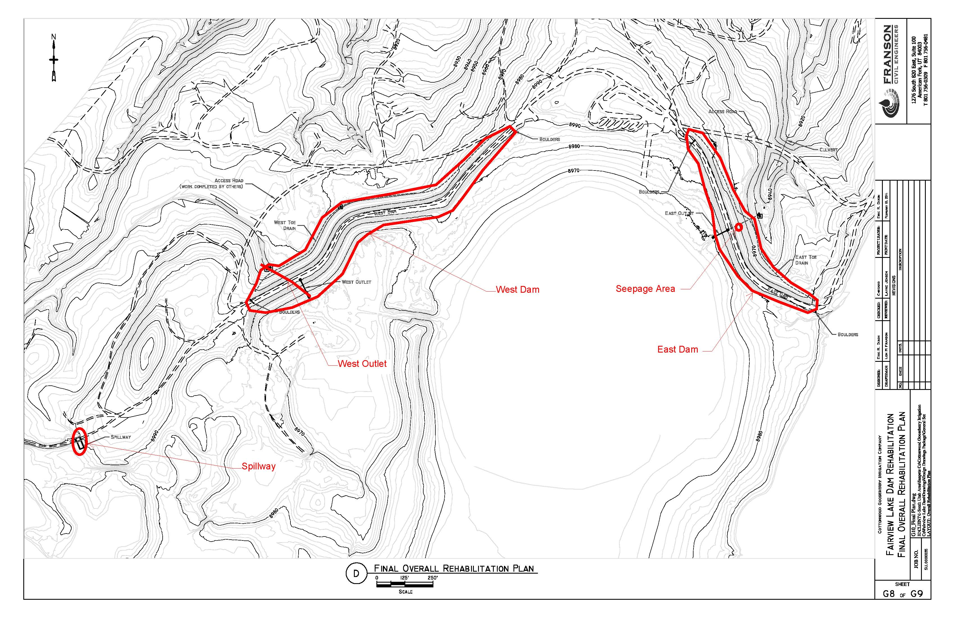

Slide 8
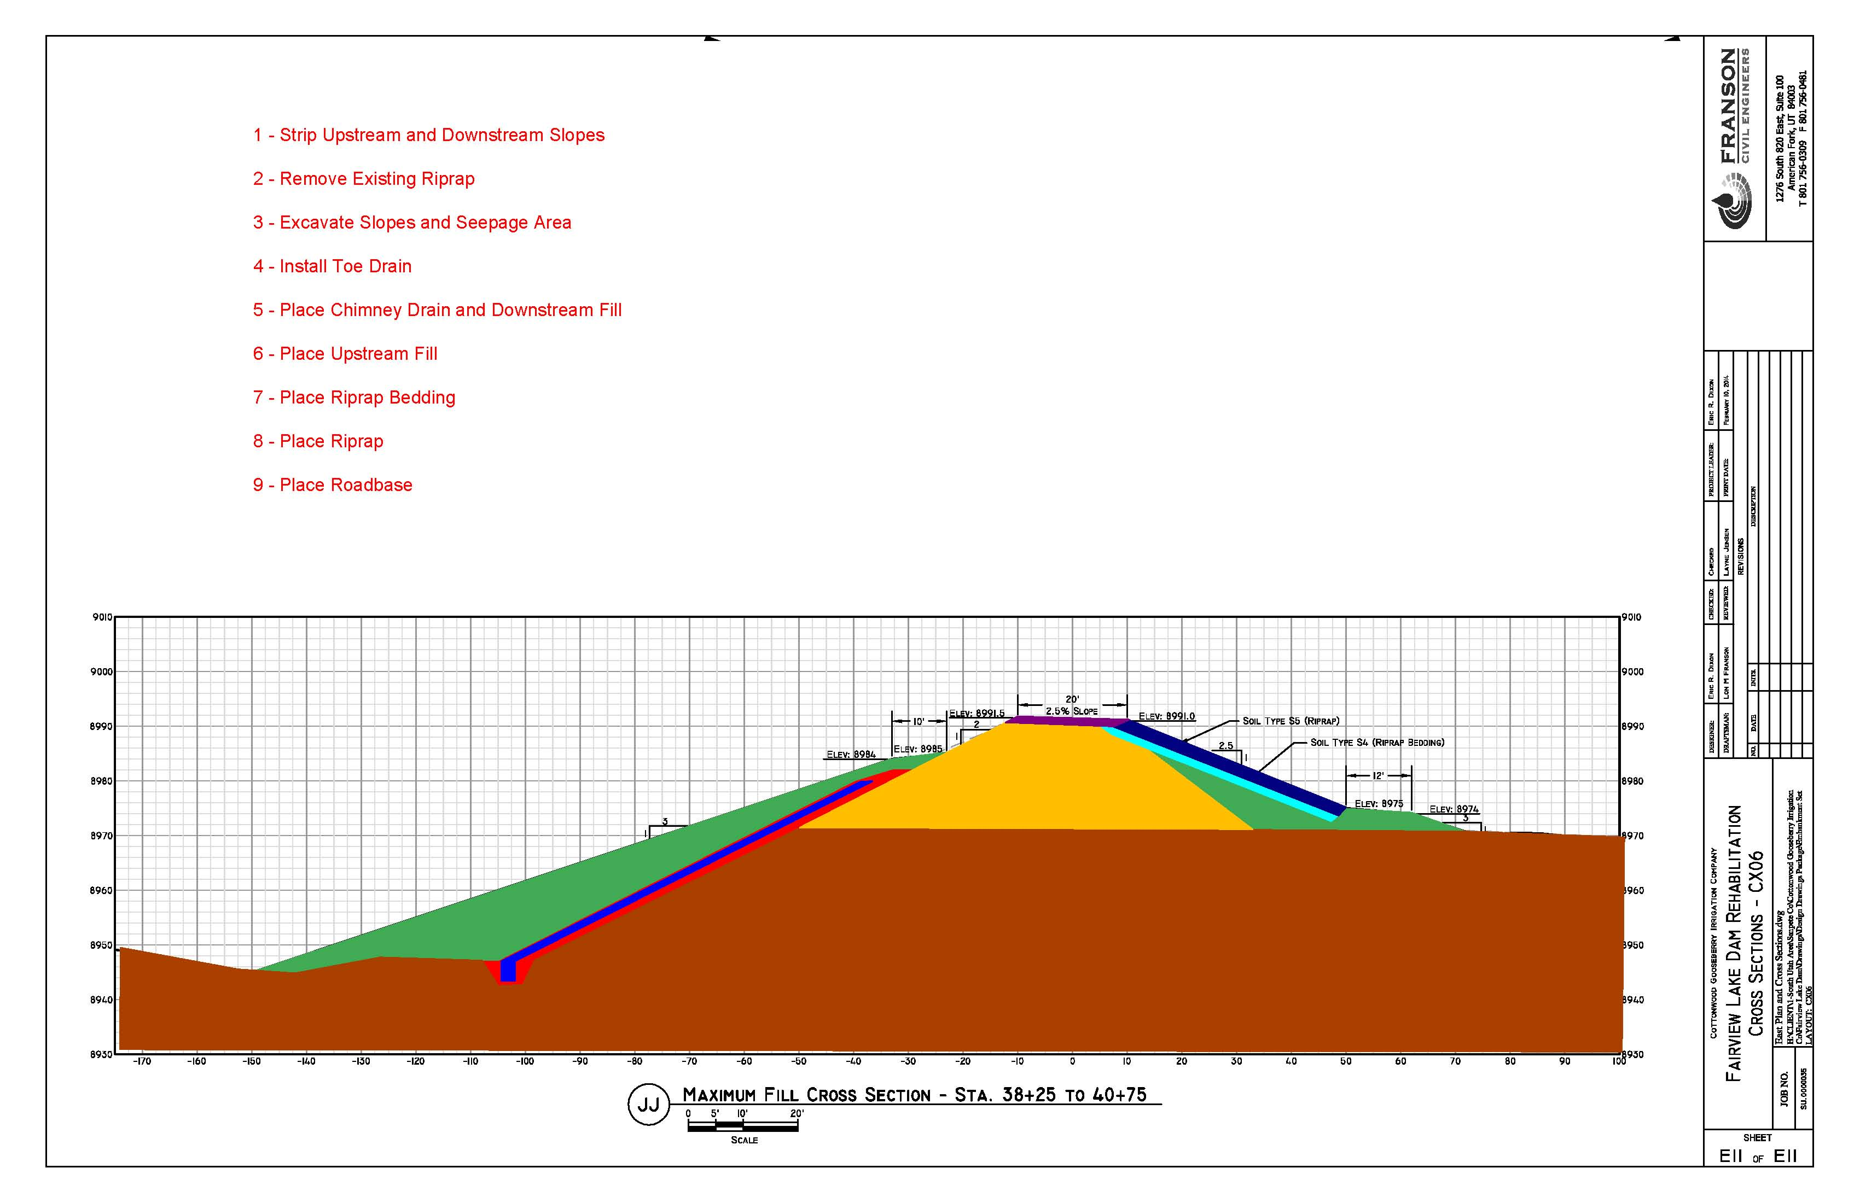

Slide 9
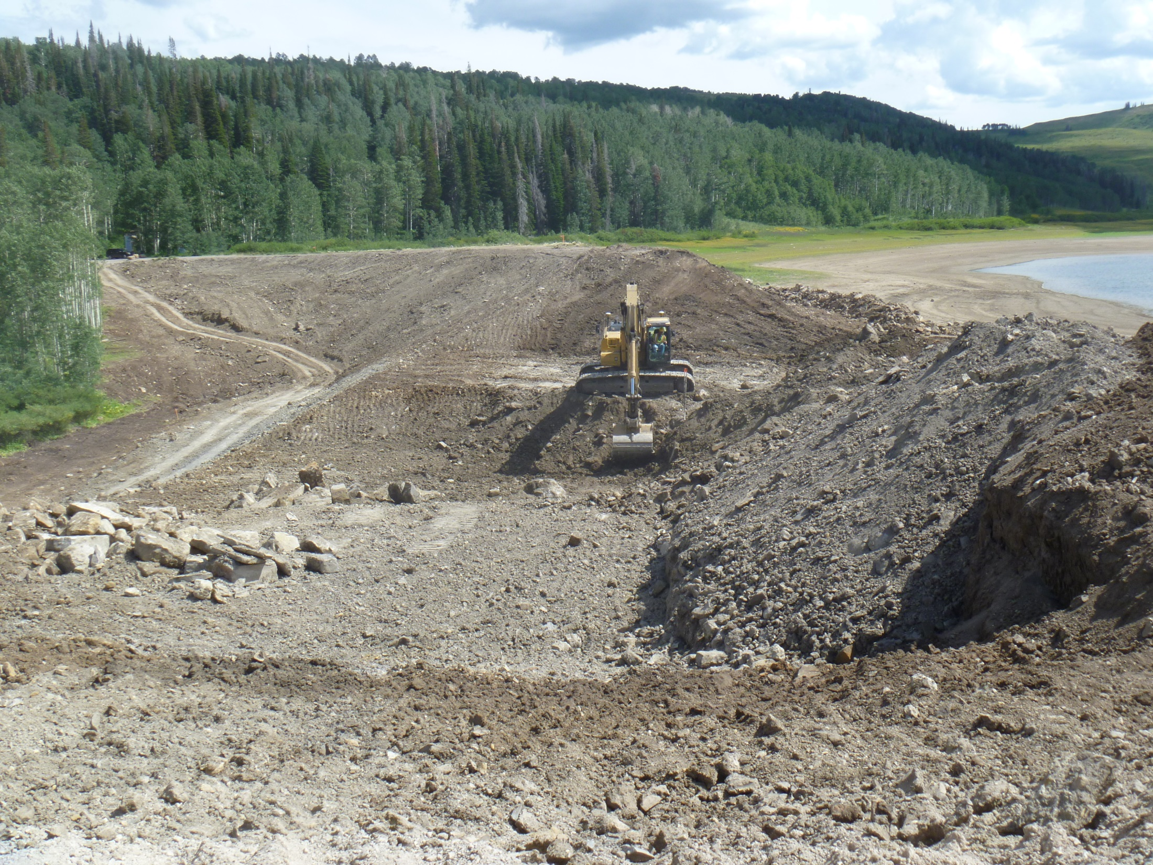

Slide 10
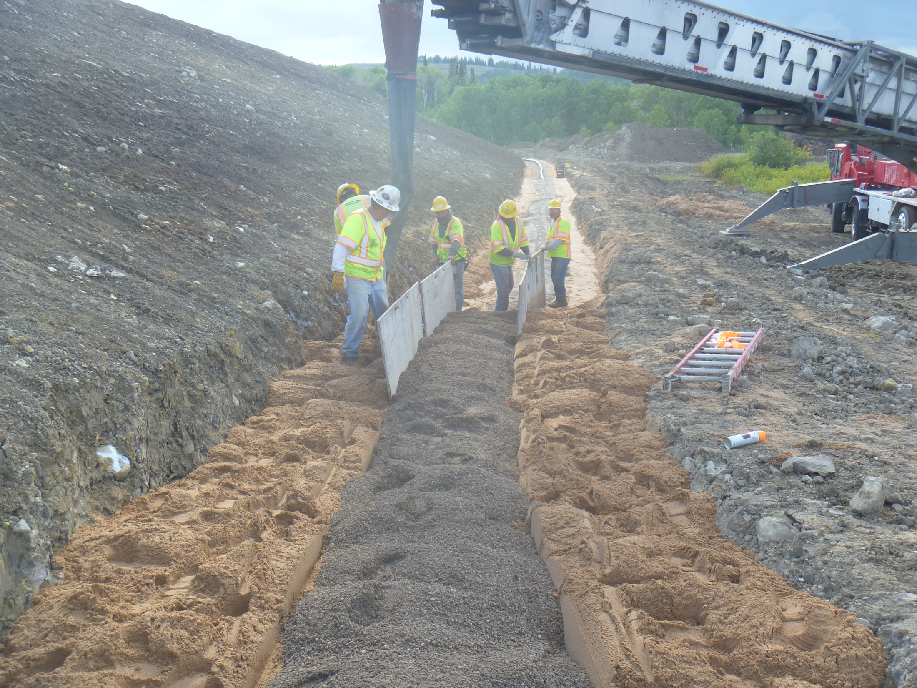

Slide 11
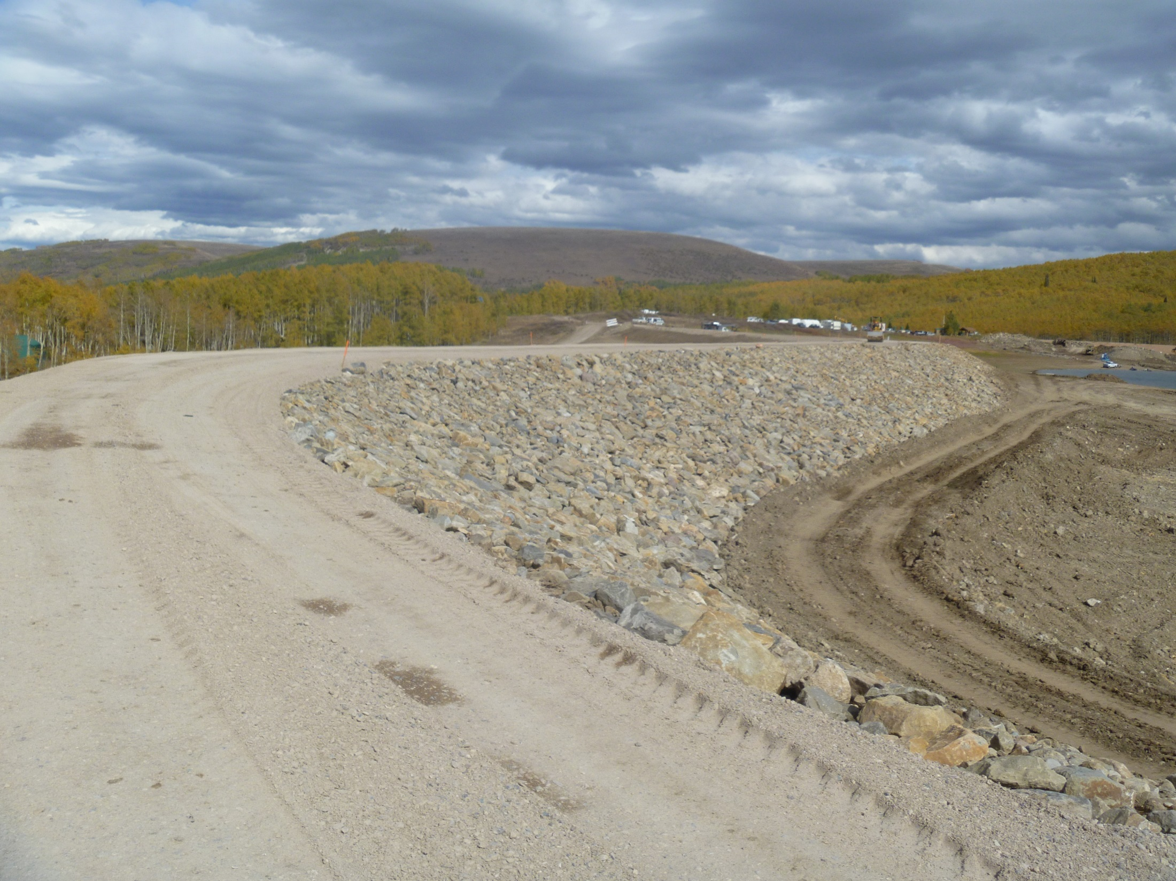

Slide 12
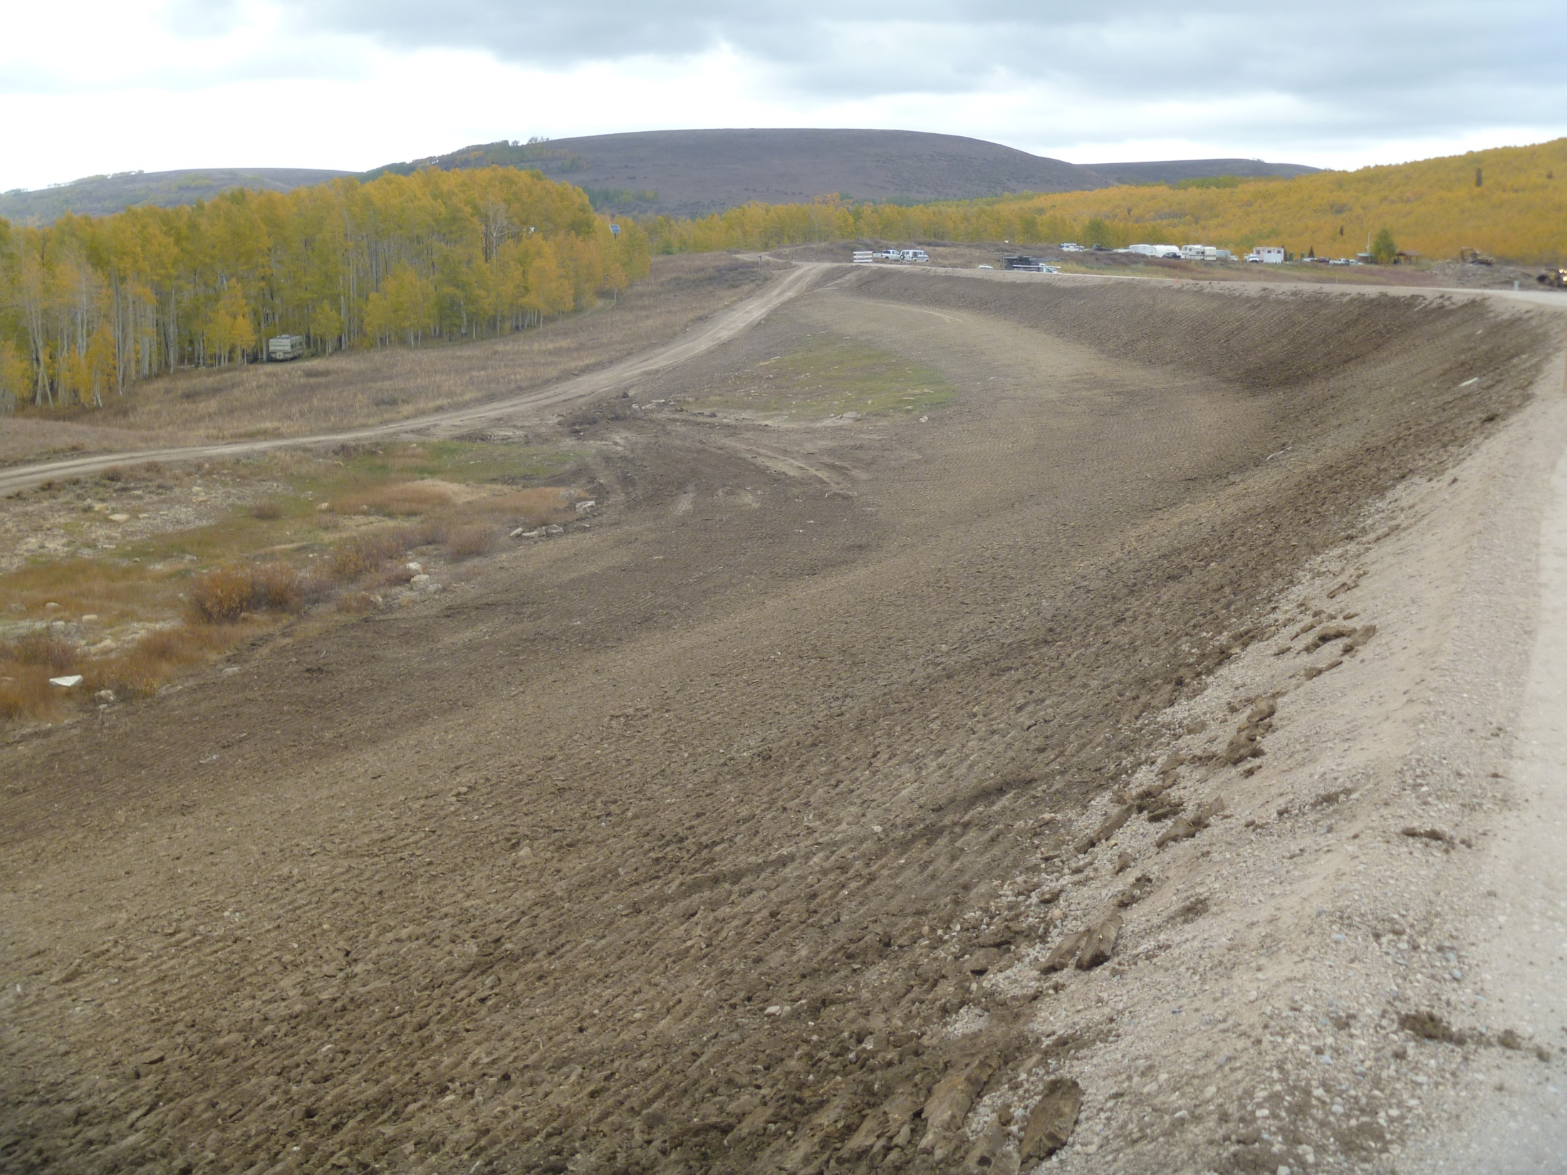

Slide 13
Manderfield Dam
Designer – RB&G Engineering
Safety Deficiencies
- Seepage
- Sinkholes in Basin
- Slope Stability
- Seismic Stability
- Spillway capacity

Slide 14
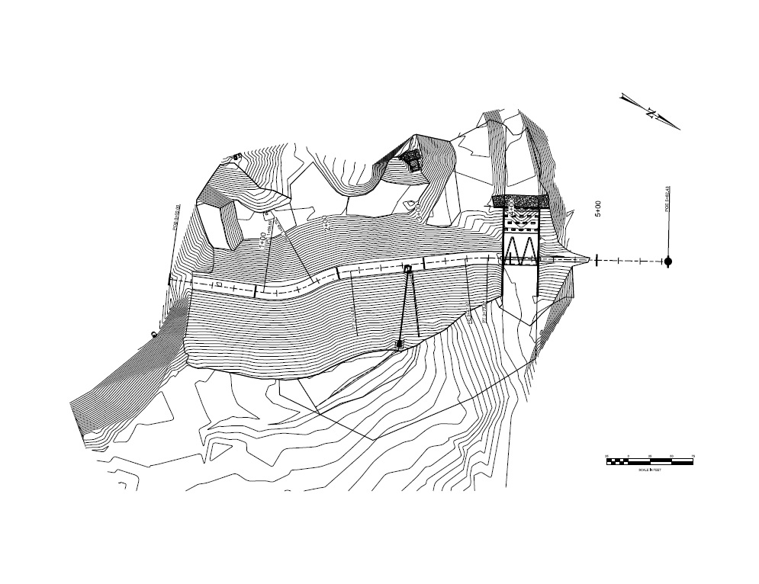

Slide 16
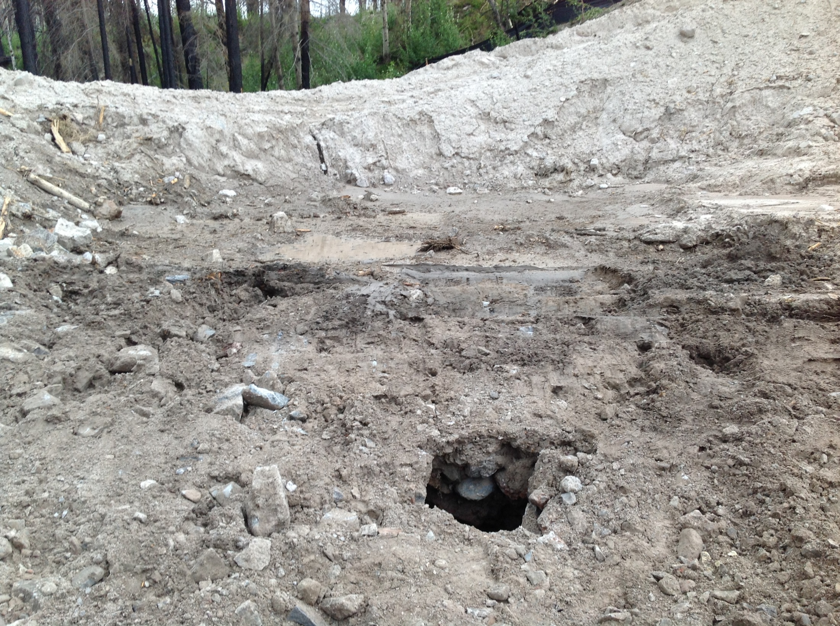

Slide 17
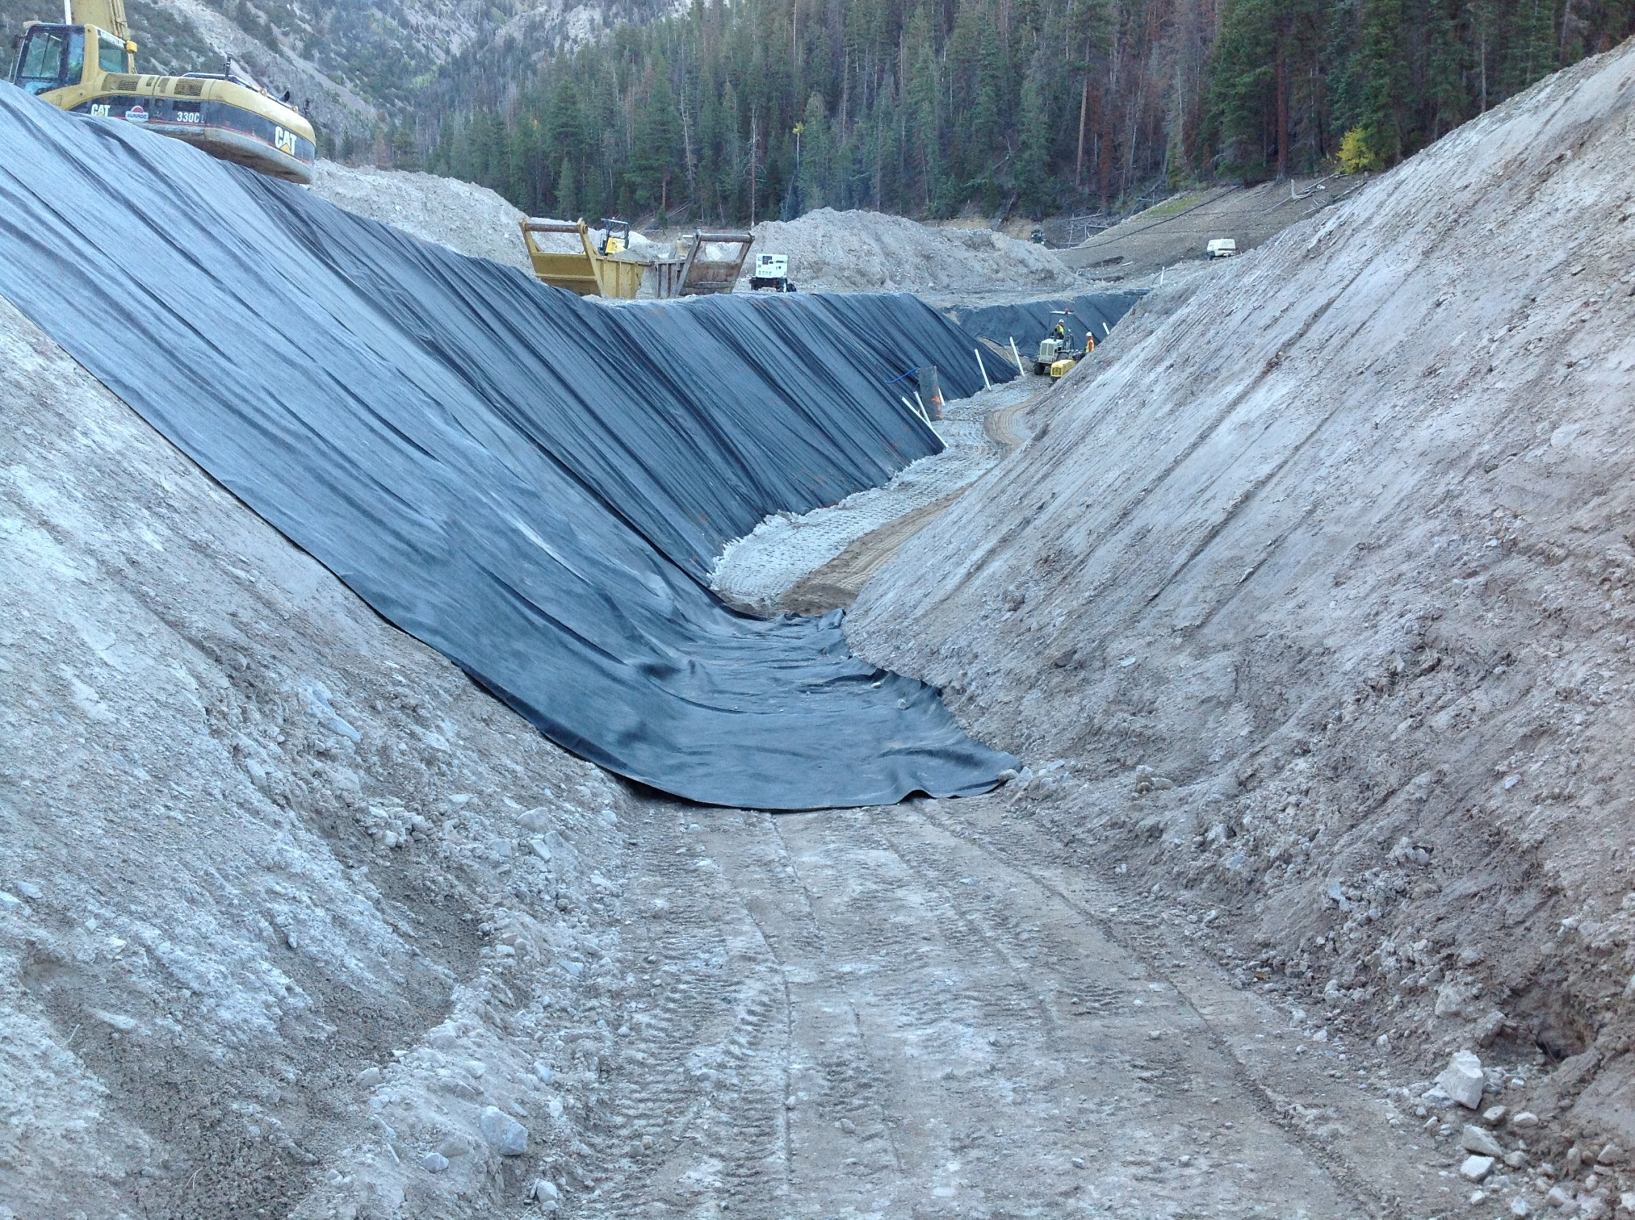

Slide 18
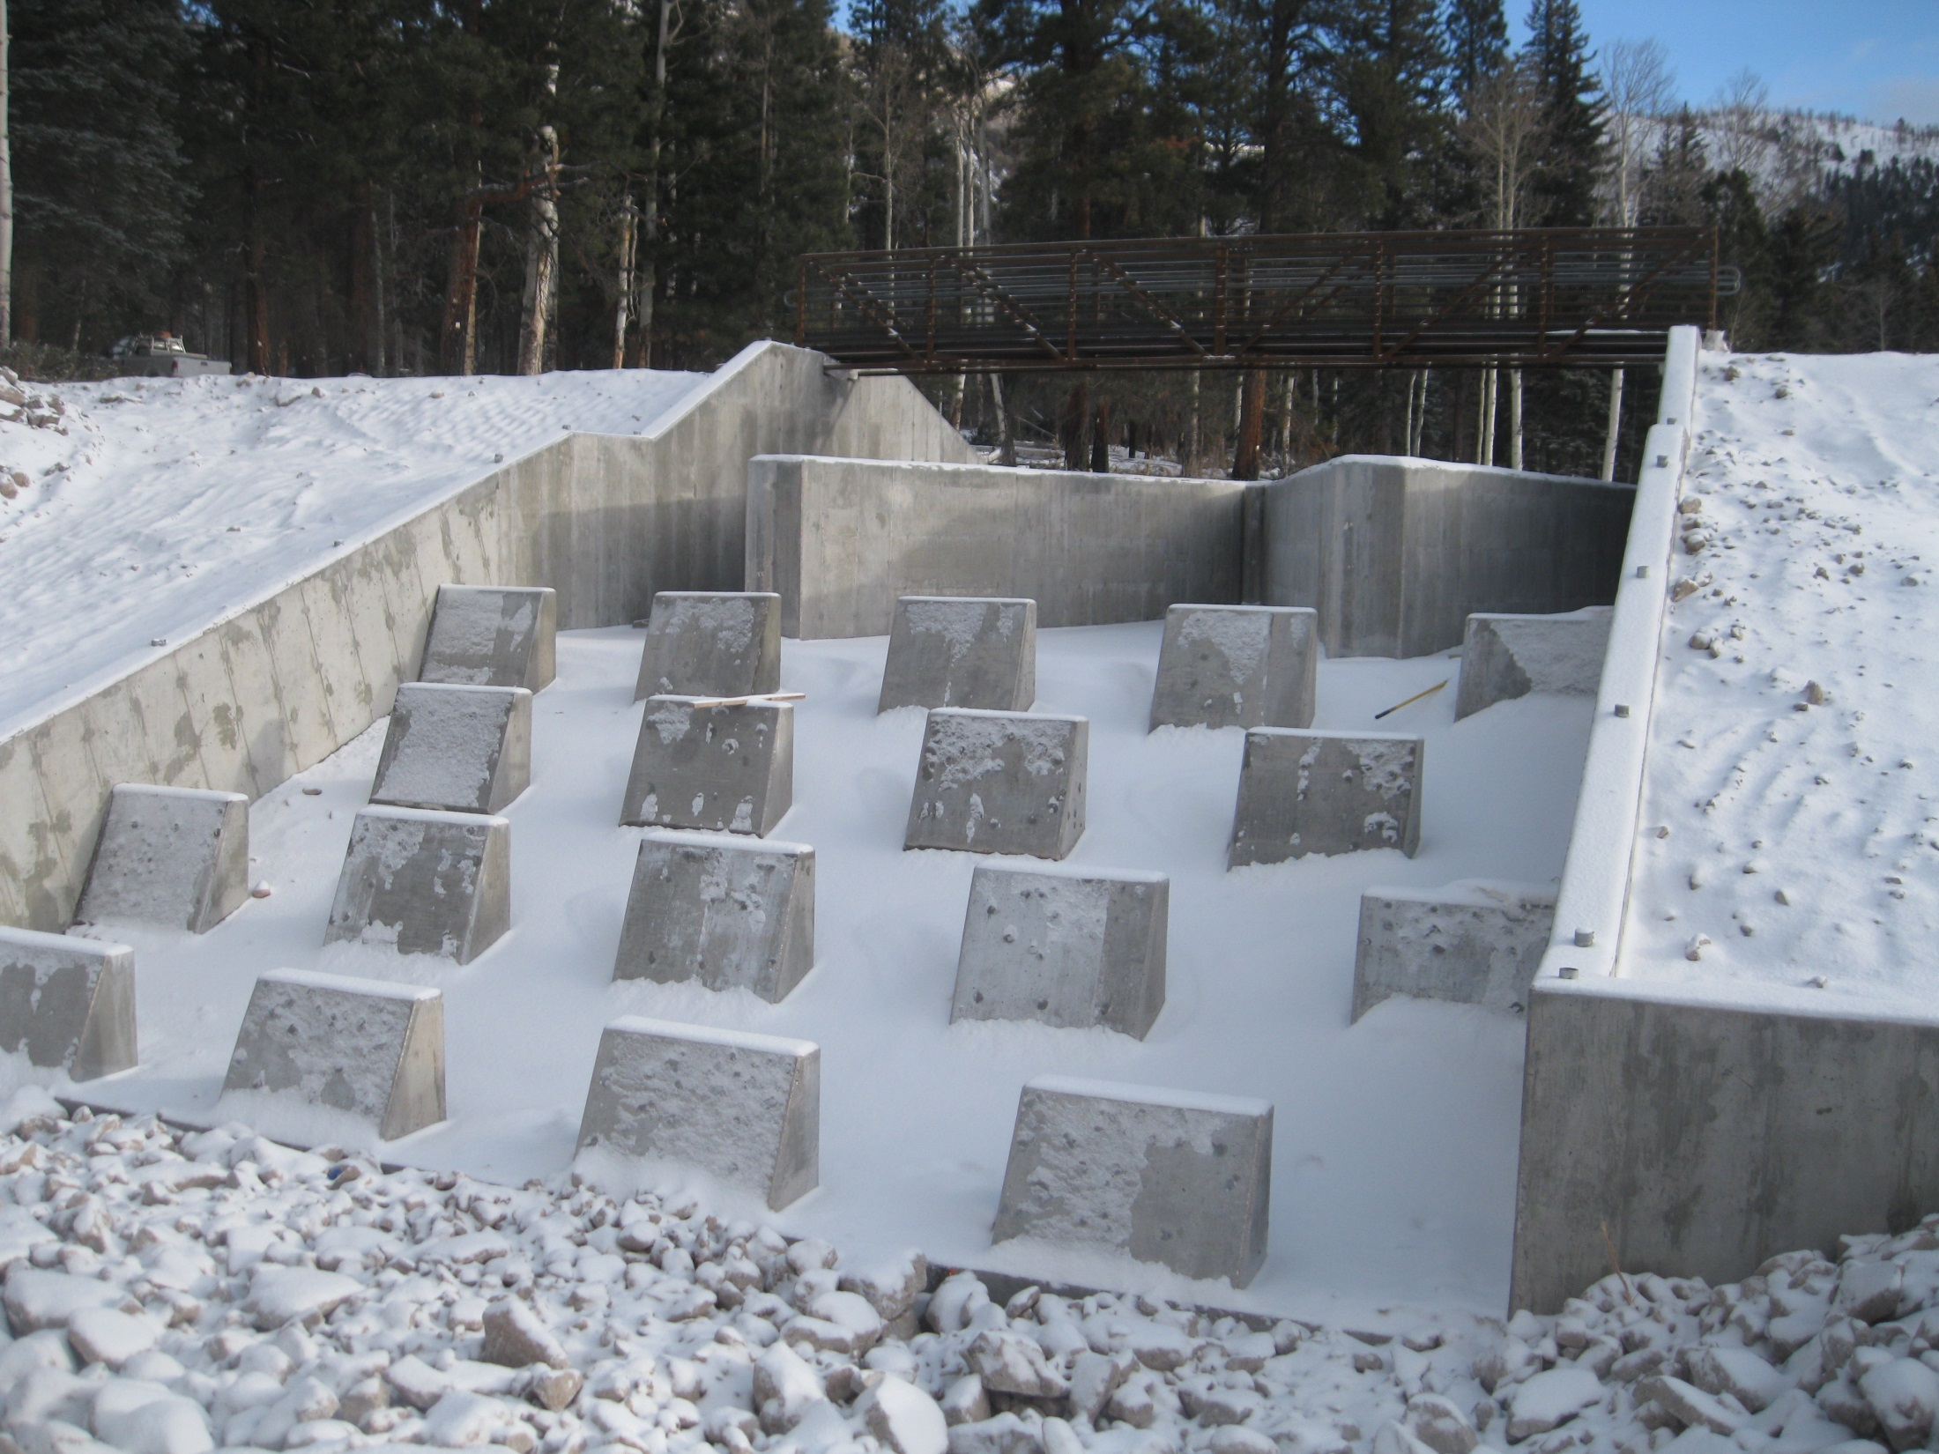

Slide 19
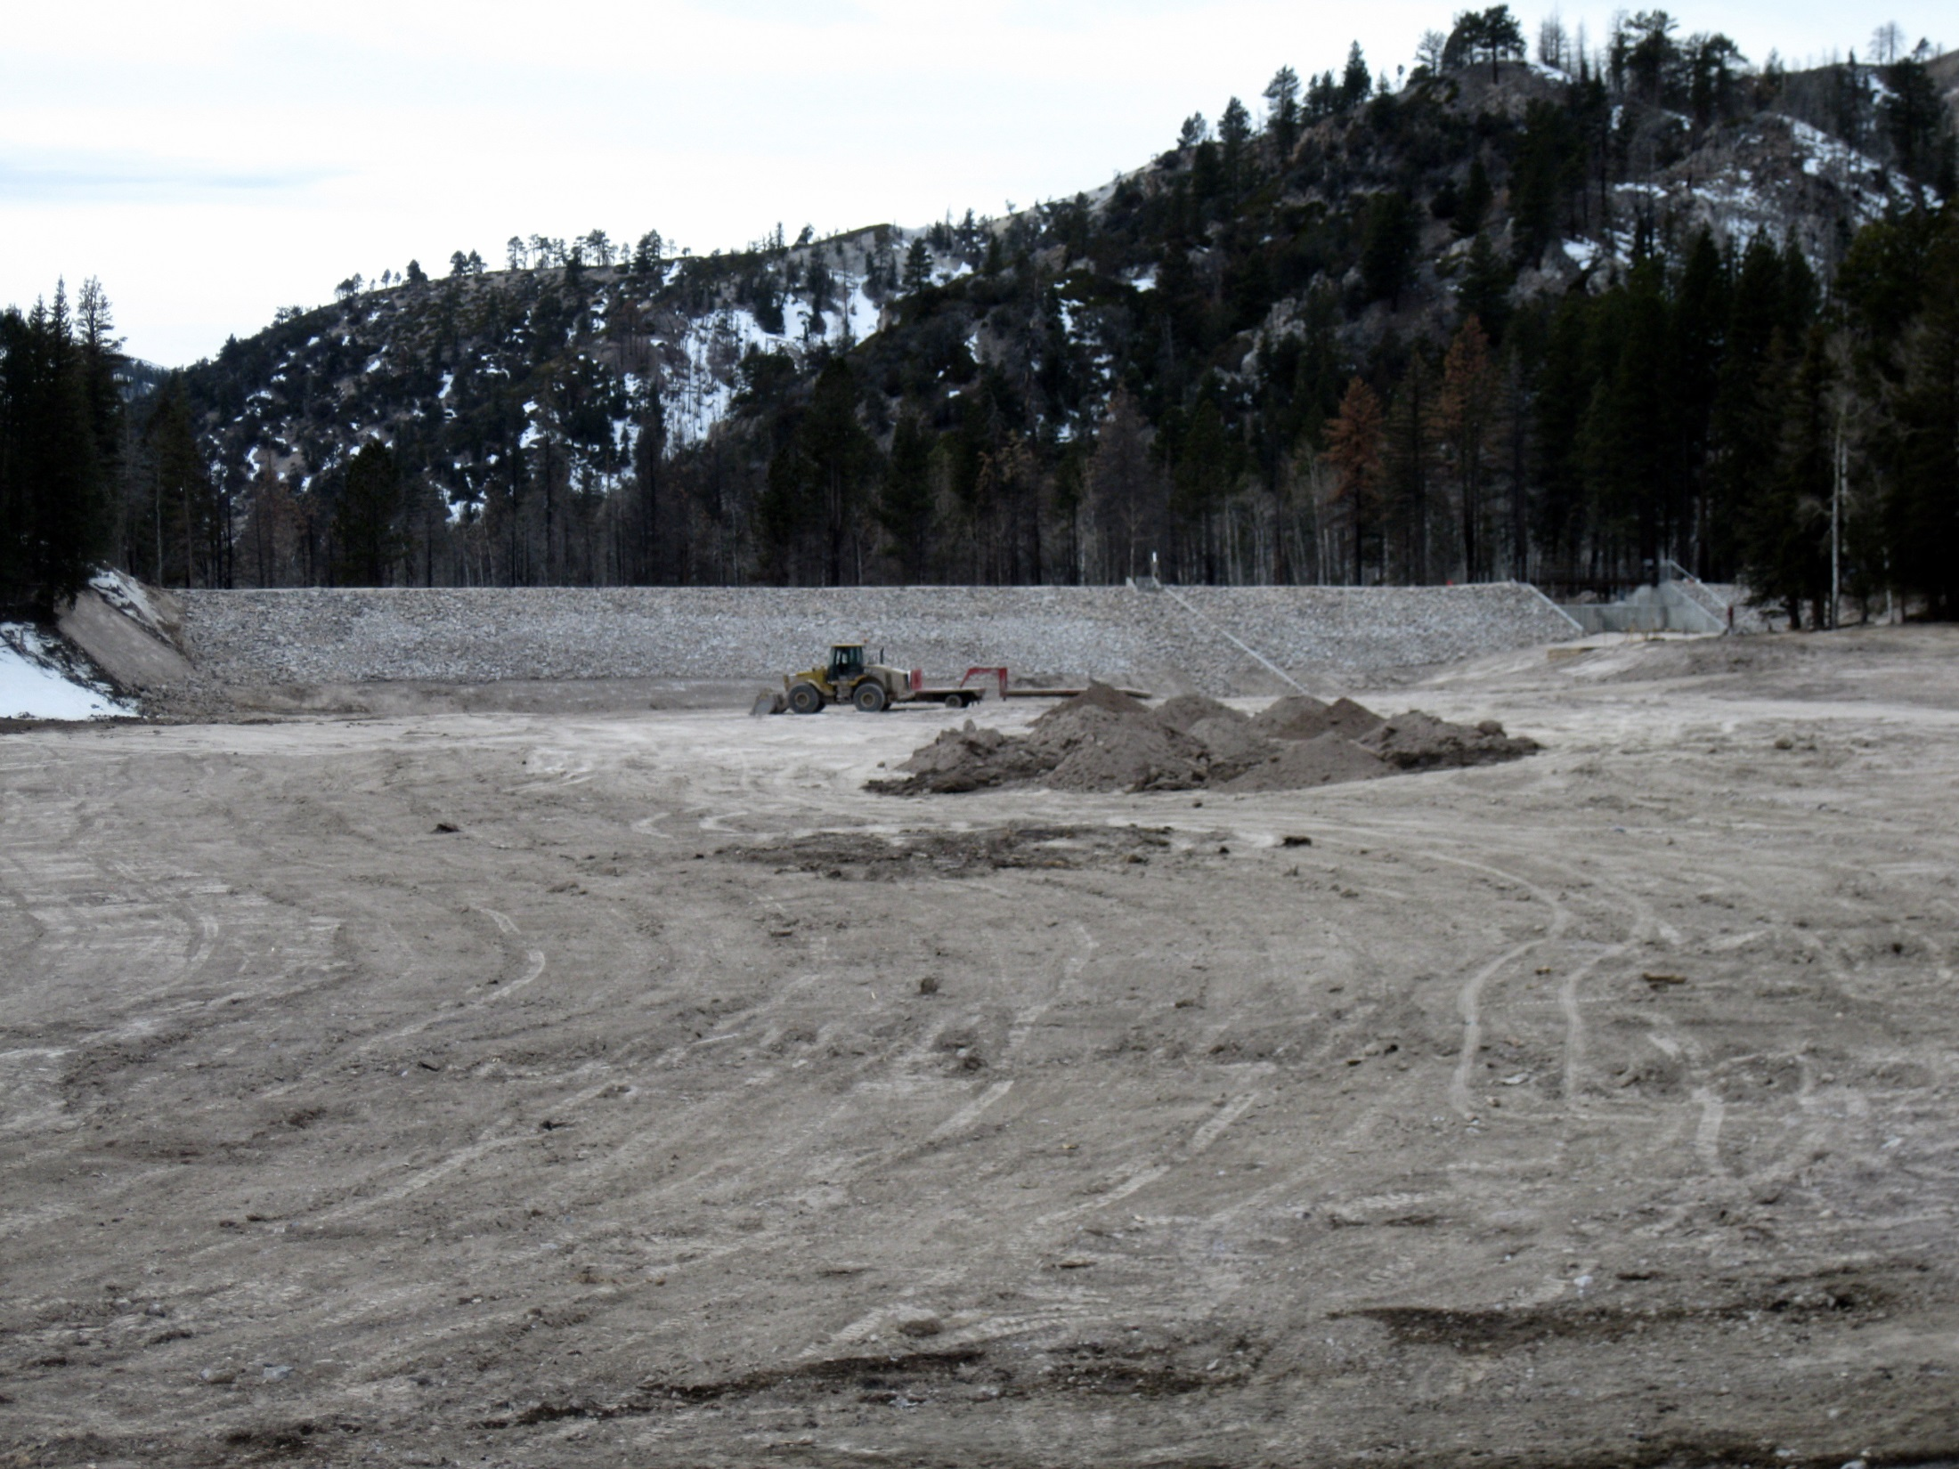

Slide 20
Rule Modifications for dams in Utah
Seismic Standards – 84% attenuation for high and moderate
(In effect) moderate may be reduced to 50%
Spillway Design Flood – Current is PMF for high and moderate
(Proposed) moderate may be reduced to 1,000 year event
Design review process – Preliminary Design
(Proposed) Design Reports/Conceptual Drawings
Design Review Meeting
Final Design
Modified reports, Drawings, Specs

Slide 21
Inspections and Monitoring
Why keep worrying about a dam after many years of successful operation?

Slide 22
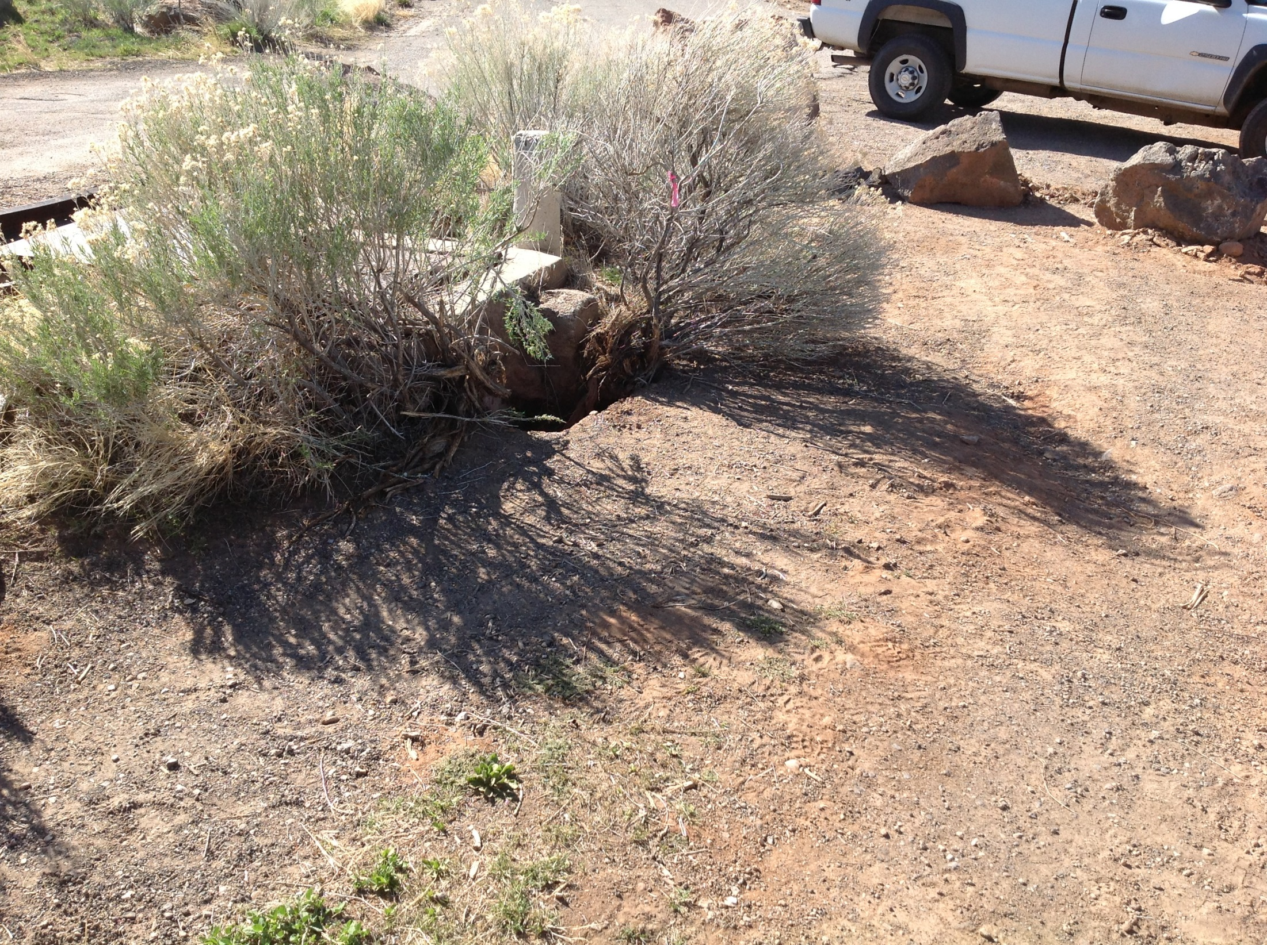
Baker Dam
Built in 1950

Slide 23
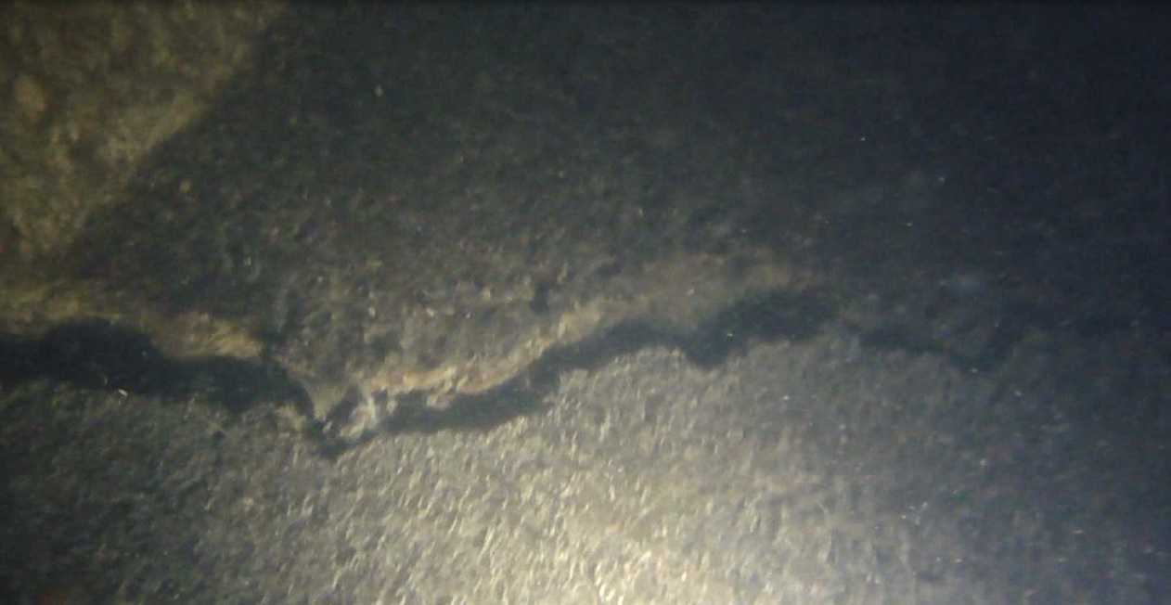

Slide 24
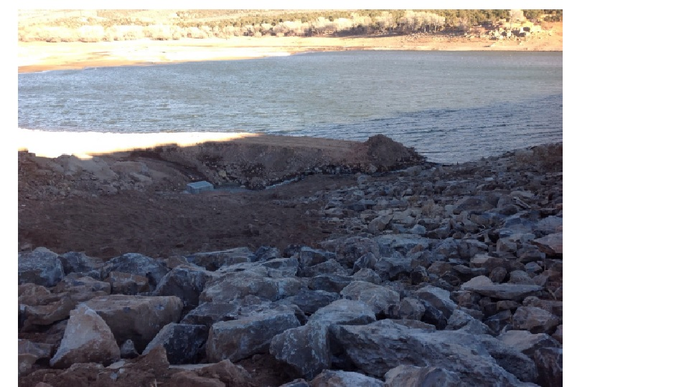

Slide 25
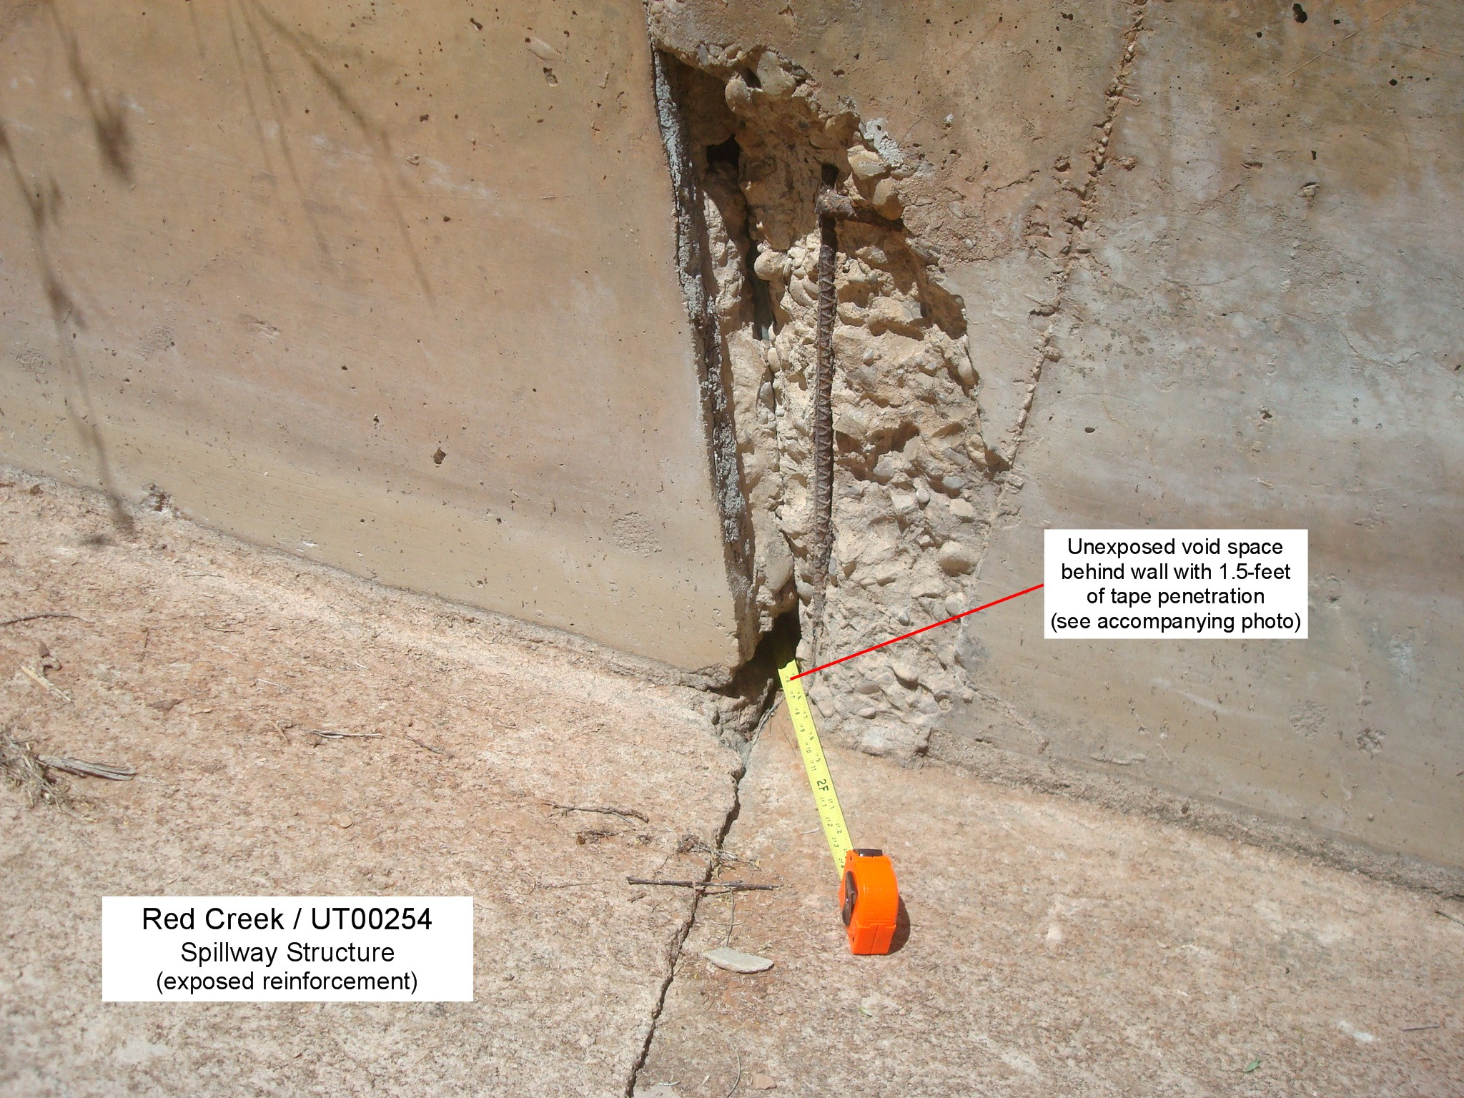
Built in 1960

Slide 26
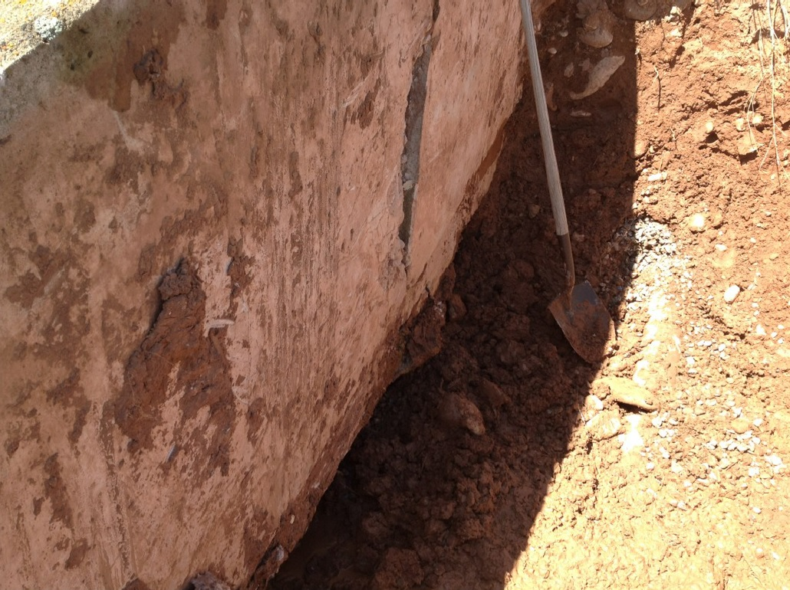

Slide 27
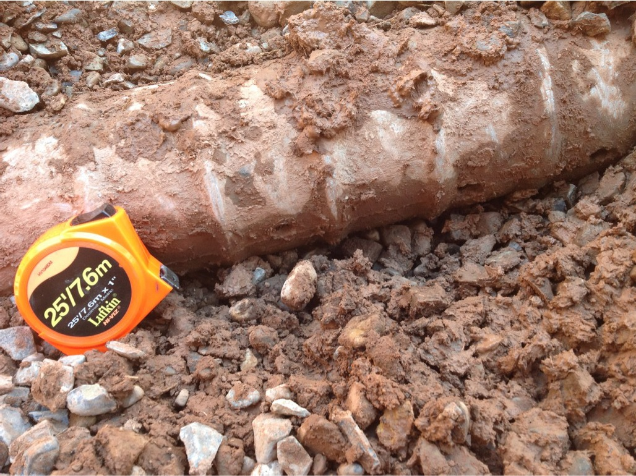

Slide 28
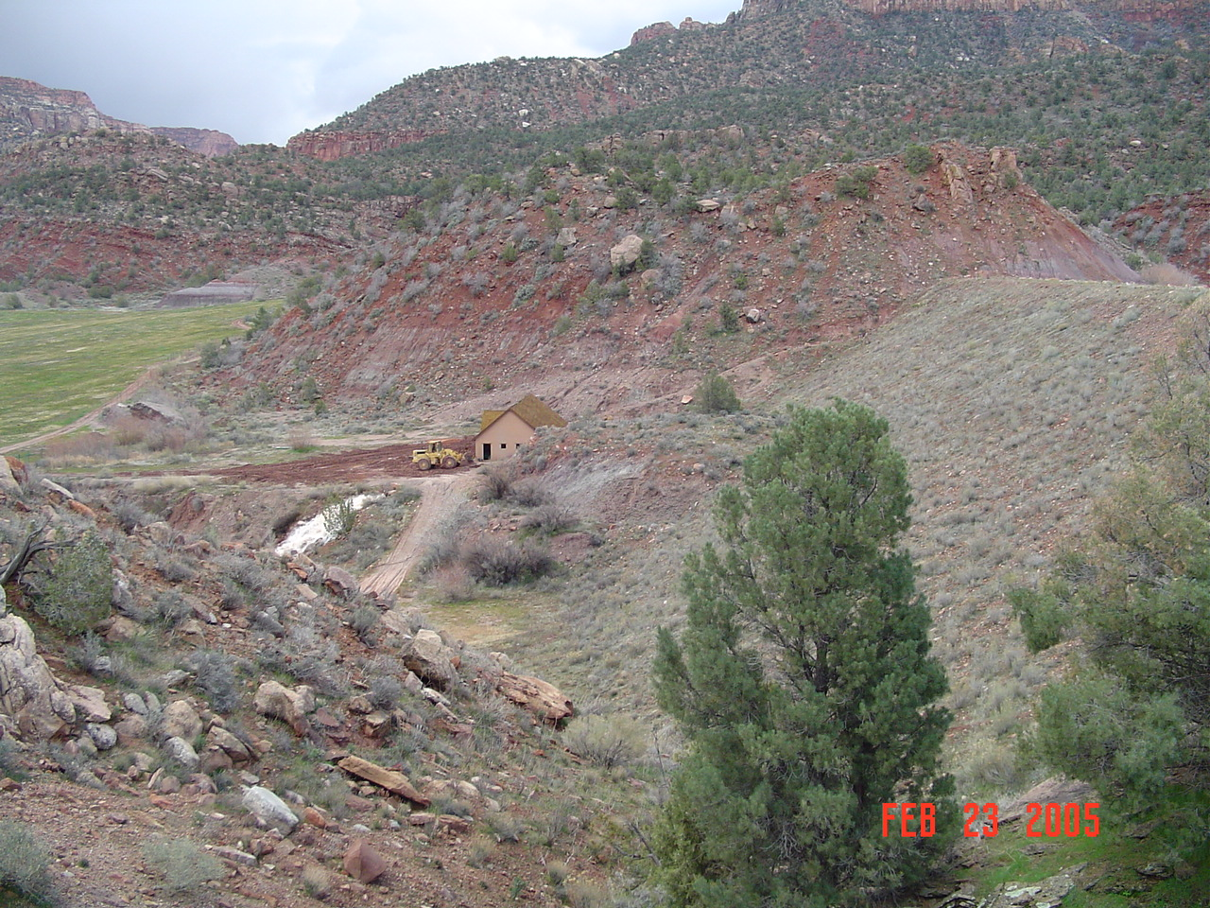
South Creek Dam
Built in 1988

Slide 29
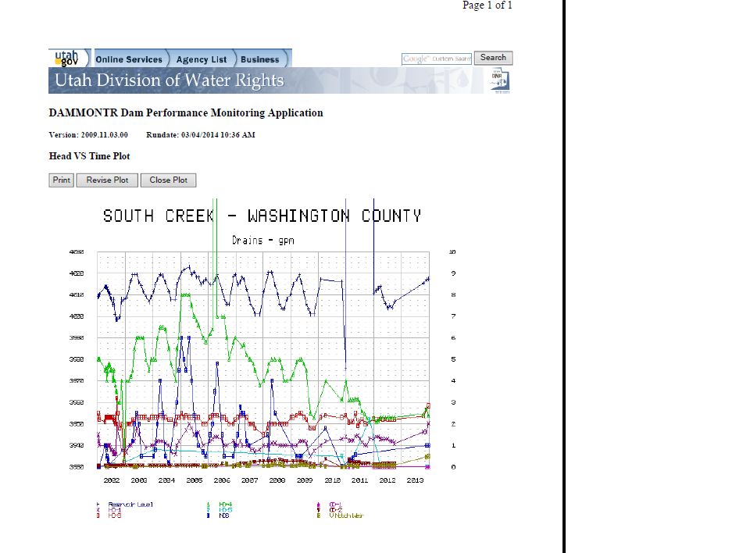

Slide 30
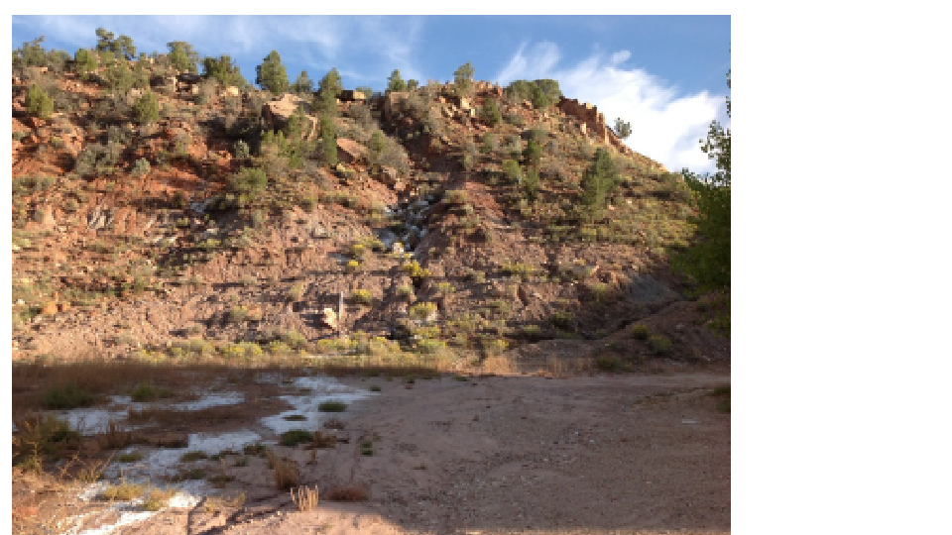

Slide 31
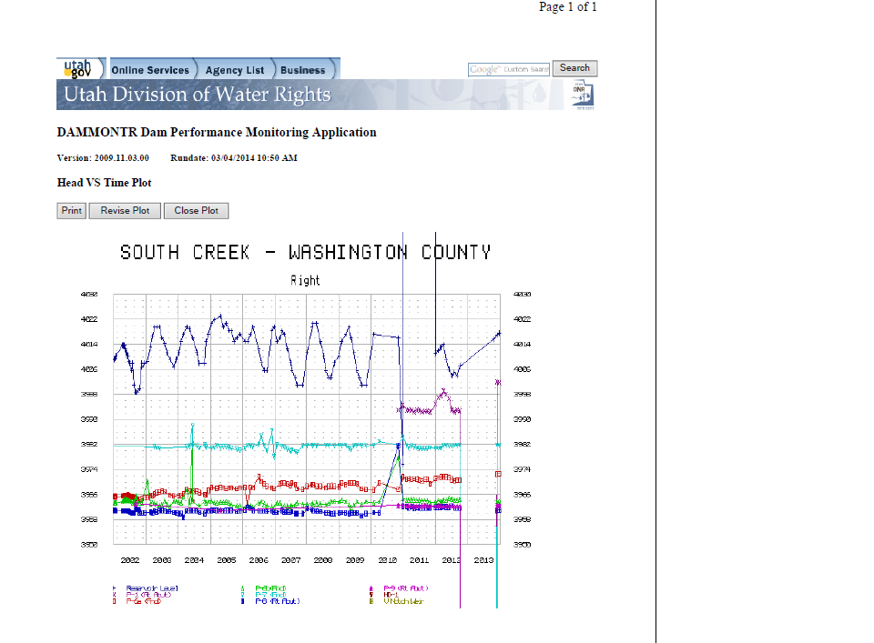

Slide 32
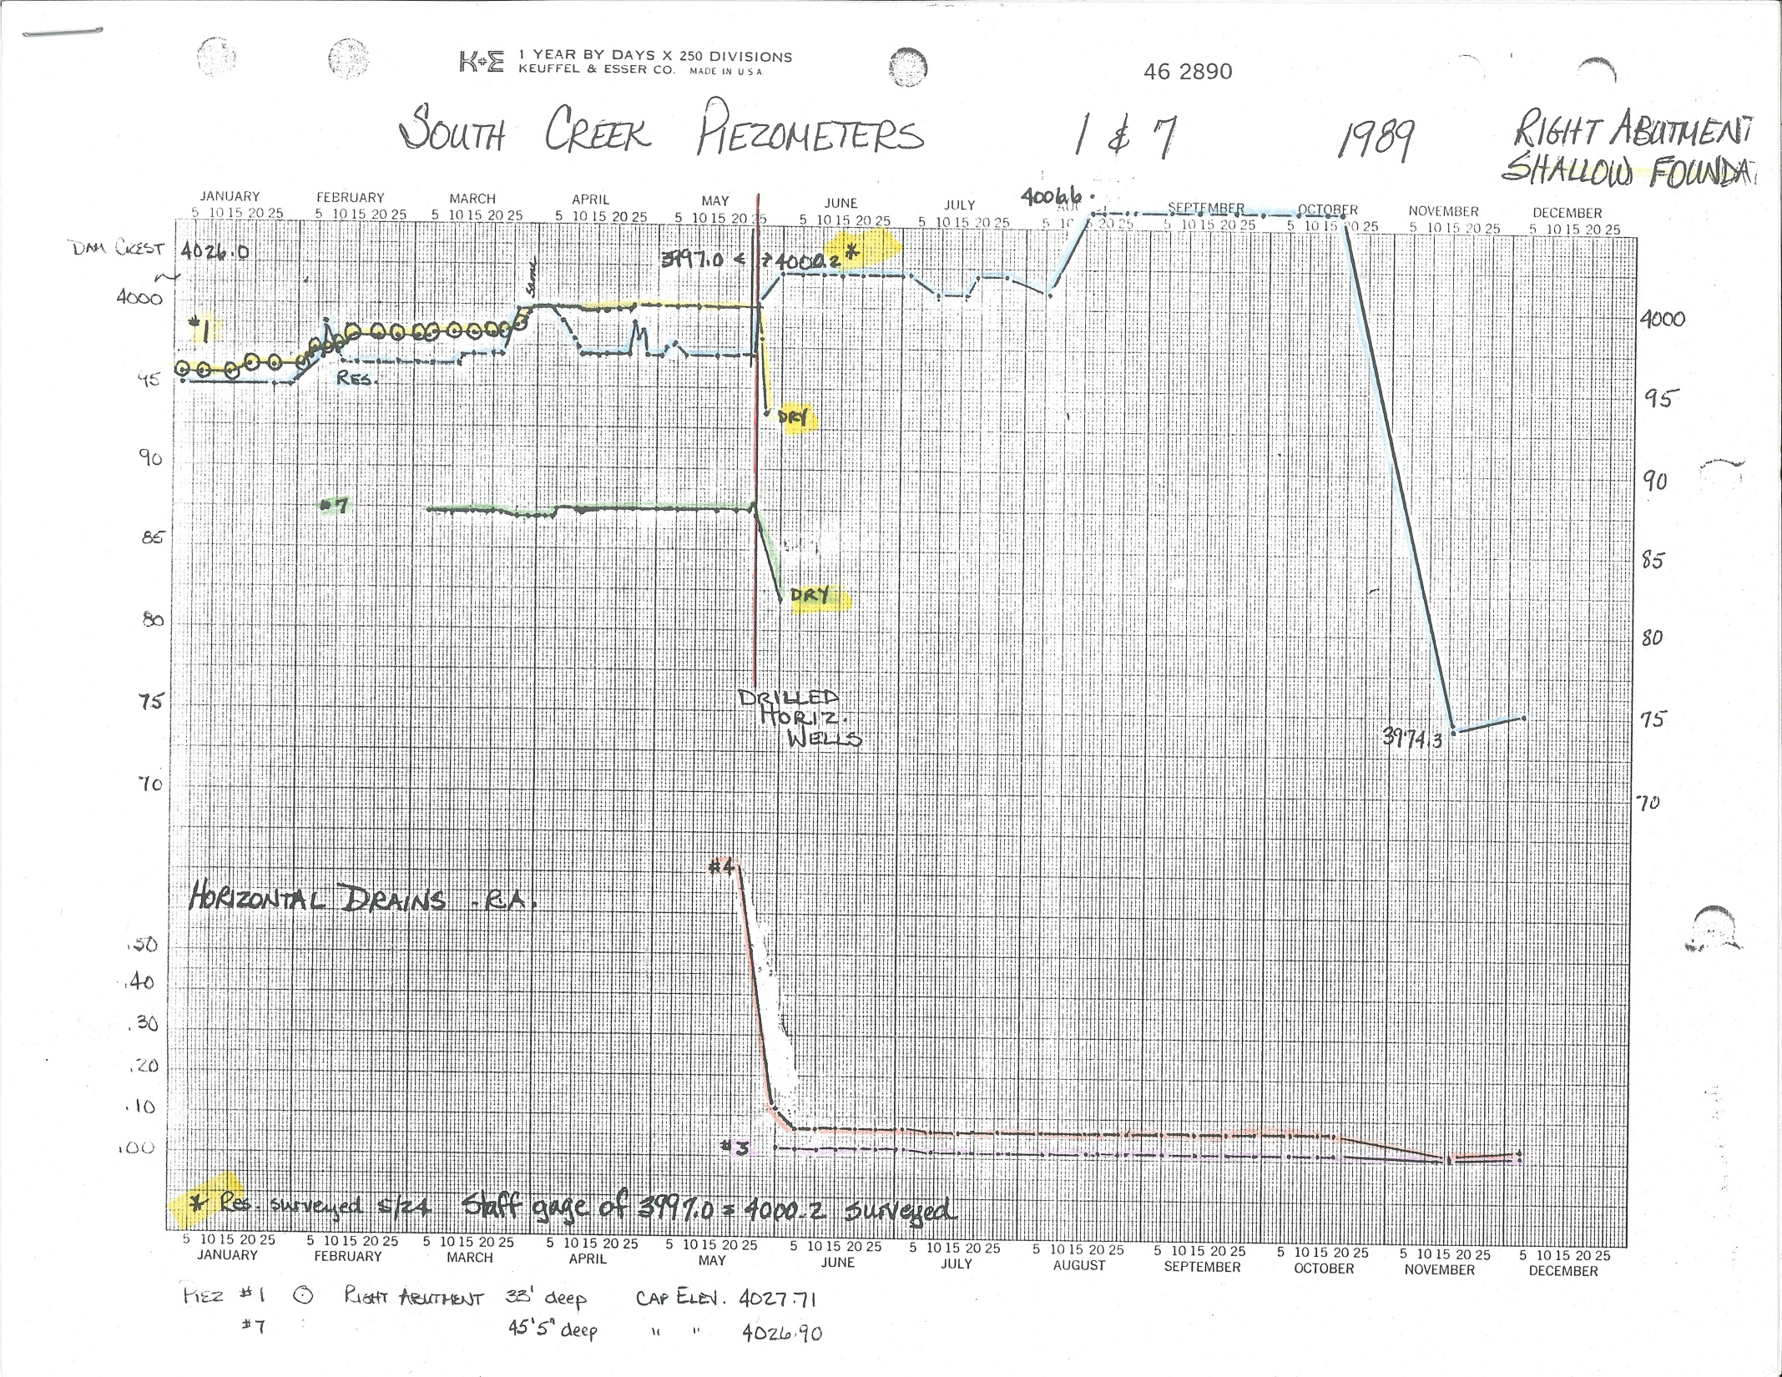

Slide 33
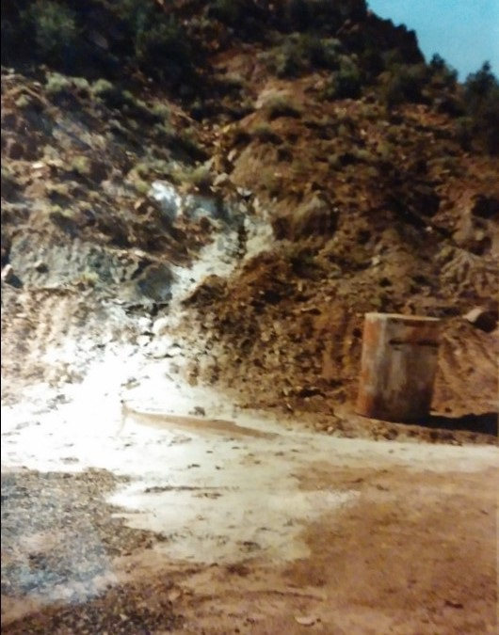

Slide 34
Canals in Utah
House Bill 370
The State Engineer shall, by July 1, 2017, inventory and maintain a list of all open human-made water conveyance systems that carry 5 cubic feet per second….
The State Engineer … may contract with a local conservation district …. To provide technical support for a canal owner who is adopting a management plan….

Slide 35
Questions

