Slide 1
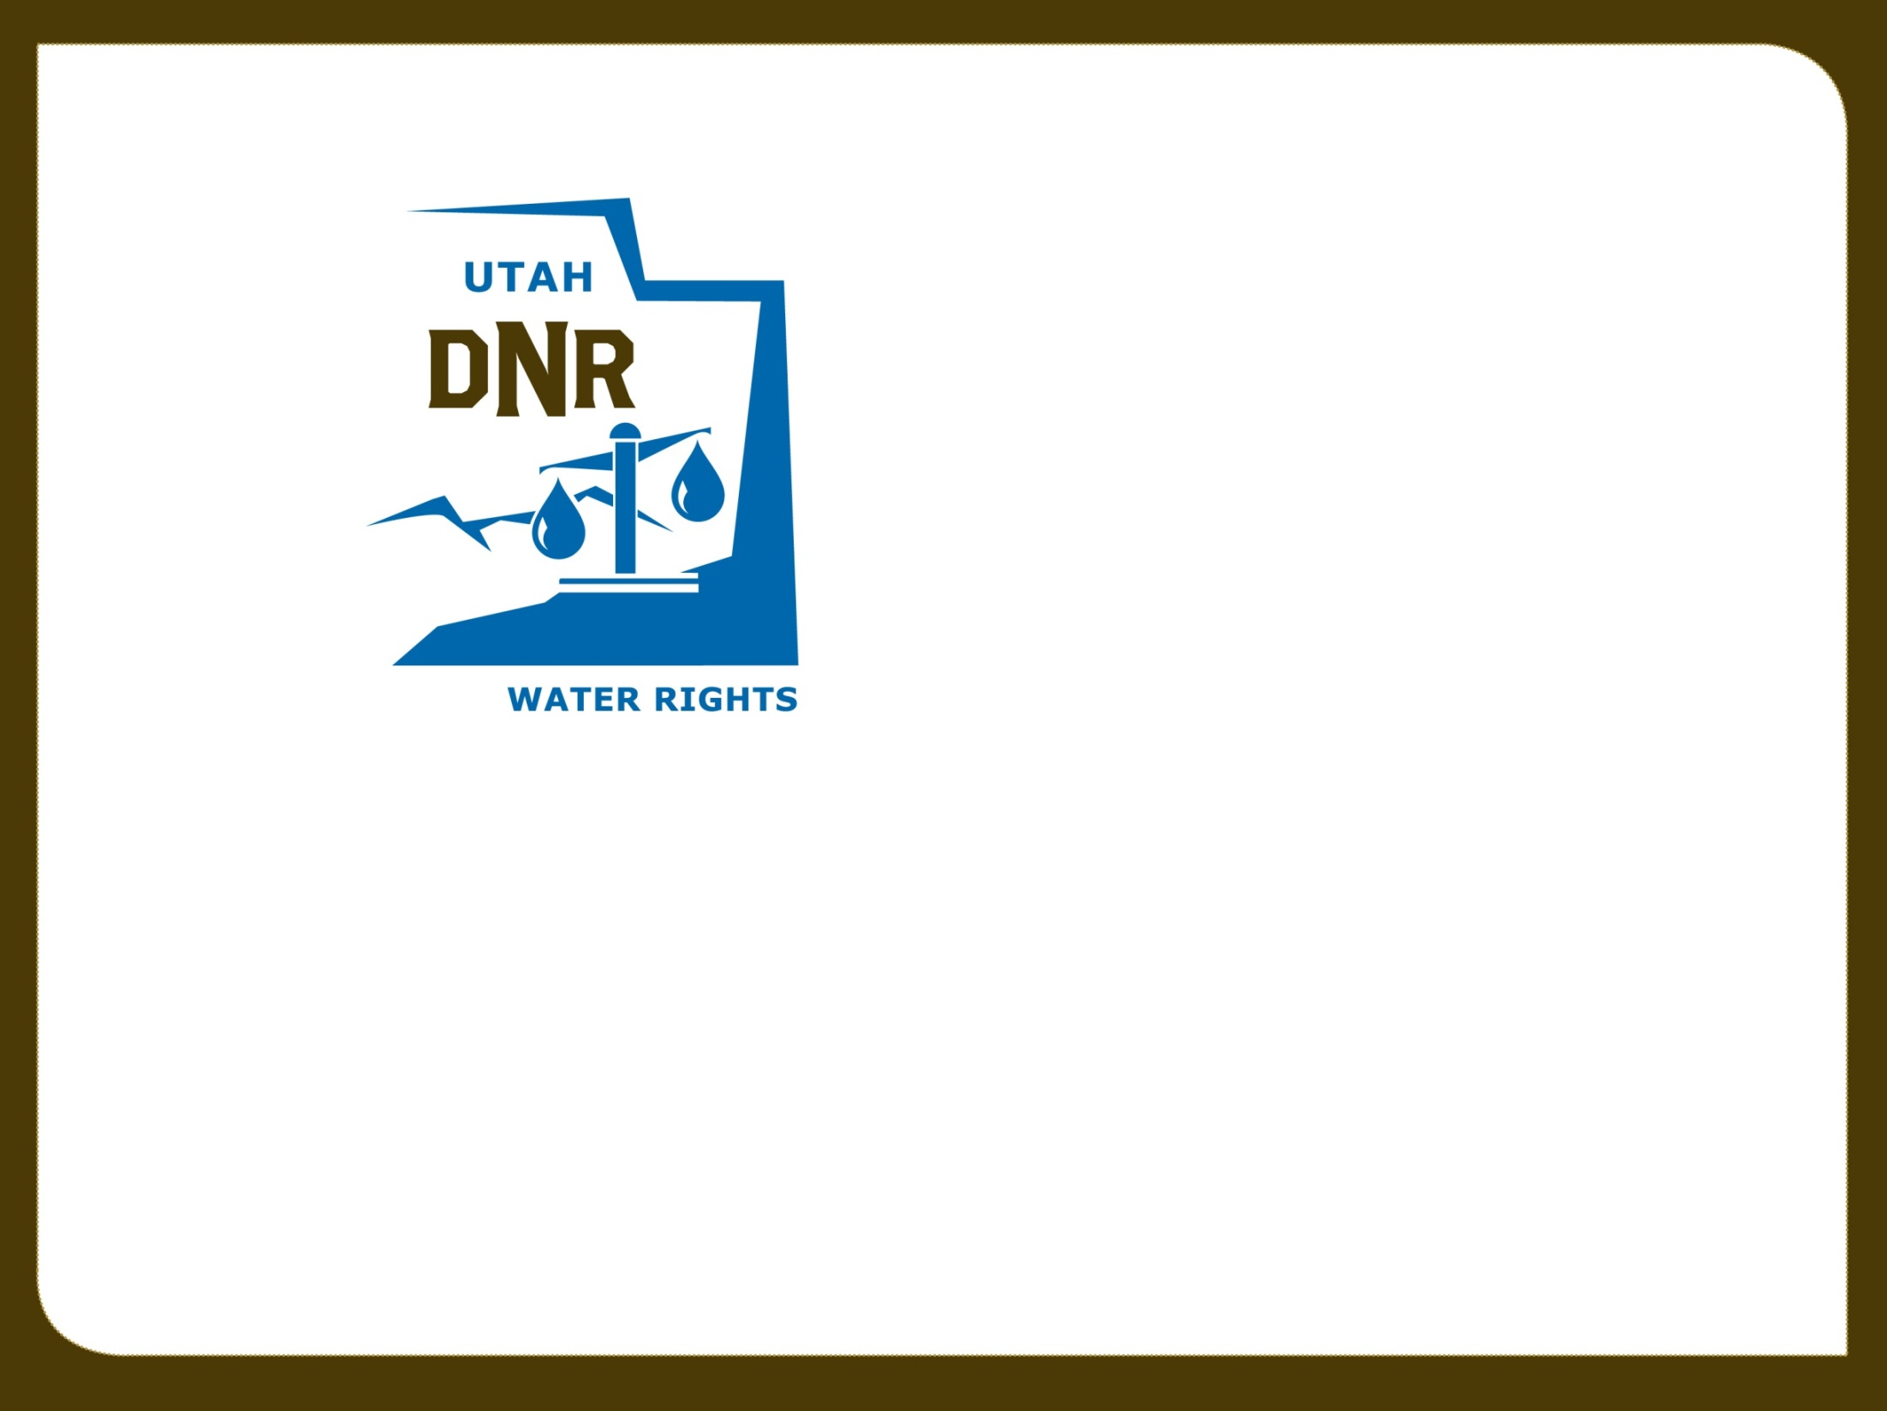

Adjudication
RWAU Training—April 2021
Megan Wanlass
Adjudication Engineer

Slide 2
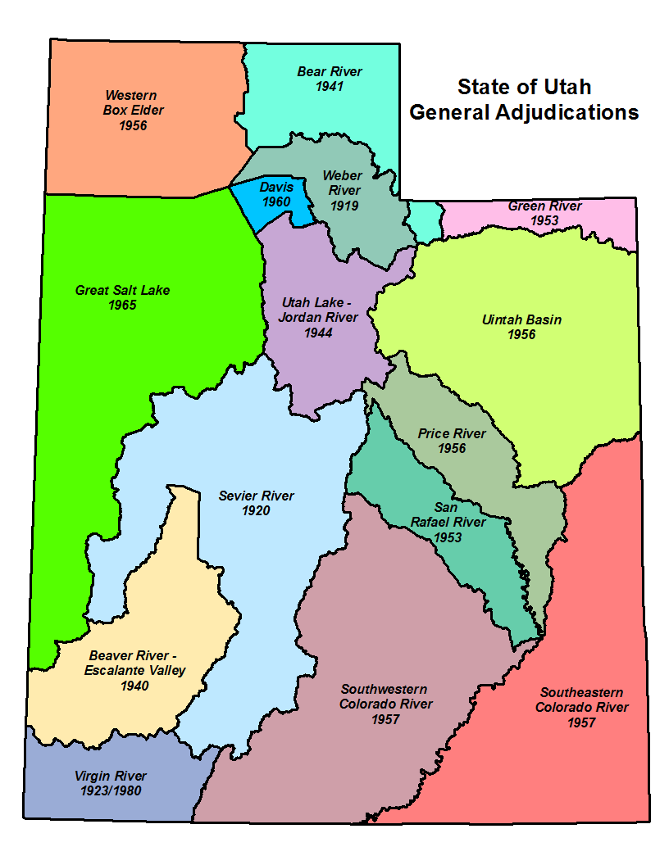
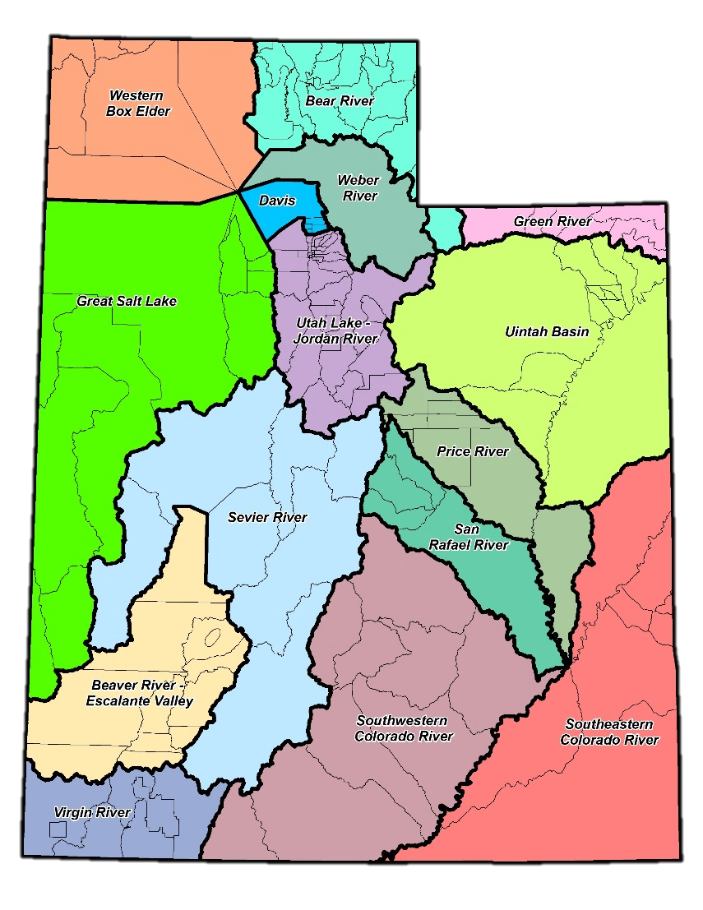
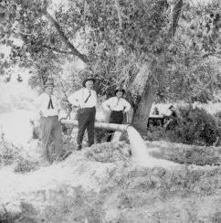
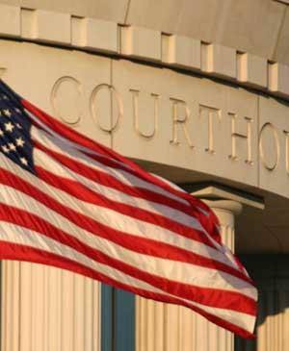
What is a General Stream Adjudication?
What it IS…
Action in State District Court
Joins all water users - including State and federal agencies - and the State Engineer (Division of Water Rights)
Governed by Utah State Code: Title 73, Chapter 4
To determine the nature and extent of all existing water rights within each river drainage
Notes:
So, we’ve talked about adjudication in its broadest sense, but what I really want to talk about is the concept of a General Stream Adjudication. Water rights adjudication can be accomplished through simple litigation between two parties. Any decree resulting from the litigation is only applicable to the parties formally joined in the suit.
However, a General Stream Adjudication is an action in District Court which joins all water users within a stream drainage and the State Engineer as parties to the litigation. Joining all parties within a drainage is important because it helps to prevent multiple decrees among different users which might contradict each other or even miss pertinent aspects of the respective system.
For example, the Spanish Fork River has been the recipient of multiple decrees. As mentioned earlier, the original decree was a High Council Decision in 1879 which divided all of the waters of the river among 5 canal companies. However, it failed to recognize water users who diverted water from the Spanish Fork River and its tributaries up-stream from the mouth of the canyon and even failed to recognize one of the oldest canals on the river (who simply wasn’t a party to the dispute).
The General Stream Adjudication process is outlined in Title 73, Chapter 4 of the Utah State Code.
As you can see on the map, every major river drainage in the State of Utah is currently or has been under a General Stream Adjudication order. Some of these adjudications were petitioned by water users to the State Engineer (as dictated by Utah Code) such as the Weber River basin, while others were court-ordered by expanding the scope of an existing dispute among specific parties to a General Stream Adjudication, such as the Utah Lake / Jordan River basin.
Due to the size of the drainages and the growth of water development throughout the State, the main river drainages are often split into smaller areas—divisions and even subdivisions—which facilitate the ability of our staff to go into an area and proceed quickly—relatively speaking.

Slide 3
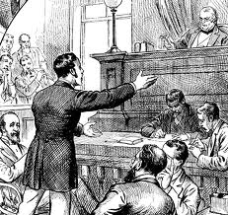
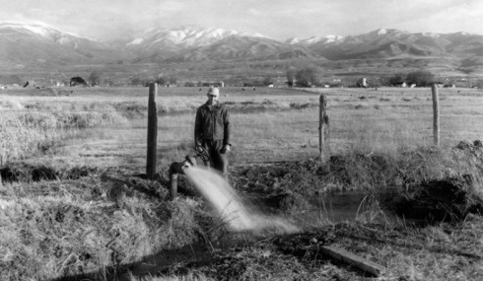
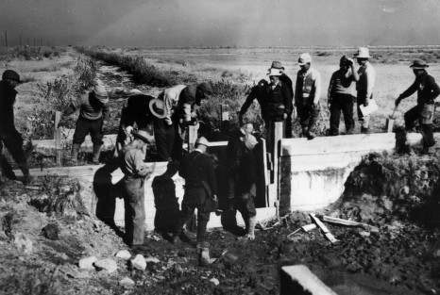
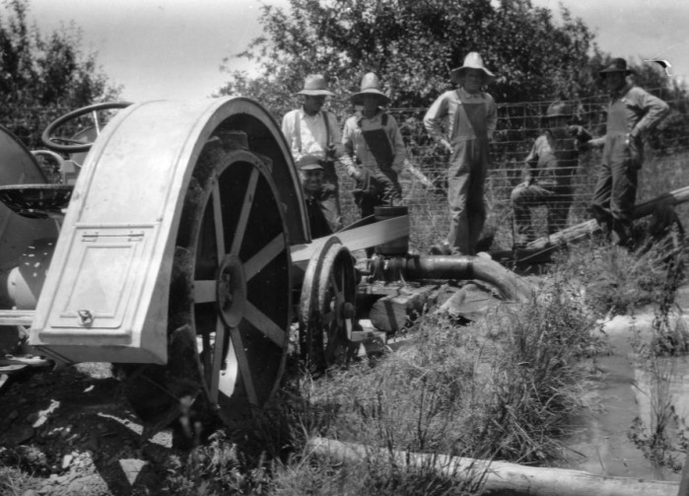
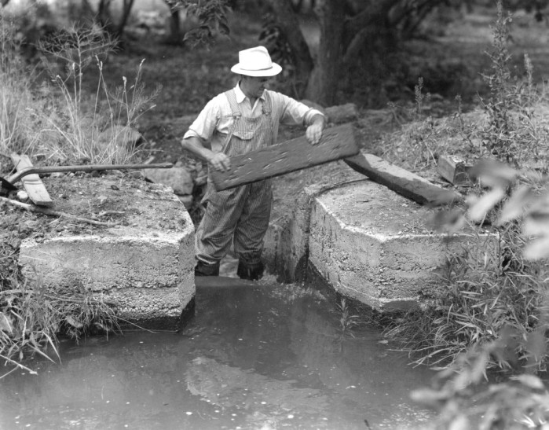
Why Do We Conduct General Adjudications?
Bring all claims on to the permanent record:
  Pre-Statutory Claims
    Diligence Claims (1903)
    Underground Water Claims (1935)
  Federal Reserve Rights
    Winter’s Doctrine (1908)
    McCarran Amendment (1952)
To prevent a “multiplicity of suits” and bring clarity to the water rights picture.
Remove/reduce rights which have been wholly or partially forfeited through non-use.
To obtain final comprehensive decrees on all water rights within the respective drainage.
…but what about Federal rights?
Notes:
So, in an attempt to illustrate the importance of the foregoing critical questions, let’s pose the question, “Why do we conduct general stream adjudications?” The answer is… it depends. For one thing, it probably depends on the period of history in which you asked it. Originally, general stream adjudications were utilized to bring all pre-statutory claims on to the permanent record. This is easy to understand from the perspective of water users in 1903. At the time that Utah’s first comprehensive water law was passed, it’s obvious that the number of pre-statutory claims far exceeded the number of appropriated rights since the system had yet to create any. Consequently, it was imperative to determine and quantify existing rights in order to allow the State Engineer to process future appropriations. This holds true through today, although the ratio of pre-statutory claims to certificated rights is much smaller--as will be illustrated in the next slide.
If you were to ask why we conduct general adjudications today, I think that it would be impossible to leave out the issue of Federal Reserve rights. As a result of a 1908 Supreme Court decision in Winters v. United States, the court ruled that by creation if the Fort Belknap Indian Reservation, there was an implied water right for the amount of water for the reservation to be self-sufficient. Today, federal reserved water rights can be asserted on most lands managed by the federal government. Reserved rights are, for the most part, immune from state water laws and therefore, are not subject to diversion and beneficial use requirements and cannot be lost by non-use. Federal Reserve rights are limited by the "primary purpose" and "minimal needs" of the reservation or the respective federal agency’s original congressional mandate. In addition, federal reserved water rights are nontransferable. By law, these rights can only exist on lands owned by the federal government. If a land transfer occurs, any existing federal reserved water right becomes invalid.
Although Federal Reserve rights were known to exist, there was no way to force the Federal Government to assert or quantify their claims since it possessed sovereign immunity and could not be joined involuntarily in a suit. In 1952, a senator from Nevada by the name of Pat McCarran introduced a bill that would allow states to pursue quantification of Federal Reserve rights. As it came to be known, the McCarran Amendment, waives U.S. sovereign immunity with respect to water rights and allows states to determine Federal water rights in state courts. Hence, federal water claims may be quantified in state stream adjudications, but only if such proceedings are comprehensive (meaning that all claimants to a specific water body are joined in the suit).
Some other benefits of a general adjudication is the consolidation and settlement of multiple controversies and bringing clarity to the overall water rights picture by joining all water users within a given system (as opposed to piecemeal litigation), defining supplemental relationships, removing forfeited rights from the record, and obtaining final decrees on all rights within the drainage.

Slide 4
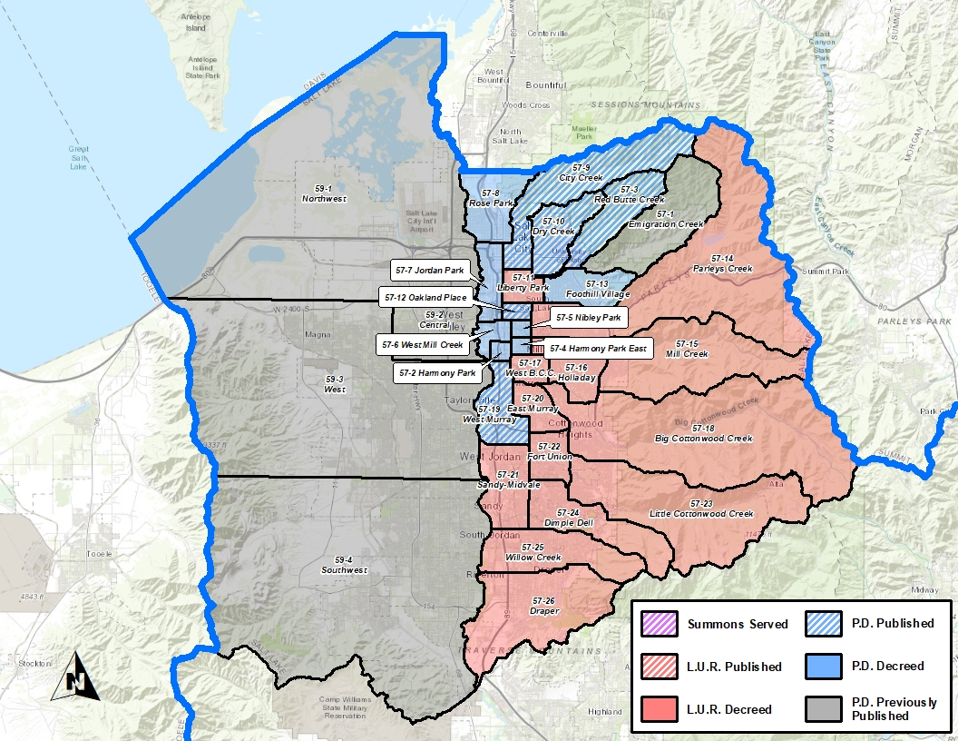
Current Adjudication Efforts
Revised statute to streamline and modernize the water rights adjudication process.
  SB 75 (2016)
  SB 61 (2018)
  HB 355 (2019)
Focus efforts in areas experiencing greatest development, predominately the Salt Lake Valley.

Slide 5
Current Adjudication Efforts
Revised statute to streamline and modernize the water rights adjudication process.
  SB 75 (2016)
  SB 61 (2018)
  HB 355 (2019)
Focus efforts in areas experiencing greatest development, predominately the Salt Lake Valley.

Slide 6
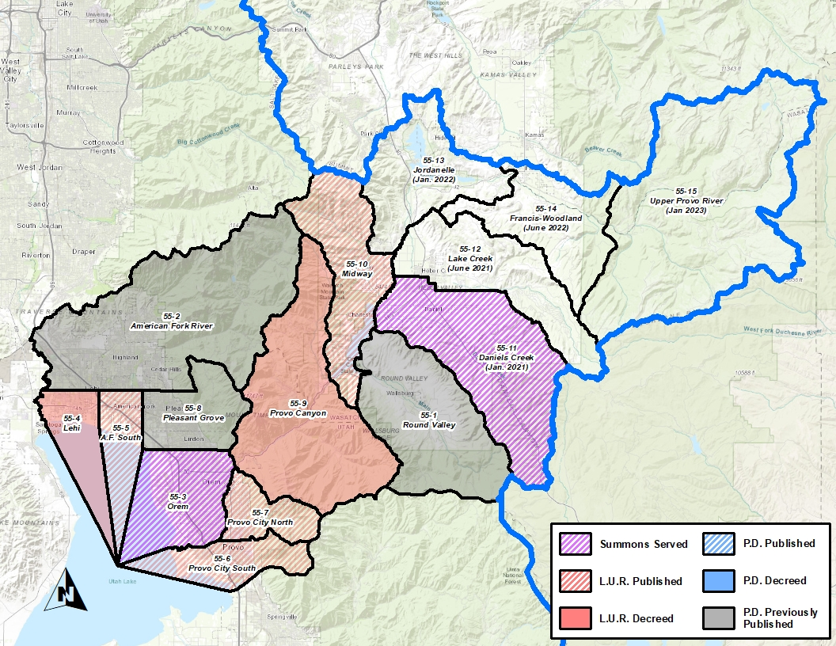
Current Adjudication Efforts
Revised statute to streamline and modernize the water rights adjudication process.
  SB 75 (2016)
  SB 61 (2018)
  HB 355 (2019)
Focus efforts in areas experiencing greatest development, predominately the Salt Lake Valley.

Slide 7
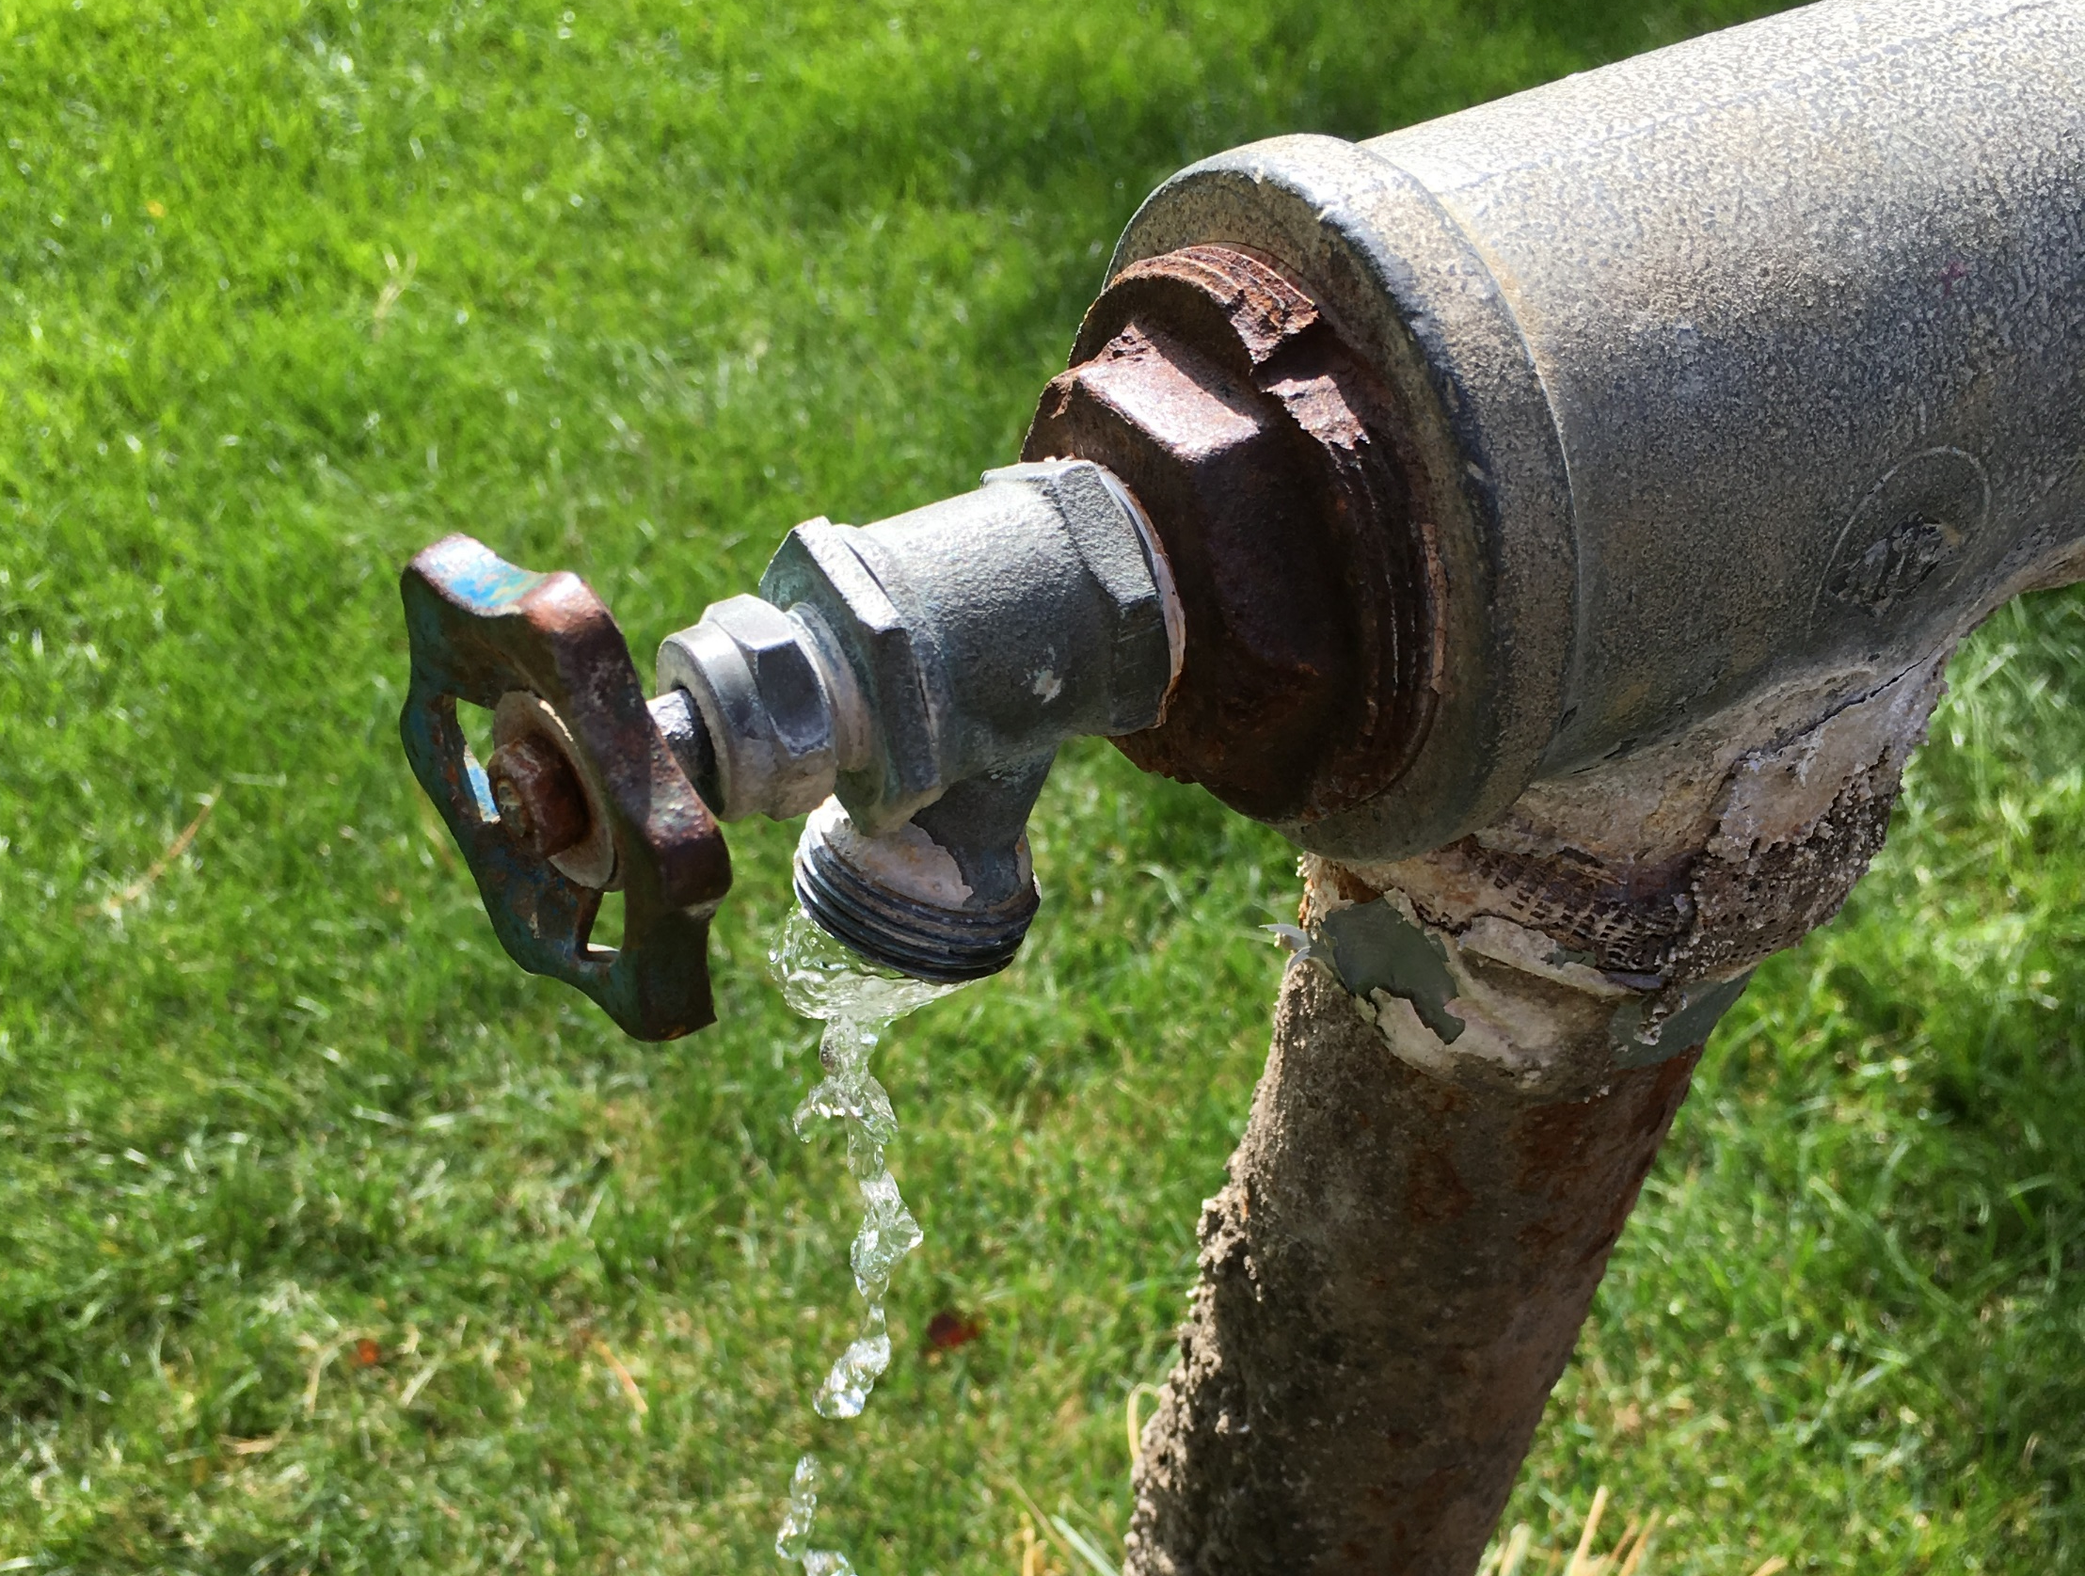
Adjudication Process
Where it begins

Slide 8









The Adjudication Process
1
2
NOTICE
3
SUMMONS
PETITION
4
5
6
7
90 DAYS TO FILE OBJECTION
PUBLIC MEETING
NOTICE TO FILE
CLAIMS WITHIN 90 DAYS
LIST OF
UNCLAIMED RIGHTS
UNCLAIMED RIGHTS
90
90
The Adjudication Process
HB 355
8
9
10
11
PROPOSED DETERMINATION AND
HYDROGRAHPIC SURVEY
PUBLIC MEETING
OBJECTION
RESOLUTION & DECREE
CLAIM INVESTIGATION
W.U.C.
W.U.C.
P.D.
12
13
14
15
90 DAYS TO FILE OBJECTION
PUBLIC MEETING
FINAL SUMMONS
OBJECTION
RESOLUTION & DECREE
90
Notes:
Petition or Court Order: The water rights adjudication process is typically initiated one of two ways. Water users may petition the State Engineer to file an action in the respective district court to initiate an adjudication; alternatively, a suit involving several water rights might be converted into a general water rights adjudication by the court. This has already occurred within each of the 15 major drainages in the State of Utah. (Utah Code 73-4-1)
General Notice: For each area, division, or subdivision, the State Engineer publishes notice in a newspaper designated by the court once a week for two consecutive weeks. The notice provides the name of the action, location of the court, and name of the water source involved. (UCA 73-4-3)
Summons: For each area, division, or subdivision, the State Engineer serves a summons on potential claimants of record by mail. Summons is also published in a newspaper designated by the court once a week for five consecutive weeks. (Utah Code 73-4-4)
First Public Meeting: The State Engineer holds a public meeting in the adjudication area, division, or subdivision to inform water right claimants about the process. (Utah Code 73-4-3)
Notice to Submit Claims: After the initial public meeting, the State Engineer sends notice to claimants to file a statement of claim (i.e., water user's claim) along with a copy of the form or instructions on how to obtain one. (Utah Code 73-4-3)
Claim Filing: Claimants have 90 days from the date of the notice in order to file a claim with the State Engineer or the respective district court. Claimants may request one 30-day extension by filing a written request with the State Engineer prior to the conclusion of the 90-day period. Claimants who fail to file a claim within the prescribed 90-day timeframe (or authorized extension) risk being prevented from asserting their claim in the future and having any unclaimed right deemed abandoned by the court. (Utah Code 73-4-3, 5, 9, and 10). If your water right is listed in the name of a previous owner, you should still file a claim (as a claimant) to protect your water right from being deemed abandoned. Later, update title to your water right. The title updating process is separate from adjudication.
List of Unclaimed Rights: After the conclusion of the 90-day claim filing period (plus any extensions), a List of Unclaimed Rights is published and filed with the court to document water rights that exist on the records of the State Engineer for which no claim was filed. The List of Unclaimed Rights is meant to provide additional notice regarding existing rights that may be subject to being deemed abandoned by the court. The State Engineer sends notice to claimants that the List of Unclaimed Rights has been filed and instructions on how to obtain a copy of the list and their obligation to file an objection within 90 days if dissatisfied. (Utah Code 73-4-9.5)
Second Public Meeting: After filing the List of Unclaimed Rights, the State Engineer holds a public meeting in the adjudication area, division, or subdivision to explain the List of Unclaimed Rights to the claimants. (Utah Code 73-4-9.5)
Final Summons: Following the notice of the List of Unclaimed Rights, the State Engineer makes a final search for potential claimants and publishes summons in a newspaper designated by the court once a week for five consecutive weeks. (Utah Code 73-4-22)
Objection Resolution & Decree: Individuals who disagree with the List of Unclaimed Rights have 90 days to file an objection and water user's claim with the court. They must also file a water user's claim with the State Engineer. Once objections (if any) are resolved, the court renders a decree on the List of Unclaimed Rights that: (1) identifies any rights to be removed from the list, (2) adjudges the unclaimed rights abandoned, and (3) prohibits future unknown claims from being asserted. (Utah Code 73-4-9.5)
Proposed Determination: Once claimants have filed their respective water user's claims, the State Engineer evaluates and maps the claims and develops a Proposed Determination of water rights. Subsequent to the rendering of a decree on the List of Unclaimed Rights, the State Engineer files the Proposed Determination with the court and provides notice to claimants of how to view or obtain a copy of it and their obligation to file an objection within 90 days if dissatisfied. The Proposed Determination represents the State Engineer's official recommendation to the court as to the status and nature of water rights within the respective boundary. (Utah Code 73-4-11)
Public Meeting: After filing the Proposed Determination, the State Engineer holds a public meeting in the adjudication area, division, or subdivision to explain the Proposed Determination to the claimants. (Utah Code 73-4-11)
Objection Resolution & Decree: Individuals who disagree with the Proposed Determination have 90 days to file an objection with the court. Once objections (if any) are resolved, the court renders a decree on the Proposed Determination. (Utah Code 73-4-12,15)

Slide 9
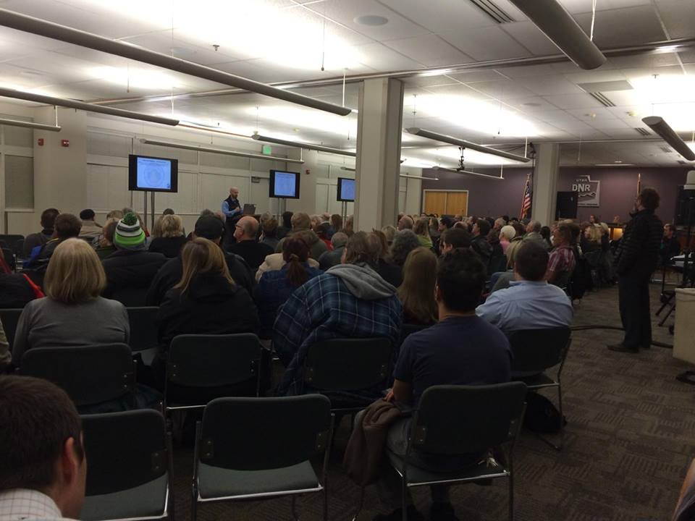
Public Meeting
State law requires the State Engineer to hold an initial Public Meeting in the local area to inform water users about the adjudication process.

Slide 10




Filing your Water User’s Claim
Notice to Submit Claims
Water User’s Claim Forms
1
2
  Water Right Owners
  A pre-filled water user’s claim
  mailed to water right owners of record
  Published
  in a local newspaper
BLANK W.U.C.
Property Owners
A blank water user’s claim will be mailed to property owners
Mailed
to water right owners and property owners
W.U.C.
Filing Your Water User’s Claim
Field Investigation and Mapping
3
4
W.U.C.
District
Court
or
State
Engineer
W.U.C.
90
Claimants will have 90 days to complete/review and file their water user’s claims with the District Court or State Engineer. Claimants can request one 30-day extension from the State Engineer prior to the conclusion of the 90-day period.
Water user’s claims that are filed are investigated and mapped by the State Engineer. This investigation forms the basis of the State Engineer’s recommendation to the District Court.

Slide 11
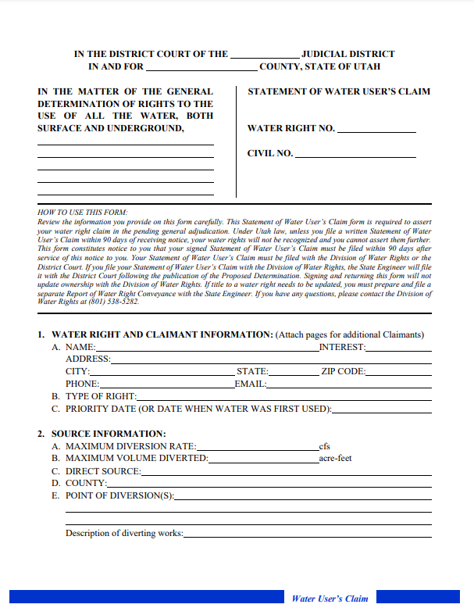
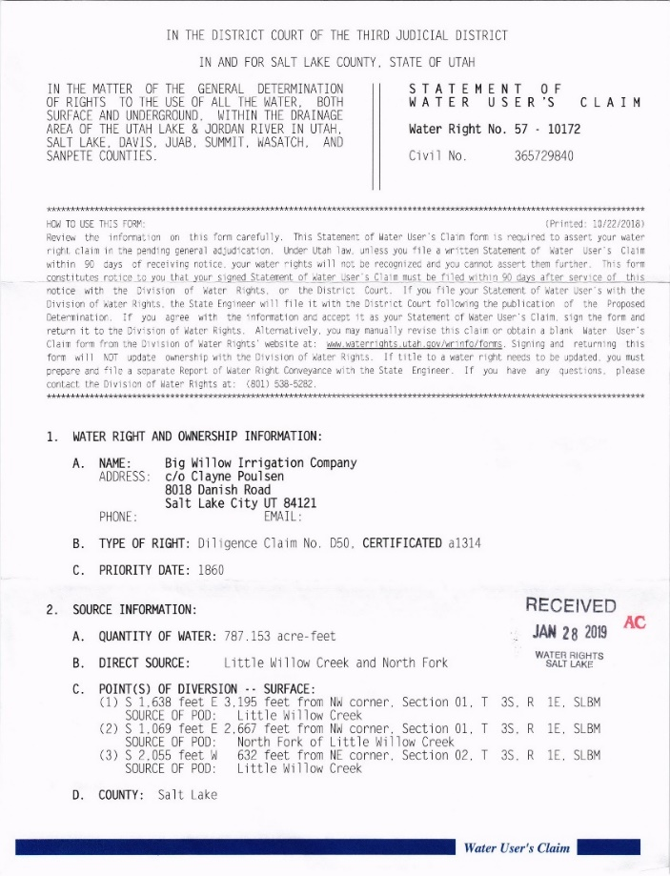
Water User’s Claims
The water user must complete and file a Water User’s Claim with the State Engineer (or Court) for each water right.
Due to complexity of defining water rights, Adjudication staff may help the water user in completing the claim.
State Engineer files the claim with the Court on behalf of the water user as a courtesy.
Claims are only required on perfected rights (i.e., certificated rights, decreed rights, and diligence claims). This includes perfected changes on Share Statements. All entities (including individuals, companies, and municipalities) that own a water
right in the adjudication area
should file.
Notes:
The statue states that water users are responsible for completing a Water User’s Claim and filing it with the state engineer or the court; however, through years of experience, we’ve determined that it saves time, energy, and money to assist water users in filling out a claim due to the lack of understanding on what some of the technical terms mean or in what manner to describe their water right.
We also accept the Water User’s Claims and file them with the court at the completion of the Proposed Determination. Water User’s are welcome to opt out of the assistance of the Adjudication Staff at their leisure.
Water User’s Claims are only taken on rights which have been perfected (certificated), previously decreed, or qualify as diligence claims.
Occasionally, a water user wants to make a claim that is inconsistent with what the Adjudication Staff observe in the field. When this occurs, a “State Engineer’s Recommendation” is prepared and published in the proposed determination in the place of the claim. Water users will have the opportunity to object to any perceived errors in the Proposed Determination, which will be discussed shortly.

Slide 12
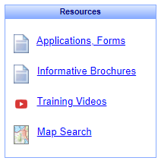
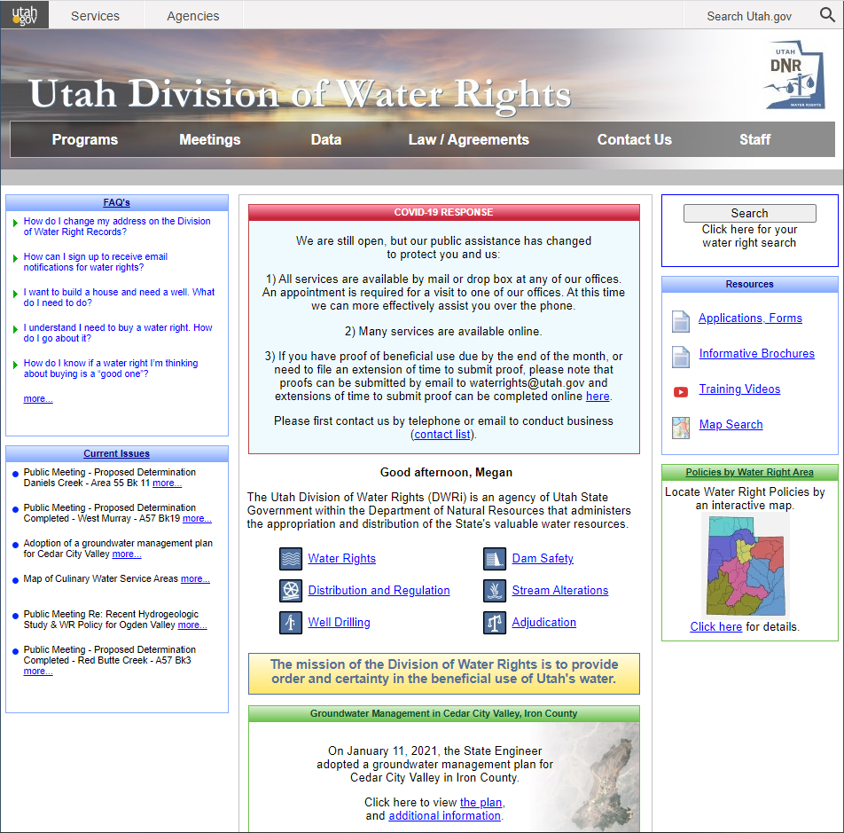

Map Interface
Interactive Water Rights Map
Notes:
So, how do you know if you are in an adjudication area? This is where the Map interface on our website can come in handy.
When you navigate to our website – waterrights.utah.gov – and click on “Map Search” in the Resources section you can use our interactive map.

Slide 13
List of Unclaimed Rights
List of Unclaimed Rights (L.U.R.)
Objections to the L.U.R.
5
6
UNCLAIMED RIGHTS
District
Court
&
State Engineer
OBJECTION
&
W.U.C.
90
  Water rights of record for which no claim was filed within the 90-day period will be included in the List of Unclaimed Rights, mailed to all parties. A public meeting is held once the List of Unclaimed Rights is published / filed with the court.
Claimants will have 90 days to file an objection to the List of Unclaimed Rights with the District Court. They must also file a water user’s claim with the court and the State Engineer.
Objection Resolution (as needed)
Judicial Decree
7
8
W.U.C.
Once objections (if any) are resolved, the court renders a judgment that the rights on the L.U.R. are abandoned with the exception of those allowed as a result of a successful objection. It may also prohibit future diligence claims from being filed.
The State Engineer may choose to litigate, file a concurring motion, or remain silent. If the court allows the claim, the State Engineer will evaluate the claim in the Proposed Determination.

Slide 14
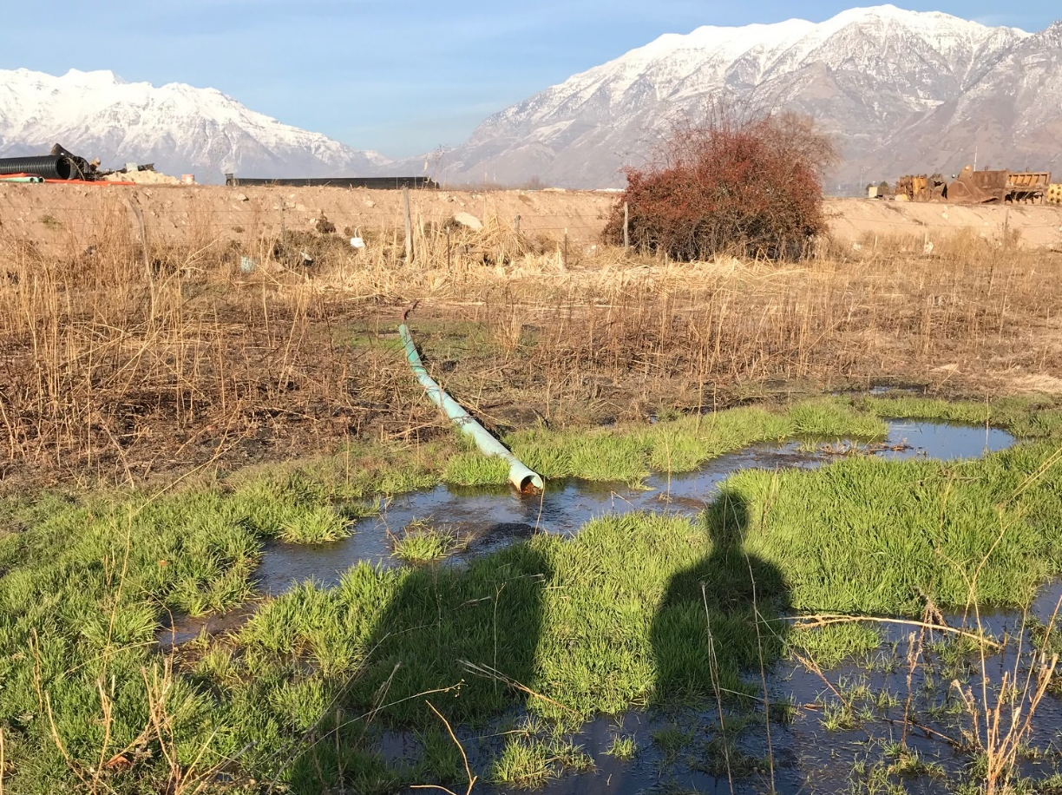
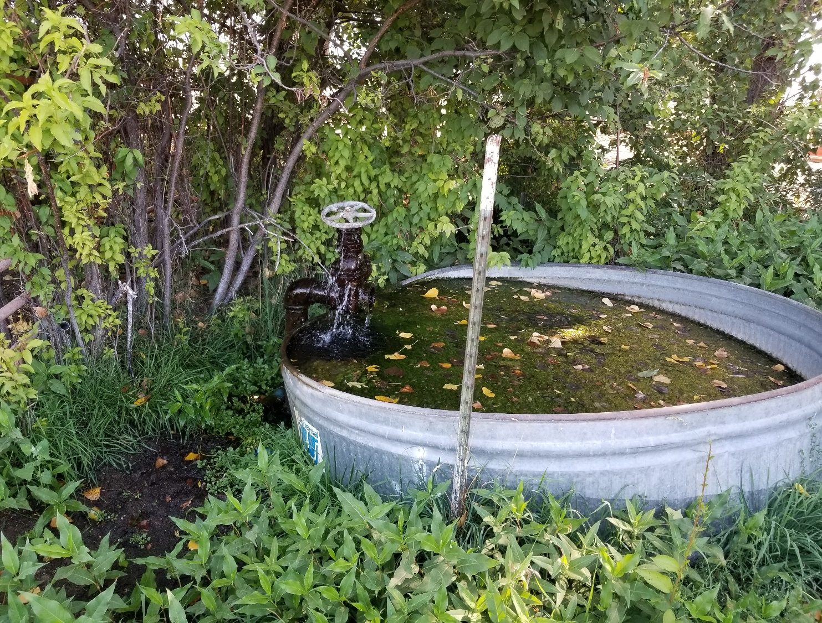
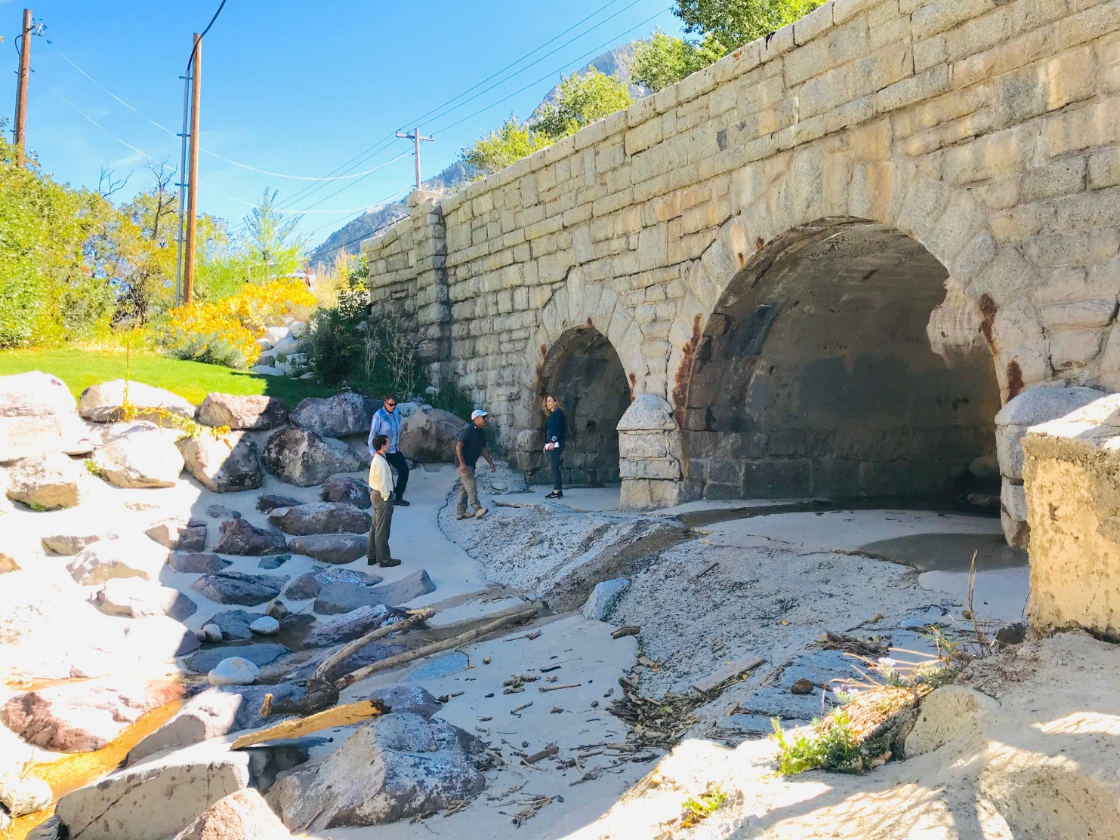
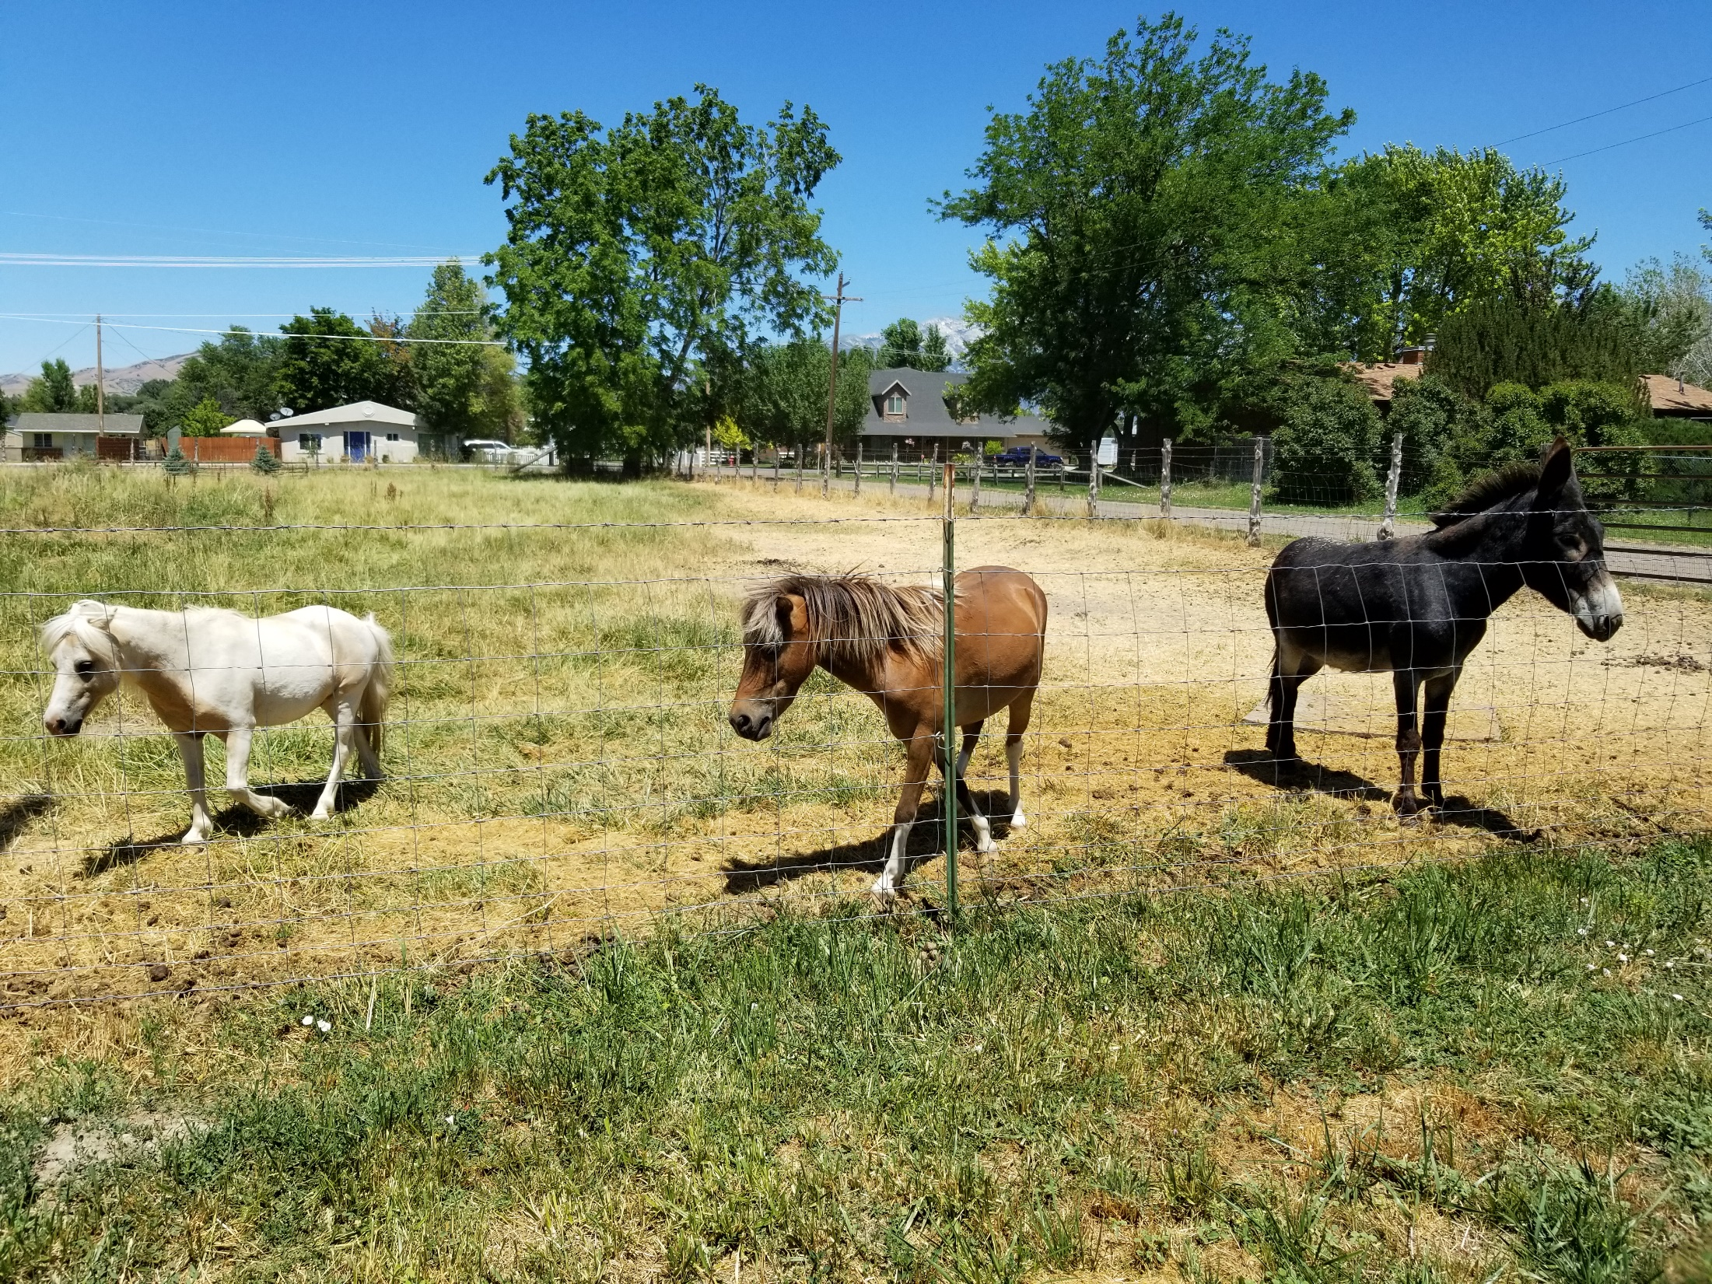
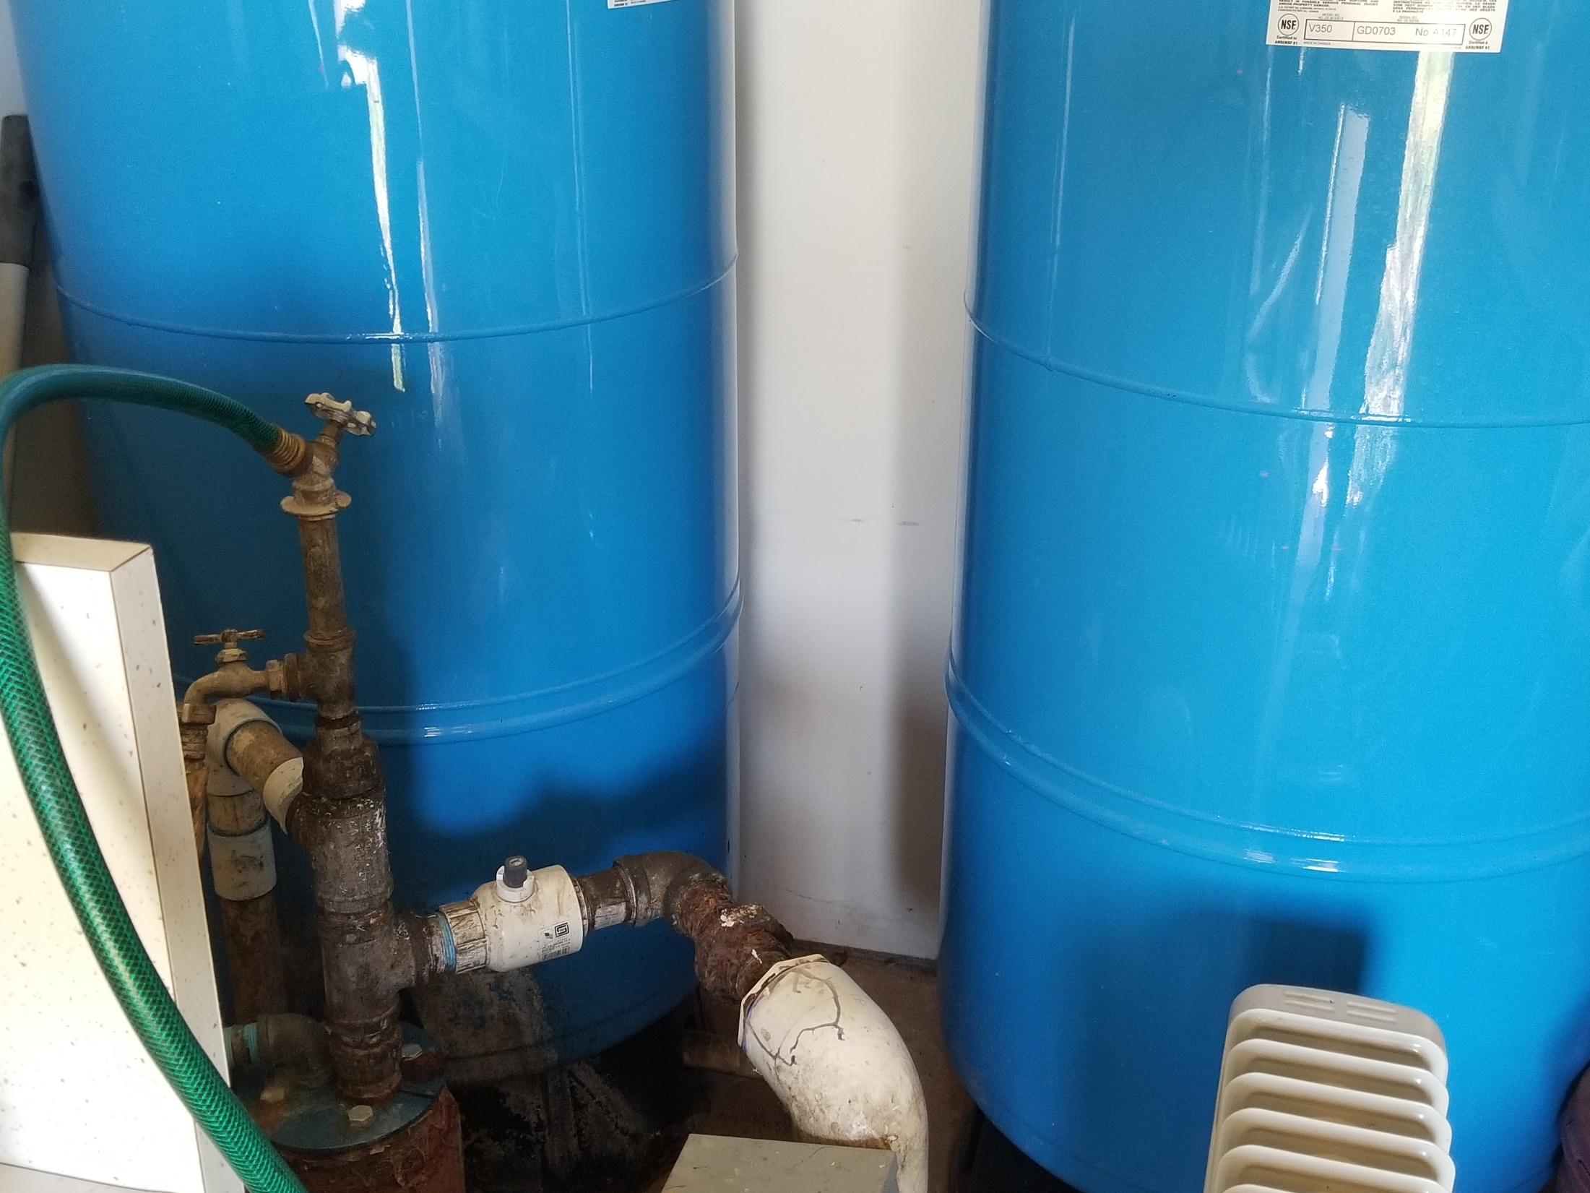
Claim Evaluation
Notes:
Teams (Technicians) will conduct field reviews of the claims in an attempt to locate the POD(s) and investigate the details associated with the individual or groups of water rights.
If possible, Techs will attempt to contact the water right owner or claimant in order to set up a date and time to meet.
Claim evaluation consists of reviewing the WUC and underlying documents on the water right file(s), Techs will then visit the property and verify the uses with the owner/claimant.
They then take pictures of the beneficial uses (irrigation, livestock, domestic connections, the POD itself, and any other relevant information)
In addition, the tech will confirm the location of the POD using a GPS device.
Upon returning from the field, the technician will use the images, notes, UTM location of the POD, and relevant information from the file to construct a memo, map, and SER.

Slide 15
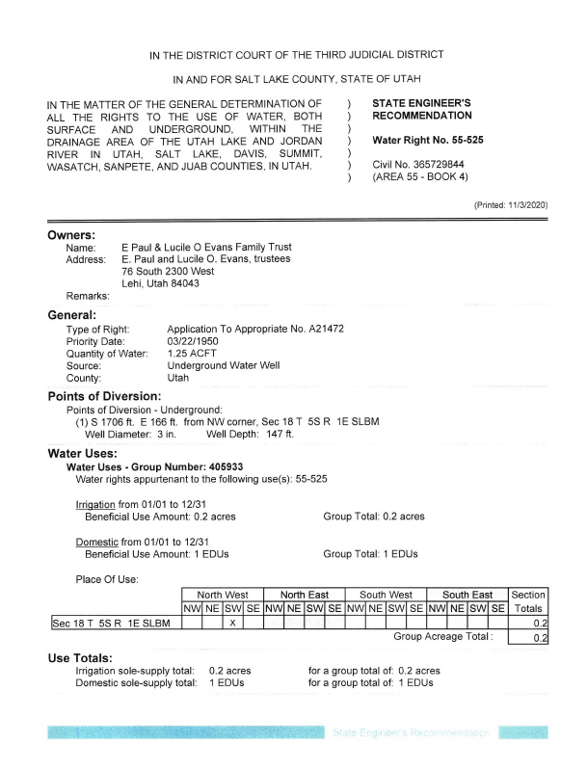
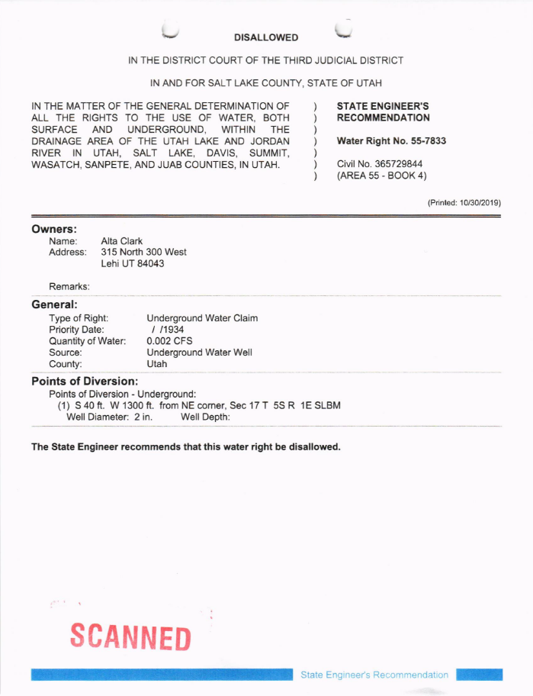
State Engineer’s Recommendation (SER)
Recommended definition of the water right based on the file and field reviews.
A water right may be disallowed based on evidence of non-use (i.e., forfeiture); or a claim may be disallowed due to its invalidity (having no legal basis).
A copy of the memo, SER, and map (if applicable) will be mailed to the claimant and/or owner of record.
Notes:
A State Engineer’s Recommendation (SER) is a recommended definition for the water right based on the file and field reviews.
The memo will serve as a basis for a State Engineer’s Recommendation that will be published in the Proposed Determination.
A copy of the memo, SER, and map (if applicable) will be mailed to the claimant and/or owner of record.

Slide 16
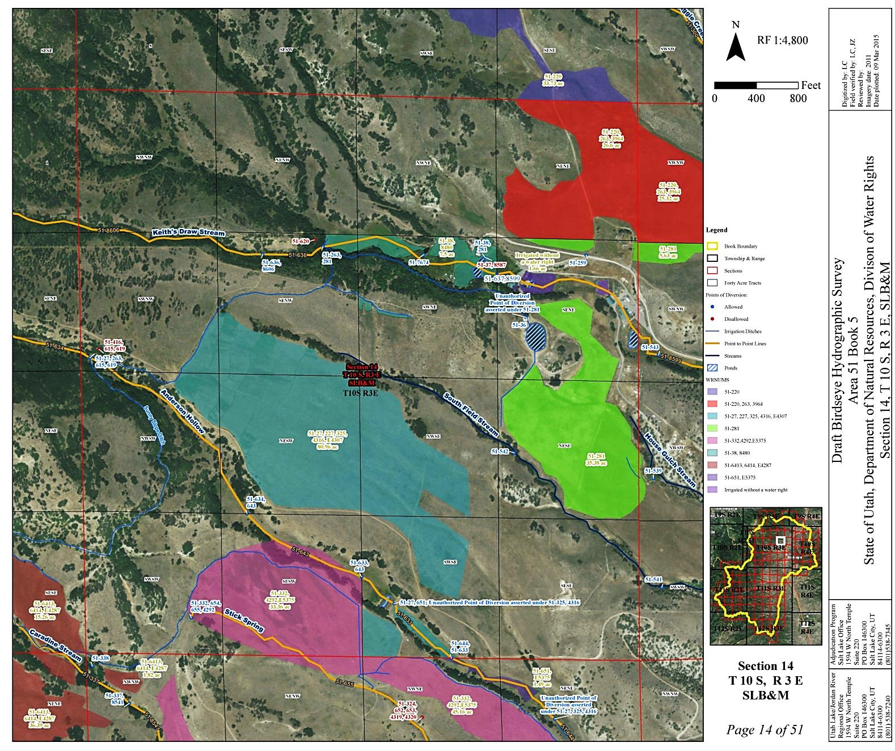
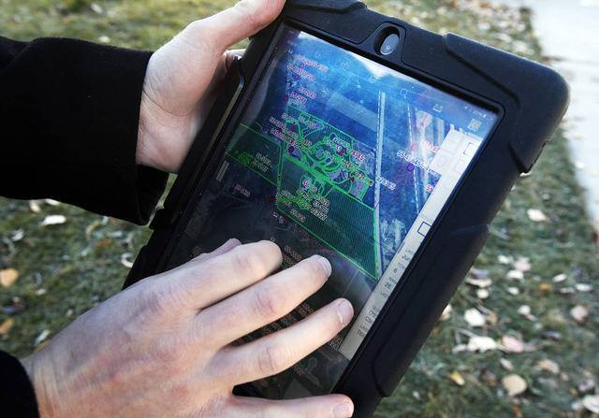
Hydrographic Survey Maps
Snap-shot in time
Hard copy originals on file at Salt Lake City Office and Regional Office.
Digital copies can be viewed online.
www.waterrights.utah.gov
  Adjudication
  Hydrographic Survey Maps
Notes:
The Adjudication staff use the information which they’ve gathered through extensive field reviews and produce a Hydrographic Survey map which identifies the location of the POD and the extent of the use.
Hydrographic survey maps not only aid in the determination of water rights, but they also represent a historical snap-shot in time which can be interesting and helpful in future research.
You can view these hydrographic survey maps at the regional offices, or the Salt Lake office, or from the comfort of your own office by viewing them online at the address shown.

Slide 17
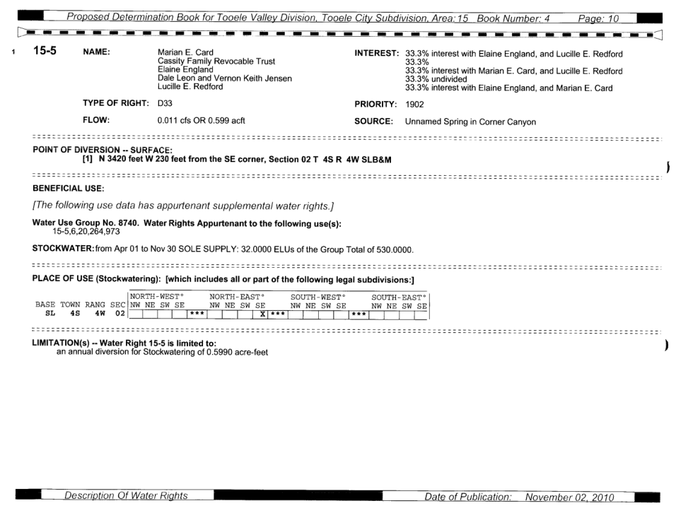
Proposed Determination
Proposed Determination (PD) represents the State Engineer’s official recommendation of rights within an adjudication boundary.
Filed with the District Court.
Distributed to water users within the adjudication boundary.
Public meeting held to discuss the PD and answer questions.
Notes:
Once the Hydrographic Survey, Water User’s Claims, and State Engineer’s Recommendations have been finalized, the Proposed Determination is published, distributed to the water users, and filed with the court. Each book has a unique name and number. The name typically incorporates some geographic aspect of the respective subdivision. The number reflects the Area number (which corresponds with the various drainage numbers used by the State Engineer’s Office) and a book number.
As shown, this is the Tooele City Subdivision, Book 15-4. On the right is what our current Proposed Determination format looks like. For the most part it mirrors the same information that you would see when viewing the water right on the Division’s database. Earlier Proposed Determinations have different formats depending on the vintage.

Slide 18

Moving towards a Decree

Slide 19
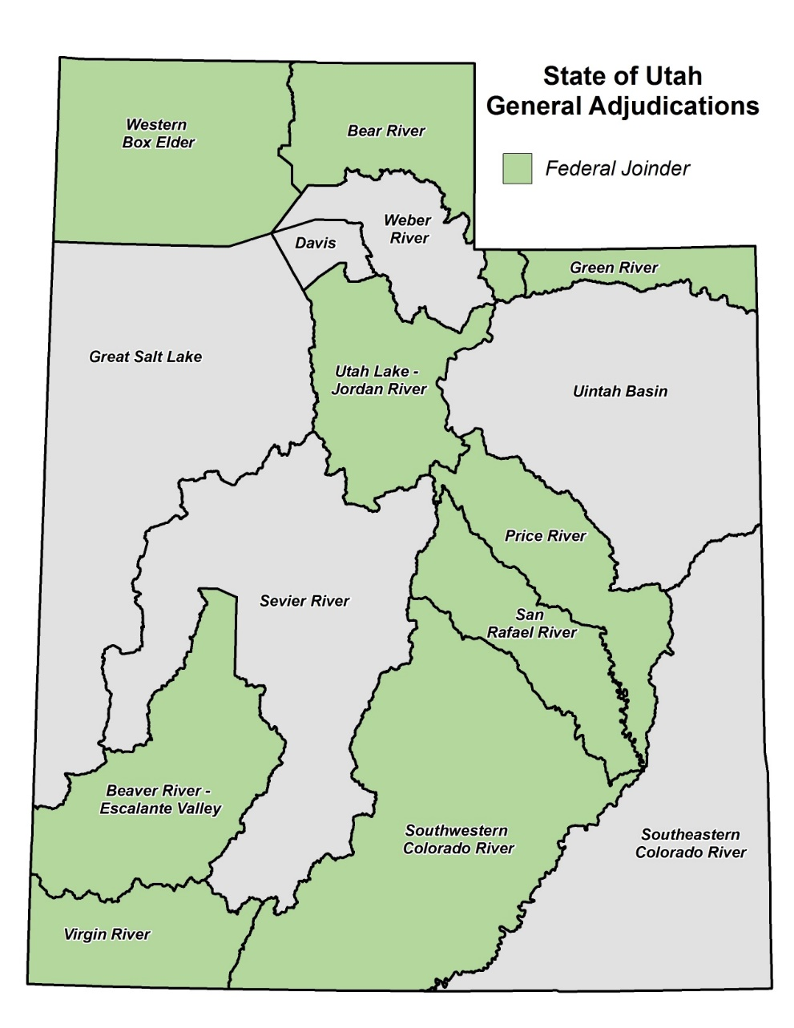
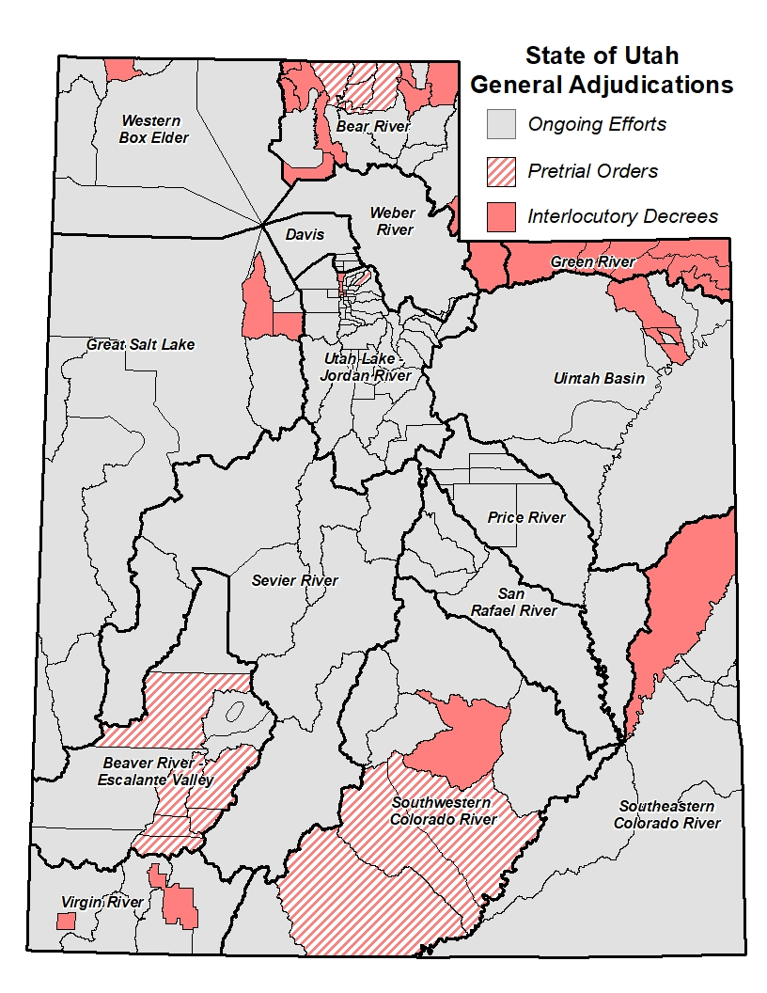
Decrees
In the “early” days, one Proposed Determination was published for one river drainage (e.g. Weber & Sevier Rivers).
Interlocutory or Partial Decrees are often issued for sub-divisions of the river drainage.
Federal Reserved Water Rights have historically been described in the proposed determination. However, due to lack of federal joinder, they are often omitted from interlocutory decrees.
Decrees often include language closing the respective basin from additional diligence claims.
Notes:
As mentioned before, in the early days, there was one Proposed Determination for each large river drainage basin; however, as Utah has increased in population and natural resource development, the number of water rights has increased beyond the ability of the State Engineer to tackle each basin at a time—resulting in the smaller subdivisions. In parallel with preparation of proposed determinations for smaller geographical areas within the larger drainage, we petition the court for an Interlocutory or Partial Decree. An Interlocutory Decree is an transitional decree which is used to settle the issues within that particular book. Once all subdivisions have an interlocutory decree, the court is petitioned to issue a decree on the entire drainage.
As a result of a 1908 Supreme Court decision in Winters v. United States, the court ruled that by creation if the Fort Belknap Indian Reservation, there was an implied water right for the amount of water for the reservation to be self-sufficient. Today, federal reserved water rights can be asserted on most lands managed by the federal government. Reserved rights are, for the most part, immune from state water laws and therefore, are not subject to diversion and beneficial use requirements and cannot be lost by non-use. The federal government, however, is required to submit all reserved water rights claims to the state’s adjudication process, and are limited by the "primary purpose" and "minimal needs" requirements. In addition, federal reserved water rights are nontransferable. By law, these rights can only exist on lands owned by the federal government. If a land transfer occurs, any existing federal reserved water right becomes invalid.
The McCarran Amendment, a 1953 law, waives U.S. sovereign immunity and allows states to determine Federal water rights in state courts. Hence, federal water claims may be quantified in state stream adjudications, but only if such proceedings are comprehensive (meaning that all claimants to a specific water body are joined in the suit). As a result, the Federal Government is purposefully exempted from the Interlocutory Decrees (although their water rights are recognized in the Proposed Determination). Once an entire drainage has interlocutory decrees, the Federal Government is then joined as a party to the action just like any other water user and formally adjudicated.
When a court issues an Interlocutory Decree, it will often include language which closes the respective basin from further assertion of diligence claims… which is the primary purpose of a General Stream Adjudication.

Slide 20
Frequently Asked Questions
What if a water user chooses not to participate in a general adjudication?
  Any rights not claimed may be declared abandoned and they also lose the right to appeal or object to the proposed determination.
  What if my water right is listed in the name of a previous owner?
  The title updating process is separate from adjudication. You should file a claim (as a claimant) to protect your water right from being declared abandoned. Later, update title to your water right.
Lastly…
  Grand Juries are typically NOT a part of the Adjudication Process.
Notes:
When the Adjudication Program goes into an area, one of the most prominent questions is whether or not a water users will lose their water right. It should be noted that the State Engineer does not have the authority to take a water right away. We can only recommend to the court that the water right be disallowed in the Proposed Determination.
Ultimately, individuals who are using their water right in conformance with the records on file with the Division of Water Rights have nothing to fear.
Those who are using water without a right of record are required to submit a claim during the process or risk being barred by the court from asserting a right.
When a water right, or portion of it, has fallen out of use for more than 7 years, the water right (or the un-used portion) may be recommended to be disallowed in the Proposed Determination. This ensures that water which is not being used, returns to the public for future appropriation or sustainment of other rights. If knowledge of recent use is cloudy, we will often give a water user the benefit of the doubt in order to prevent unnecessary constraints on water users.

Slide 21
Who can I contact to discuss the
Adjudication Process?
Michael Drake, P.E.
Adjudication Program Manager
Phone: 801-538-73
E-mail: michaeldrake@utah.gov
Gary Brimley, P.E.
Adjudication Engineer Manager
Phone: 385-226-7805
E-mail: garybrimley@utah.gov
Adjudication Program General Info
Phone: 801-538-5282
E-mail: waterrights_adjudication@utah.gov
Utah Division of Water Rights
1594 West North Temple
Suite 220, PO Box 146300
Salt Lake City, UT 84114-6300
www.waterrights.utah.gov

Slide 22
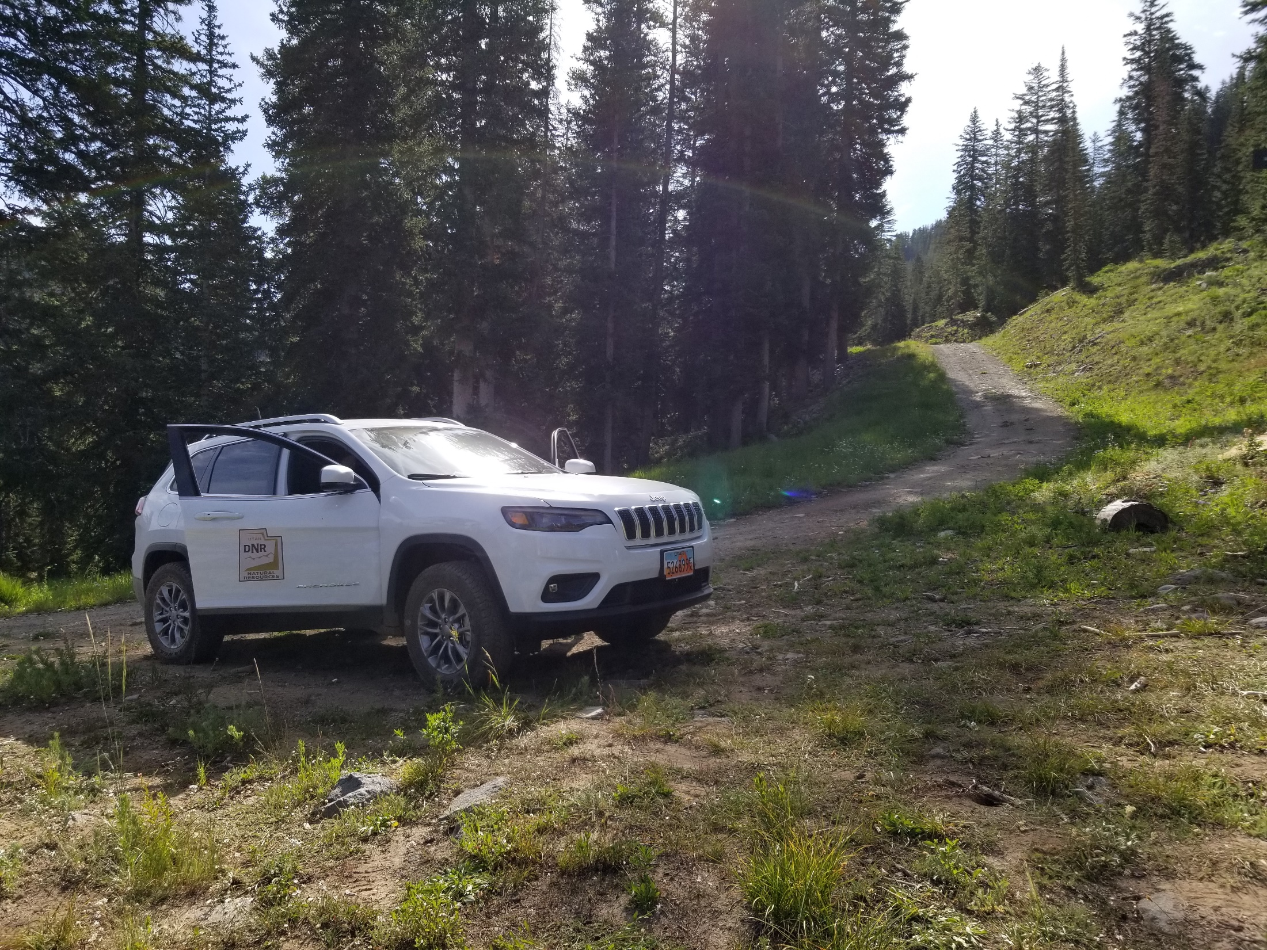
Questions?
Questions?

Slide 23
The Adjudication Process
1
2
NOTICE
3
SUMMONS
PETITION
4
5
6
7
90 DAYS TO FILE OBJECTION
PUBLIC MEETING
NOTICE TO FILE
CLAIMS WITHIN 90 DAYS
LIST OF
UNCLAIMED RIGHTS
UNCLAIMED RIGHTS
90
90
The Adjudication Process
8
14
9
PUBLIC MEETING
FINAL SUMMONS
OBJECTION
RESOLUTION & DECREE
10
CLAIM INVESTIGATION
W.U.C.
11
PROPOSED DETERMINATION AND
HYDROGRAHPIC SURVEY
12
13
15
90 DAYS TO FILE OBJECTION
PUBLIC MEETING
OBJECTION
RESOLUTION & DECREE
W.U.C.
P.D.
90
Notes:
Petition or Court Order: The water rights adjudication process is typically initiated one of two ways. Water users may petition the State Engineer to file an action in the respective district court to initiate an adjudication; alternatively, a suit involving several water rights might be converted into a general water rights adjudication by the court. This has already occurred within each of the 15 major drainages in the State of Utah. (Utah Code 73-4-1)
General Notice: For each area, division, or subdivision, the State Engineer publishes notice in a newspaper designated by the court once a week for two consecutive weeks. The notice provides the name of the action, location of the court, and name of the water source involved. (UCA 73-4-3)
Summons: For each area, division, or subdivision, the State Engineer serves a summons on potential claimants of record by mail. Summons is also published in a newspaper designated by the court once a week for five consecutive weeks. (Utah Code 73-4-4)
First Public Meeting: The State Engineer holds a public meeting in the adjudication area, division, or subdivision to inform water right claimants about the process. (Utah Code 73-4-3)
Notice to Submit Claims: After the initial public meeting, the State Engineer sends notice to claimants to file a statement of claim (i.e., water user's claim) along with a copy of the form or instructions on how to obtain one. (Utah Code 73-4-3)
Claim Filing: Claimants have 90 days from the date of the notice in order to file a claim with the State Engineer or the respective district court. Claimants may request one 30-day extension by filing a written request with the State Engineer prior to the conclusion of the 90-day period. Claimants who fail to file a claim within the prescribed 90-day timeframe (or authorized extension) risk being prevented from asserting their claim in the future and having any unclaimed right deemed abandoned by the court. (Utah Code 73-4-3, 5, 9, and 10). If your water right is listed in the name of a previous owner, you should still file a claim (as a claimant) to protect your water right from being deemed abandoned. Later, update title to your water right. The title updating process is separate from adjudication.
List of Unclaimed Rights: After the conclusion of the 90-day claim filing period (plus any extensions), a List of Unclaimed Rights is published and filed with the court to document water rights that exist on the records of the State Engineer for which no claim was filed. The List of Unclaimed Rights is meant to provide additional notice regarding existing rights that may be subject to being deemed abandoned by the court. The State Engineer sends notice to claimants that the List of Unclaimed Rights has been filed and instructions on how to obtain a copy of the list and their obligation to file an objection within 90 days if dissatisfied. (Utah Code 73-4-9.5)
Second Public Meeting: After filing the List of Unclaimed Rights, the State Engineer holds a public meeting in the adjudication area, division, or subdivision to explain the List of Unclaimed Rights to the claimants. (Utah Code 73-4-9.5)
Final Summons: Following the notice of the List of Unclaimed Rights, the State Engineer makes a final search for potential claimants and publishes summons in a newspaper designated by the court once a week for five consecutive weeks. (Utah Code 73-4-22)
Objection Resolution & Decree: Individuals who disagree with the List of Unclaimed Rights have 90 days to file an objection and water user's claim with the court. They must also file a water user's claim with the State Engineer. Once objections (if any) are resolved, the court renders a decree on the List of Unclaimed Rights that: (1) identifies any rights to be removed from the list, (2) adjudges the unclaimed rights abandoned, and (3) prohibits future unknown claims from being asserted. (Utah Code 73-4-9.5)
Proposed Determination: Once claimants have filed their respective water user's claims, the State Engineer evaluates and maps the claims and develops a Proposed Determination of water rights. Subsequent to the rendering of a decree on the List of Unclaimed Rights, the State Engineer files the Proposed Determination with the court and provides notice to claimants of how to view or obtain a copy of it and their obligation to file an objection within 90 days if dissatisfied. The Proposed Determination represents the State Engineer's official recommendation to the court as to the status and nature of water rights within the respective boundary. (Utah Code 73-4-11)
Public Meeting: After filing the Proposed Determination, the State Engineer holds a public meeting in the adjudication area, division, or subdivision to explain the Proposed Determination to the claimants. (Utah Code 73-4-11)
Objection Resolution & Decree: Individuals who disagree with the Proposed Determination have 90 days to file an objection with the court. Once objections (if any) are resolved, the court renders a decree on the Proposed Determination. (Utah Code 73-4-12,15)

