Slide 1
Jordan River Distribution Plan Public Meeting
Utah Division of Water Rights
December 3, 2019

Slide 2
Jordan River Distribution Plan Issues
Concerns from Lower Jordan River water users regarding changes on Utah Lake water rights
Upper Jordan River direct flow distribution
Concerns that Utah Lake water be used efficiently
Conveyance losses
Recent requests for environmental flows on the Jordan River
Utah Lake + Jordan River + tributaries is a single system

Slide 3
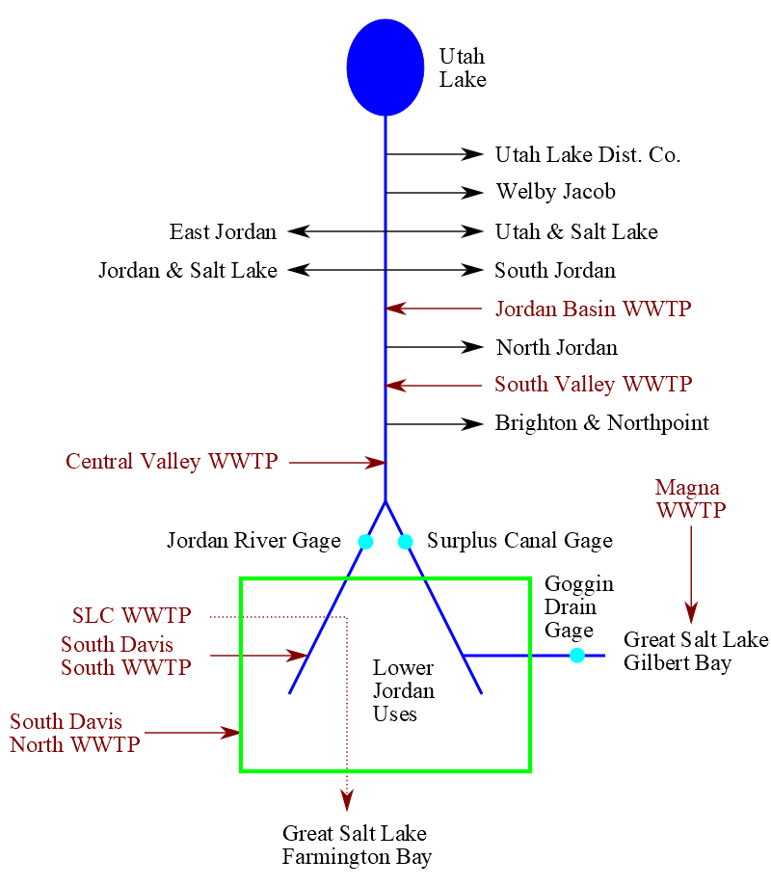
Jordan River
Snow Decree (1967)
Utah Lake Plan (1992)
Jordan River Plan

Slide 5
Urbanization and Increased Surface Water Outflow
Increased runoff -> fields to hardscape
Increased municipal underground use
Reduced depletion -> irrigation to municipal use
Increased imports

Slide 6
Urbanization and Decreased Surface Water Outflow
Development in non-tributary areas e.g. Cedar Valley
Development of non-irrigated lands e.g. western SLV
Increased underground use
New surface water development
Sewage effluent reuse

Slide 7
Jordan River Uses (Outflows)
 | 2018 Winter Flow (Nov – Feb) | 2018 Summer Flow (Jul – Sep)
Riverton City Diversion | 0 cfs | 5 cfs
North Jordan Canal Diversion | 43 cfs | 48 cfs
Brighton Northpoint Canal Diversion | 0 cfs | 10 cfs
Surplus Canal Diversion | 133 cfs | 174 cfs
Jordan River @ 1700 South | 91 cfs | 141 cfs
Total Flow | 267 cfs | 378 cfs

Slide 8
Jordan River Sources (Inflows)
 | 2018 Winter Flow (Nov – Feb) | 2018 Summer Flow (Jul – Sep)
Utah County River Make | 11 cfs | 0 cfs
Storm Runoff | 5 cfs | 8 cfs
SLV Base Flow | 132 cfs | 132 cfs
WWTP | 119 cfs | 123 cfs
Utah Lake / “Return Flow” | 0 cfs | 115 cfs
Total Flow | 267 cfs | 378 cfs

Slide 9
Salt Lake Valley/Jordan River Sewage Effluent
2018 Sewage Effluent (acre-feet)
Jordan Basin Water Reclamation | Jordan River @ 13600 South | 10,600
South Valley Water Reclamation | Jordan River @ 7400 South | 22,200
Central Valley Water Reclamation | Mill Creek @2900 South to Jordan River | 54,500
Salt Lake City Water Reclamation | Oil Drain Canal @ 2300 North to GSL | 34,900
Magna Water and Sewer | Great Salt Lake, Magna | 3,100
South Davis Sewer District South Plant | Jordan River, North Salt Lake | 3,800
South Davis Sewer District North Plant | State Canal to Farmington Bay Waterfowl Management Area, West Bountiful | 7,300
TOTAL |  | 136,400

Slide 10
Utah Lake Deliveries to SLV
Canal | Jul – Sep 2018
Utah Lake Distributing Canal | 37 cfs
Welby Jacob Canal | 72 cfs
Utah and Salt Lake Canal | 109 cfs
Irrigation - 64 cfs
Mining - 45 cfs
East Jordan Canal | 113 cfs
Canal Company - 63 cfs
Salt Lake City - 20 cfs
Draper Irrigation Company - 19 cfs
Conveyance Loss - 11 cfs
South Jordan Canal | 49 cfs
Jordan and Salt Lake Canal | 45 cfs
Total | 425 cfs

Slide 11
Utah Lake Contribution to Jordan River
Tributary | Jul – Sep 2018
Big Cottonwood Creek | 10 cfs
Little Cottonwood Creek | 12 cfs
Mill Creek | 18 cfs
Midas Creek | 2 cfs
Bingham Creek | 9 cfs
Unmeasured Inflow | 64 cfs
Total | 115 cfs

Slide 12
Managing “Return Flows” to River
Pressurized System
Regulating Ponds
Turn Schedule
Deliver to laterals based on actual acreage
Better define conveyances losses

Slide 13
Conveyance Losses
Conveyance losses in canals longer than a mile in length are to be determined as part of the general adjudication
1985 USGS Study looked at conveyance losses
Conveyance losses consist of
Seepage
Evaporation
Conveyance losses do not include water that returns to the river

Slide 14
Utah Lake Water Right Acreage
 | Total Acreage | Moved Out | Transferred to WJWUC | Transferred to SLC | Remaining Acreage
Utah Lake Distributing Co. | 8,633 | -1,687 | -688 |  | 6,258
Utah and Salt Lake Canal Co. | 9,135 | -2,548 | -2,071 |  | 4,516
East Jordan Irrigation Co. | 9,680 | -4,091 | -1,819 | -2,391 | 1,379
Salt Lake City | 2,200 |  |  | 2,391 | 4,591
South Jordan Canal Co. | 5,927 | -1,766 | -1,077 |  | 3,084
North Jordan Irrigation Co. | 1,170 | -421 | -100 |  | 649
Draper Irrigation Co. | 1,470 | -977 |  |  | 493
Sandy Canal Co. | 630 | -630 |  |  | 0
Welby Jacob Water Users Co. | 2,400 | -1,733 | 5,755 |  | 6,422
Total | 41,245 | -13,853 |  |  | 27,392

Slide 15
Road Map Forward
90 day comment period (March 2, 2020)
Public meeting to propose a Jordan River Distribution Plan
Address conveyance losses in an upcoming addendum
Other basin-wide considerations

