Slide 1
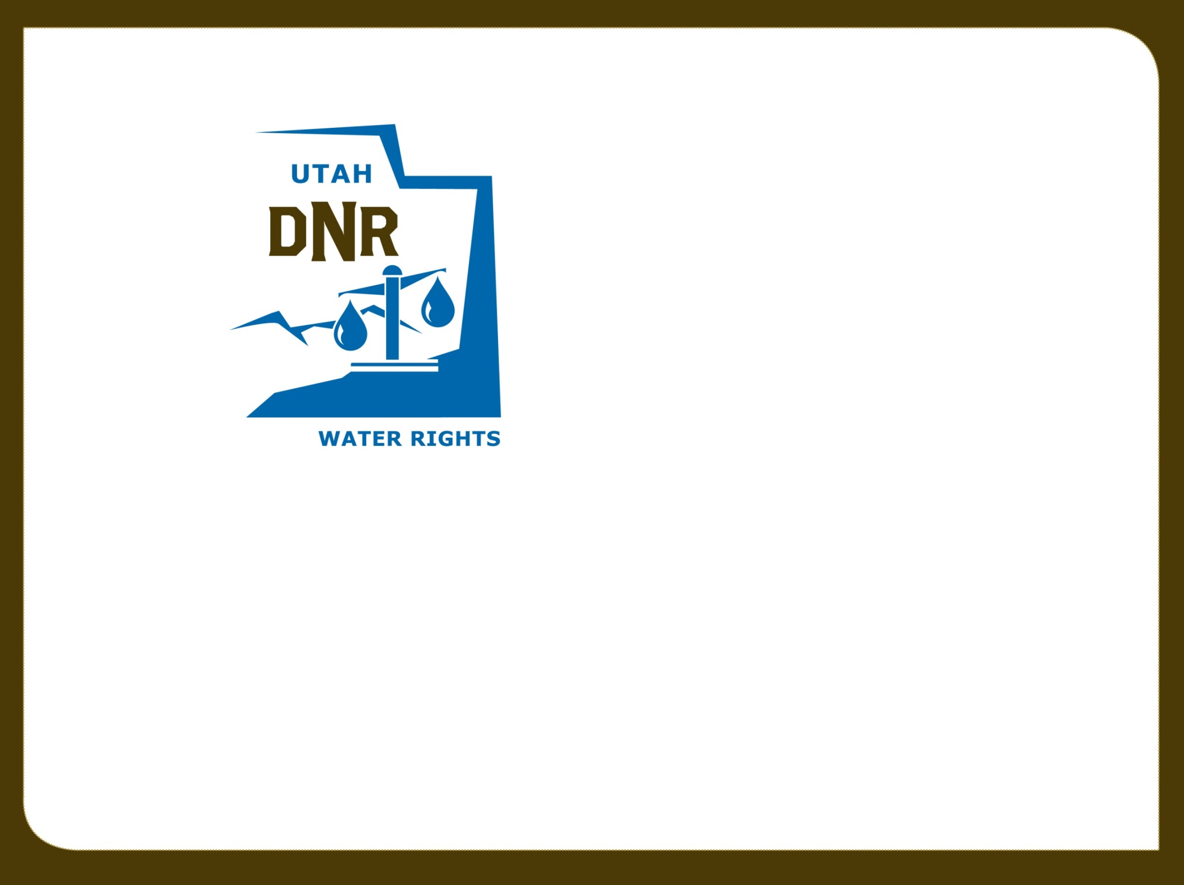

Water Rights and the topic of Reuse
Water Users Workshop
Boyd Clayton / Teresa Wilhelmsen
March 20, 2019

Slide 2
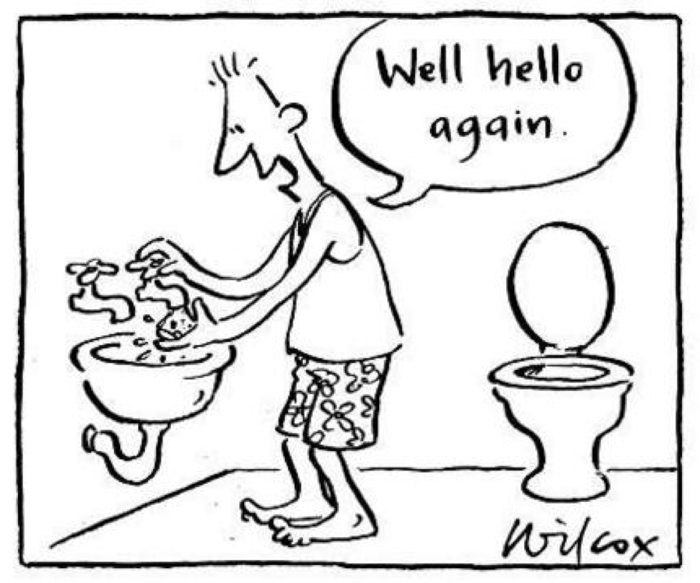
What is Reuse?

Slide 3
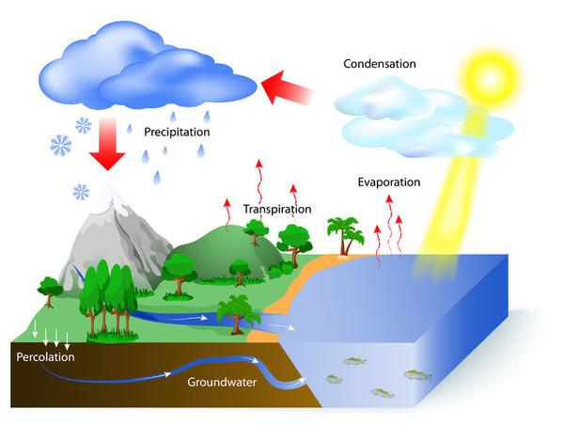
Nature’s version of Reuse

Slide 4
Water Reuse in Carbon Cycle

Slide 5
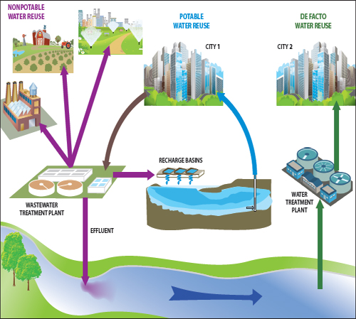

Slide 6

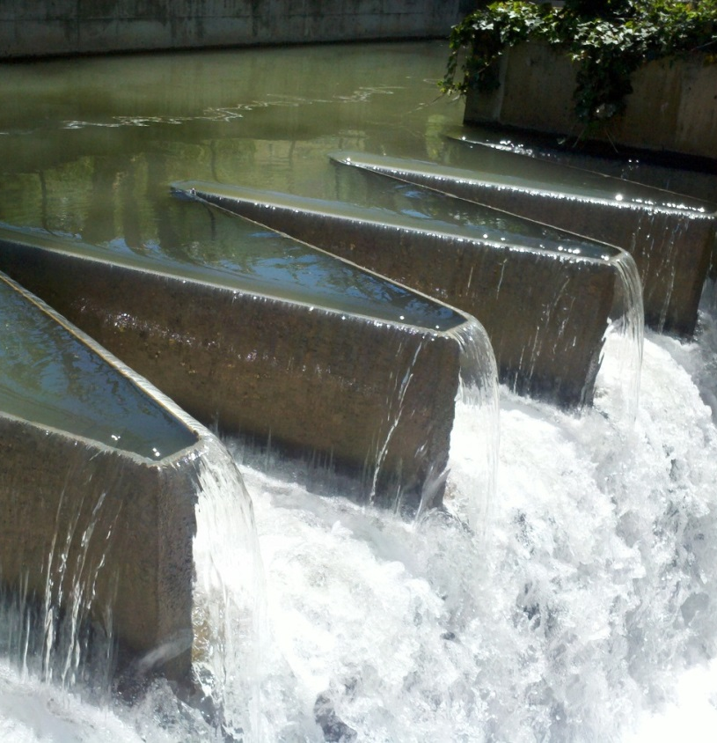
Is Reuse a water right issue?
No –Water once diverted is yours to use however you want.
It may be – A water right is a right to divert and use for a specific purpose while the water is in your control.
Yes – Once you have a water right perfected you must continue to exercise it exactly as perfected. Reuse is a change in the right.

Slide 7
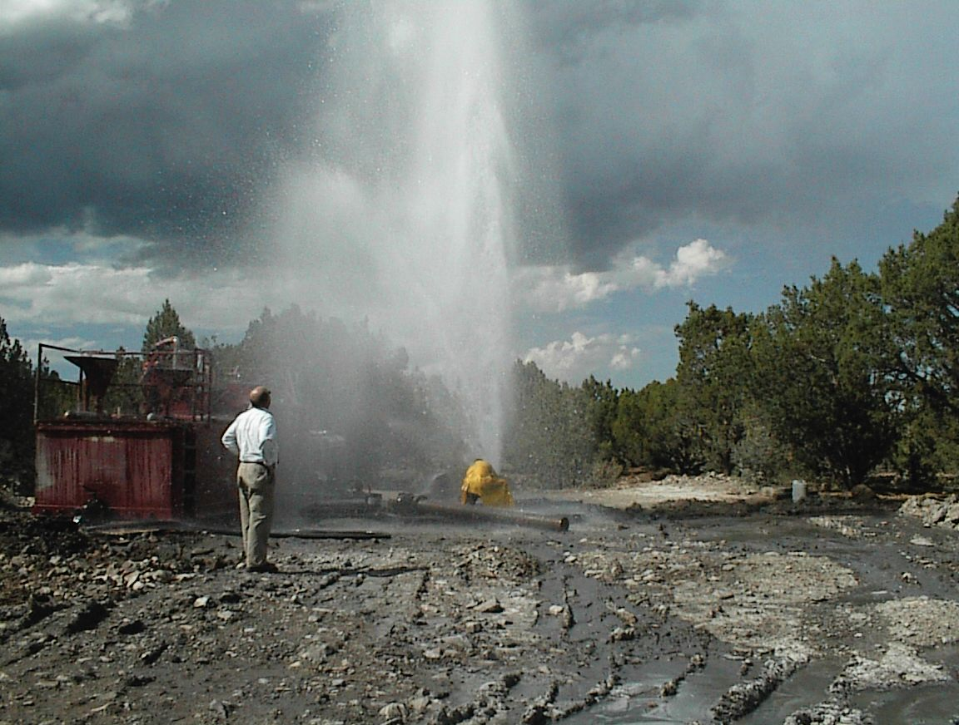
PUBLIC Policy:
The paramount purpose of our statute and the decisions of this court are to the effect that the waters of this state shall be applied and used so as to produce the greatest possible benefit to the inhabitants thereof, and every appropriator of water must yield to that purpose, if in so yielding all of his rights may be preserved without material injury or damage to him.
United States v. Caldwell (1924)

Slide 8
Fundamental Water Right Statutes
 | All waters in this state, whether above or under the ground, are hereby declared to be the property of the public, subject to all existing rights to the use thereof. (Utah Code Section 73-1-1) Beneficial use shall be the basis, the measure and the limit of all rights to the use of water in this state. (Utah Code Section 73-1-3) A person may acquire a right to the use of the unappropriated public waters in this state only as provided for in this title. The appropriation of public waters in the state shall comply with the requirements of this title. A person obtaining, initiating the use of, or providing notice of intent to appropriate a water right shall comply with the requirements of this chapter. An appropriation may be made only for a useful and beneficial purpose. Between appropriators, the one first in time is first in rights. A use designated by an application to appropriate any of the unappropriated waters of the state that would materially interfere with a more beneficial use of the water shall be dealt with as provided in Section 73-3-8. A person may not acquire a right to the use of water either appropriated or unappropriated by adverse use or adverse possession. (Utah Code Section 73-3-1) Each appropriator is entitled to receive the appropriator’s whole supply before any subsequent appropriator has any right. (Utah Code 73-3-21.1(2))

Slide 9
Common Law Concepts
Underlying Utah’s water law is a strong policy to promote conservation. Improvements to prevent seepage support this policy. Even in the event of deprivation of water to others, water system improvements have been allowed to further this public policy (Steed v New Escalante Irrigation (1992))
Utah is one of the arid states and the conservation of water is of utmost importance to the public welfare. To waste water is to injure that welfare and it is the duty of the user of water to return surplus or waste water to the stream from which it was taken so that further use can be made by others. (Brian v Fremont Irrigation Company (1947))

Slide 10
Common Law Concepts (Cont)
The appropriator of water may, so long as the water is under his control, sell or transfer the right to the use of such waters to someone other than the appropriator of the waste water as long as he does so in good faith and the waters are beneficially used, or he may capture and use them for further beneficial use if he does so before they get beyond his property and control. (McNaughton v Eaton (1952))

Slide 11
Common Law Concepts (Cont)
Once water has passed from the control of the appropriator or user and flows into another stream it becomes part of the stream. (Smithfield West bench Irrigation Co v Union Central Life Ins Co (1943))
After water has run through canals and been used on the lands of the appropriators they have no interest or right in the water which leaves their lands and finds its way again into the main channel either as run-off water or as seepage water, for as soon as it reaches the main channel its identity is lost and it becomes a part of the natural flow. (Salt Lake City v Telluride Power Company (1932))

Slide 12
Common Law Concepts (Cont)
Waters which have been appropriated and reduced to possession and in this particular instance brought into a new watershed cease to be public waters and are not subject to appropriation (Tanner v Bacon (1943))
Where within a river system a person claims to be using seepage water brought into that river system from an outside source, the burden is upon him to show that the water comes from the outside source rather than from streams and seeps tributary to the river system (Rasmussen v Moroni Irrigation Co (1920))

Slide 13
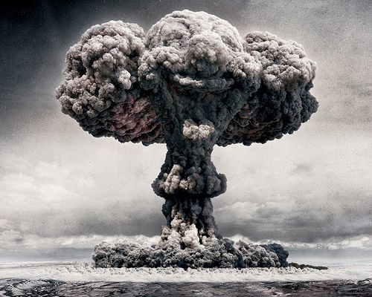
What could happen
The legislature is empowered to recalibrate and even reverse our common-law decisions. (Utah Stream Access Coalition v VR Acquisitions (2019))
Wastewater reuse and Groundwater recharge and recovery are examples of such recalibrations. There are now specific statutes which regulate these issues.

Slide 14
Statutory Criteria
73-3c Wastewater Reuse Act
Enacted 2006
Amendments 2006, 2008
Permissible Reuse
  Public agency owning a water right, or
  Public agency under a contract authorizing the use
    Water right for municipal use
    Consistent with underlying water right.
    If not, a change application may be necessary.
Water Quality Board Approval

Slide 15
Statutory Criteria
73-3c Wastewater Reuse Act
Application to the State Engineer
  Statutory compliance
    Advertised
    Protests
    Approve or reject
    Proof project is completed
    Judicial review of the decision
  Consistent with the underlying water right
  Return flow requirement satisfied
  Priority of reuse
    If use consistent with underlying water right, priority of use is same as underlying water right.

Slide 16
Statutory Criteria
73-3b Groundwater Recharge and Recovery Act
Enacted 1991
Amendments 2008, 2009, 2010
May not artificially recharge an aquifer without first obtaining a recharge permit
May not recover water artificially recharged without first obtaining a recover permit
Must have a valid water right
Recovered water to be used only as authorized prior
Unless a change or exchange application is filed and approved

Slide 17
Statutory Criteria
73-3b Groundwater Recharge and Recovery Act
Procedures
  Advertise
  Protests
  Judicial Review
Review
  Technical and financial capability
  Valid water right
  Hydrologically feasible
  Water quality permits
  Not impair existing water rights
  Recovery POD within hydrologic impact of the recharge project

Slide 18
Statutory Criteria
73-3b Groundwater Recharge and Recovery Act
Completion
  Proof of completion
  Certificate
Operation
  Storage account
  Monitoring
  Reporting

Slide 19
Existing Wastewater Reuse Filings
Wastewater Reuse Applications:
NS001 | City of Hildale / Twin City Water Works*
NS002 | City of Orem*
NS003 | Payson City Corporation*
NS004 | City of St. George*
NS005 | Central Valley WRF / City of South Salt Lake*
NS006 | City of Tooele*
NS007 | South Davis Sewer District*
NS008 | City of Saratoga Springs
NS009 | Central Weber Sewer Improvement District*
NS010 | Lehi City*
NS011 | Fairview City
NS012 | Town of Eagle Mountain^{NF}
NS013 | Richmond City Corp*
NS014 | Mona City*
NS015 | Santaquin City*
NS016 | Willard City*
NS017 | Perry City*
NS018 | Hyde Park City^{WD}
NS019 | Roosevelt City Corporation*

Slide 20
Existing Recharge / Recovery Filings
Recharge Applications:
RC001 | Jordan Valley Water Conservancy District*
RC002 | Jordan Valley Water Conservancy District*
RC003 | Brigham City Corporation*
RC004 | Washington County Water Conservancy District*
RC005 | Leamington Town*
RC006 | Weber Basin Water Conservancy District*
RC007 | Santaquin City Corporation*
RC008 | RLF Deep Creek, LLC^{WD}
RC009 | Summit Creek Irrigation and Canal Company*
RC010 | Summit Creek Irrigation and Canal Company
RC011 | Coalville City Corporation^{LAP}
RC012 | Central Iron County Water Conservancy District*
RC013 | Millville City
RC014 | Cedar City Corporation
RC015 | Cedar City Corporation
RC016 | Cedar City Corporation
RC017 | RFL Deep Creek, LLC
RC018 | Sandy City Corporation
Recovery Applications:
RC001-001 | Jordan Valley Water Conservancy District*
RC002-001 | Jordan Valley Water Conservancy District*
RC003-001 | Brigham City Corporation*
RC004-001 | Washington County Water Conservancy District*
RC005-001 | Leamington Town
RC006-001 | Weber Basin Water Conservancy District
RC007-001 | Santaquin City Corporation
RC008-001 | RLF Deep Creek, LLC^{WD}
RC009-001 | Summit Creek Irrigation and Canal Company
RC017-001 | RLF Deep Creek, LLC

Slide 21
Test Questions
Can a water user improve their conveyance system even if it means those relying on the waste no longer receive it?
Can a water user capture their tail water and re-apply it even if it affects those who were relying on their waste?
Can I drill a well to recover water which was lost during my diversion and water use?
Can one make improvements to store their diversion and then release it later to their use when they want it?
Can a sewer district sell water they have treated?
Is all of the water a city collects in a waste water treatment system their water to reuse?

Slide 22
Test Questions
Can you obtain a water right by filing a water reuse, a recharge, or a recovery application with the State Engineer?
Does an approved water reuse application need to be consistent with the underlying water right?
If you have an approved wastewater permit, can you reuse the entire amount of water discharged from the treatment plant?
Can you enlarge a water right beyond its historical consumptive use amount by filing a wastewater reuse application?
Can a person use recovered water in a manner not consistent with the valid use prior to the artificial recharge?

Slide 23
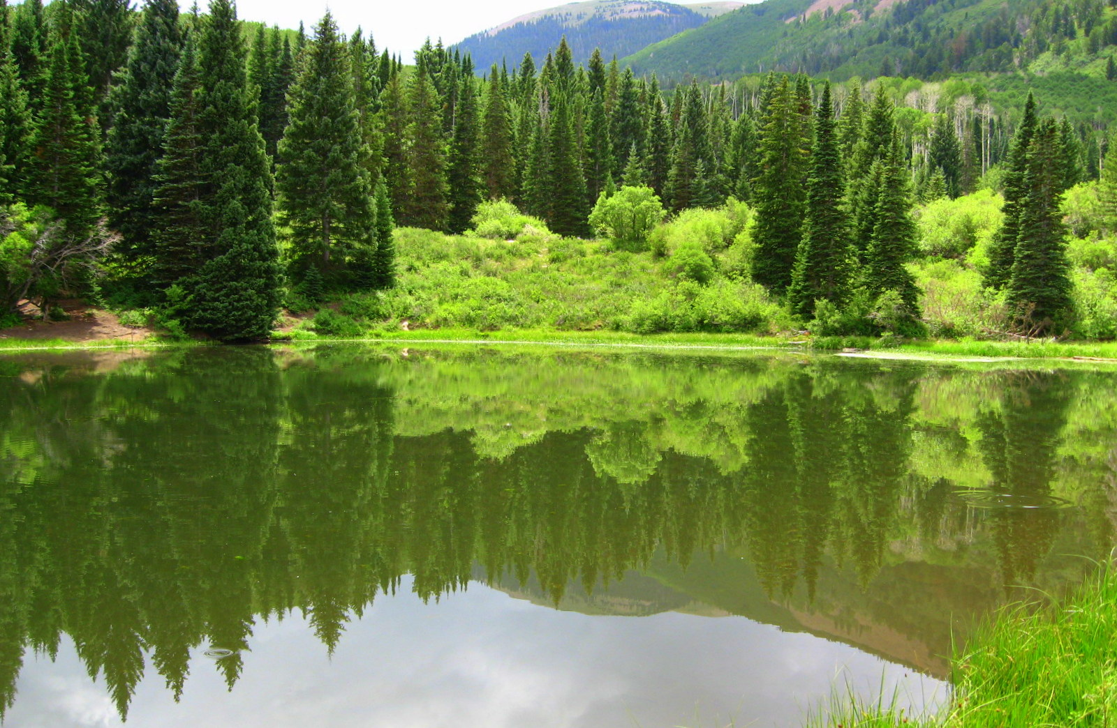
Thank You
– Any Questions?

