Slide 1
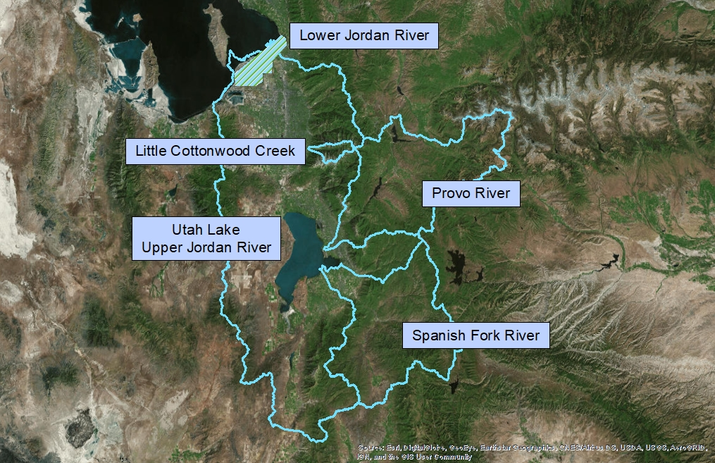
Notes:
On paper we have what appears to be a true priority system
In practice there are exceptions that have existed from territorial and early statehood days:
Class system – codified in territorial and early state statute
Separately administered sections
Exceptions are a result of:
State Engineer recommendation
Stipulations
Court’s discretion
Provo River and Utah Lake are operated jointly in accordance with 1993 Distribution Plan
Spanish Fork and Little Cottonwood operate independently of any downstream rights
Lower Jordan River operates as a single class, sharing shortages and not making calls to tributaries or Utah Lake
Most if not all other streams have decrees but not a commissioner

Slide 2
Utah Lake/Jordan River Drainage Priority Dates
Upper Provo River
Priority | Summer
1st Class | 208 cfs
2nd Class | 11 cfs
5th Class | 25 cfs
11th Class | 12 cfs
12th Class | 10 cfs
14th Class | 64 cfs
15th Class | 20 cfs
16th Class | 21 cfs
17th Class | 67 cfs
Lower Provo River
Priority | Summer | Winter
Class A | 288 cfs | 229 cfs
1908 | 136 cfs
1911 | 35 cfs
1917 | 200 cfs | 200 cfs
1945 | 100,000 ac-ft
1971 | 300,000 ac-ft
Little Cottonwood
Priority | Summer
Primary | 95 cfs
1st Surplus | 17 cfs
2nd Surplus | 47 cfs
Third Surplus | 304 cfs
1909 | 5 cfs
Jordan River
Priority | Summer | Winter
1849 | 14 cfs | 14 cfs
1862 | 108 cfs | 90 cfs
1878 | 34 cfs | 19 cfs
1886 | 76 cfs | 83 cfs
1889 | 8 cfs
1890 | 236 cfs | 236 cfs
1901 | 14 cfs | 15 cfs
1908 | 4 cfs
1912 | 100 cfs | 100 cfs
1915 | 35 cfs
1918 | 24 cfs | 24 cfs
1926 | 35 cfs | 35 cfs
1949 | 8 cfs | 8 cfs
1951 | 30 cfs | 30 cfs
Spanish Fork River
Priority | Summer
Primary | 390 cfs
1909 | 300 cfs
1914 | 90 cfs
Utah Lake
Priority | Summer
1853 - 1879 | 189,307 ac-ft
1908 - 1909 | 112,739 ac-ft
Notes:
(This is a simplification of the priority schedule)
Many water rights were assigned a class in the decree but not a priority date
The adjudication will assign priority dates based on when the water was put to beneficial use
The state engineer will continue to distribute water as historically, meaning in sections and according to classes
Base flow on the Lower Jordan is about 300 cfs in the summer and 200 cfs in the winter
1890 water rights would be fully or partially cut off under base flow conditions if the lower users didn’t share the shortages

